Slide 1
UNIT II
ALTERNATING CURRENT AND FILTERS

Slide 7
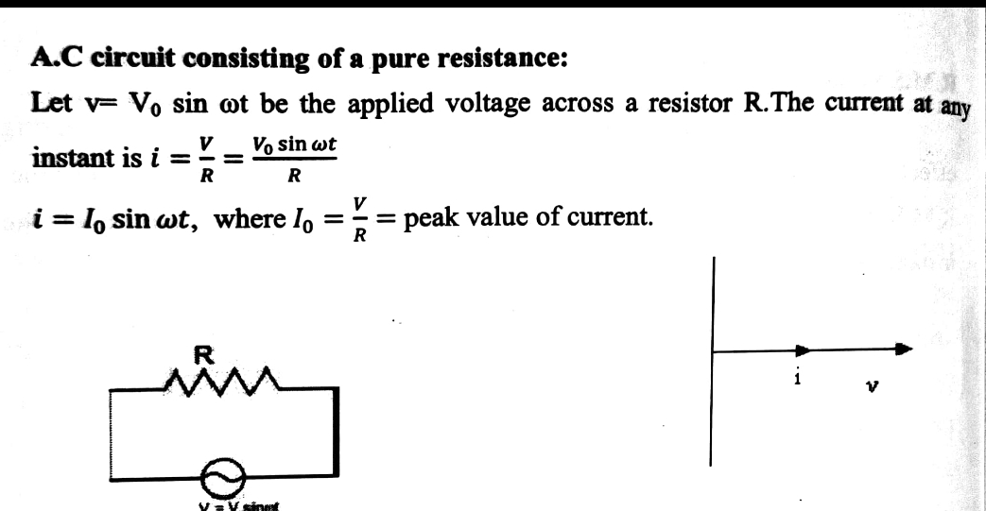

Slide 12
