Slide 1
BCAC 232: Data Structures

Slide 2
Introduction:
Data Structures are the programmatic way of storing data so that data can be used efficiently. Almost every enterprise application uses various types of data structures in one or the other way.
Why to Learn Data Structure and Algorithms?
As applications are getting complex and data rich, there are three common problems that applications face now-a-days.
Data Search − Consider an inventory of 1 million(10⁶) items of a store. If the application is to search an item, it has to search an item in 1 million(10⁶) items every time slowing down the search. As data grows, search will become slower.
Processor speed − Processor speed although being very high, falls limited if the data grows to billion records.
Multiple requests − As thousands of users can search data simultaneously on a web server, even the fast server fails while searching the data.
Notes:
*Data is a set of elementary items. The possible ways in which the data items are
logically related is defined by data structure .
That is , organized collection of data is called a data structure.
*To solve the above-mentioned problems, data structures come to rescue. Data can be organized in a data structure in such a way that all items may not be required to be searched, and the required data can be searched almost instantly.

Slide 3
Algorithmic notations:
1. Format Conventions
The following subsections summarize the basic format conventions used in
formulation of algorithms.
a. Name of the algorithm:Every algorithm is given an identifying name. The algorithm name should be in capital letters.
b. Introductory Comment: The algorithm name is followed by the brief description of task the algorithm performs. The description gives names and types of the variable used in the algorithm.
c. Steps: Actual algorithm is made up of sequence of numbered steps beginning with the phrase enclosed in the square brackets that describes that steps. Following this is an ordered sequence of statements which describe action to be executed or tasks to be performed
d. Comments: Algorithm steps terminates with a comment enclosed in parenthesis which helps better understanding of the step.

Slide 4
Statements and Control Structures:
The following sub sections summarize the type of statement and control structures available in algorithmic notation
a. Assignment Statement:
The assignment statement is indicated by placing the arrow (←) between the RHS of the statement and the variable receiving the value.
LHS ← RHS
Temp ← A // assigning A to Temp
A ← B // assigning B to A
B ← Temp // assigning Temp to B
i ← 0 , j ← 0 and k ← 0
b. If statement:
The if statement has one of the following two forms:
General forms:
1. if condition if(condition){
then //true
}

Slide 5
Example
int main(){
int i = 10;
if(i > 15){
cout<<“10 is less than 15”;
}
cout<<“I am Not in if”;
}
2. If condition if(condition){
then //true
--------------- }else{
--------------- //false
else }
--------------
--------------

Slide 6
Example
main(){
int i = 20;
if(i < 15 ){
cout<<“i is smaller than 15”;
}else{
cout<<“i is greater than 15”;
}
}
c. Case Statement: the case statement is used to select one expression from several alternatives.
General form of case statement
Select case(expression)
Case value 1:
Case value 2:
.
.
Case value N:
Default:
The expression is evaluated and its value is compared, to that of all of the cases. The case that matches is branched to if the expression value does not match that of any case then a branch is made to default case if there is one or to the next step if there is not.
Notes:
* Expression is evaluated once, value of expression is compared with the value of each case. If there is match the associated code block will be executed . If no match the default code block will be executed

Slide 7
Example
int day = 4; switch (day) { case 1: cout << "Monday"; break; case 2: cout << "Tuesday"; break; case 3: cout << "Wednesday"; break; case 4: cout << "Thursday"; break; case 5: cout << "Friday"; break; case 6: cout << "Saturday"; break; case 7: cout << "Sunday"; break;
default:
cout<<“Invalid day”; }

Slide 8
d. Repeat Statement:
For easy control of iteration( looping) a repeat statement as been provided. This
statement has one of the forms:
1.Repeat for INDEX = sequence
2. Repeat while logical expression
The type 1 is used when a step is repeated for counted number of times. INDEX is
variable used as a loop counter.
Example:
for(int i = 1; i < 5;i++){
cout<<“value of i is ”<<i<<endl ;
}
Type 2 is used to repeat a step until a given logical expression is false. The evaluation
and the testing of the logical expression is performed at the beginning of the loop.
Example:
int i = 1
while( i < 5 ){
cout<<“hello world”<<endl;
i++;
}

Slide 9
f. Goto and Exit loop Statements
Go to and exit loop statements are conditional statements, these causes unconditional transfer of control.
Go to statement:
This statement causes unconditional control transfer to the step referenced, Regardless of the other statements.
Example:
Label :
----
----
----
Go to label.
Exit statement:
Exit statement causes the immediate termination the control.
Example:
if I <10
Exit ( Causes the loop to exit when I value is read as less than 10)
Notes:
A goto statement provides an unconditional jump from the goto to a labeled statement in the same function.
Where label is an identifier that identifies a labeled statement.
it makes difficult to trace the control flow of a program, making the program hard to understand and hard to modify.

Slide 10
Variable Names
A variable is an entity that possess the value and its name is chosen to be
meaningful of the value it holds.
Rules for declaring Variable Names
All variable names must begin with a letter of the alphabet or an underscore(_) or $.
After the first initial letter, variable names can also contain letters and numbers.
Variable names are case sensitive.
No spaces or special characters are allowed.
You cannot use a C++ keyword (a reserved word) as a variable name.
Arrays
Array elements are denoted by ARRAY [DIM1,DIM2,...DIM N] , where ARRAY is the array name and DIM1 thru DIM N are its subscripts. Subscripts are enclosed in square brackets that denotes the location of array elements.

Slide 11
Arithmetic Operations and Expressions
Operator is the symbol it operates on operands
Operands are expression or values on which an operator operates or works
Example
5 + 4 , a + b , 3++
Unary operators operate on only one operands
Example
a++, b--, 2++, 5—
A binary operator operate on two operands
Example
a + b, c – d, A * B
Expression is valid combination of operators and operands.
Arithmetic expression formed using arithmetic operators and character or numeric operands.

Slide 12
Relations and Relational Operators:
The relational such as < ,> ,<=,>= ,!=. Relation between variables and expressions will
be considered if the variables have been assigned some value.
Example : Z<=9/3+2 (If Z=10 then 3+2(RHS) 10<=5)
A relation evaluates a logical expression , ie, it has one of two possible values True or False.
Logical Operations and Expressions:
The Algorithmic notation also includes the standard Logical operators such as:
__________________________________________
OPERATOR NOTATION
___________________________________________
Negation NOT
Logical And AND
Logical Or OR
___________________________________________
Operator’s Preccedence
__________________________________
Precedence Operators
__________________________________
1. parenthesis
2. arithmetic
3. relational
4. logical

Slide 13
Algorithm and it’s characteristics
Algorithm is a step-by-step procedure, which defines a set of instructions to be executed in a certain order to get the desired output.
Characteristics
Unambiguous − Algorithm should be clear and unambiguous. Each of its steps (or phases), and their inputs/outputs should be clear and must lead to only one meaning.
Input − An algorithm should have 0 or more well-defined inputs.
Output − An algorithm should have 1 or more well-defined outputs, and should match the desired output.
Finiteness − Algorithms must terminate after a finite number of steps.
Feasibility − Should be feasible with the available resources.
Independent − An algorithm should have step-by-step directions, which should be independent of any programming code.

Slide 14
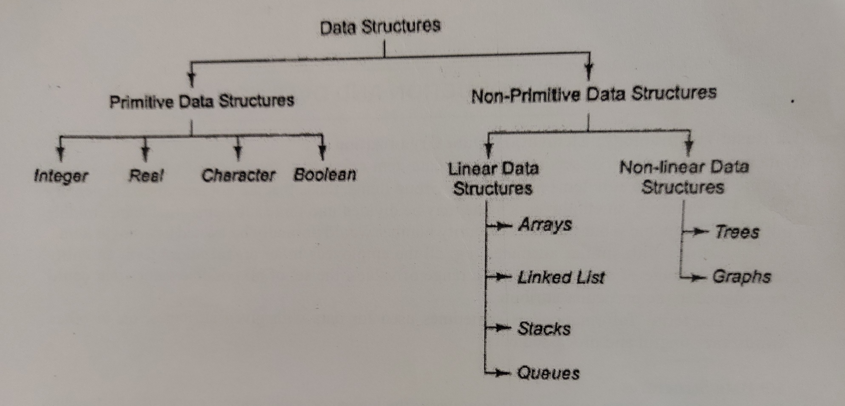
Classification of Data Structure

Slide 15
THANK YOU

