Slide 1
Mr. Trivarna Kandlur Assistant Professor Department of Computer Science Dr. B.B. Hegde First Grade College Kundapura
BCACE136 Internet Basics & HTML

Slide 2
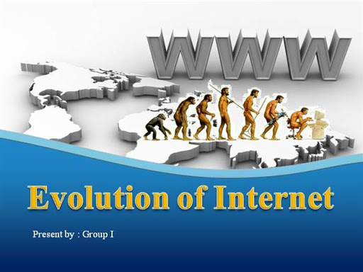
INTERNET
The word internet is derived from two words interconnections and networks.
Internet is a world wide system of computer networks, i.e. a network of networks. Which allows the user to share information.

Slide 3
Basic Internet Terms
WWW
Web page
Website
Home page
Browser
Web Server
Download and Upload
Online and Offline

Slide 4
About the Subject
Subject Name : Internet Basics & HTML
Subject Code: BCACE136
Number of Units: 2
Internal Assessment :10 marks
External Exam :40 marks

Slide 5
Unit 1
Chapter 1 :
The Internet : Introduction, Evolution, basic internet terms, Getting connect to internet, Internet applications, Data over the internet
Chapter 2 :
Internet tools: Web browser, Web browser features, Internet Explorer environment, Electronic mail, Email address structure, checking email, sending email, email attachment, How email works, advantages and disadvantages of email.
Chapter 3 :
Search Engines: Searching an internet, refining the search, Instant messaging, Features of messangers

Slide 6
Unit 2
Chapter1:
Creating Web page using HTML tags: Concepts of HTML, Head & Body Sections,Building HTML documents using various text formatting tags: : <H1>..<H6>,<B>,<U>,<I>,<FONT>,<SUP>,<SUB>,<P> with align, <BR><BLOCKQUOTE>
<BODY> with attributes bgcolor, background,text, <HR> with size,color, Lists: Ordered, unordered and definition lists <IMG><A>
Creating tables :<TABLE><CAPTION><TH><TR><TD> with various attribute
Creating frames:<FRAMEST>,<FRAME> tags with attributes
Creating FORMS with elements types textbox, radio, checkbox, list box, combo box, text area, submit, button , reset. Cascading Stylesheets : Inline, embedded and external stylesheets with examples by applying font, background and box properties.

Slide 7
Dr.B.B. HEGDE FIRST GRADE COLLEGE, KUNDAPURA. Department of Computer Science Lesson Plan: 2020-2021 (I Term)
Subject | Teacher | Class | Date
INTERNET BASICS AND HTML BCACE136 | Mr. Trivarna | I B.C.A | 29-05-2020

Slide 8
Chapter | Objectives | Methodology/Instructional techniques | Students learning points
UNIT 1: CHAPTER-1 INTERNET | To understand about internets. | Lecturing Chalk and Talk method Online Teaching | Evolution, internet terms, getting connect to internet, applications, Data over the internet.
CHAPTER-2 INTERNET TOOLS | To know about web browser and its features related to different environment, E-mails. | Lecturing Chalk and Talk method Online Teaching | Web browsers, internet explorer environment, Email, Email structures, how it works?, advantages and Disadvantages.
CHAPTER-3 SEARCH ENGINES | To learn about different functions and methods related to search engines | Lecturing Chalk and Talk method Online Teaching | Searching an Internet, Instant Messaging and its features.
UNIT 2: CREATING WEB PAGE USING HTML TAGS | To learn about the concepts of HTML and creation of different style sheets. | Lecturing method Chalk and talk method Online Teaching | Concepts of HTML, creating tables, creating frames, creating forms and cascading style sheets.

Slide 9
Text Books:
ITL Education Solution Limited, Introduction to Information Technology, PearsonEducation, 2012
Steven Holzner, HTML Black book, dreamtech publisher, 2010

Slide 10
Thank you

