Slide 1
Unit iv

Slide 2
FTP Features:
Interactive Access.
Format Specification.
Authentication Control.

Slide 3
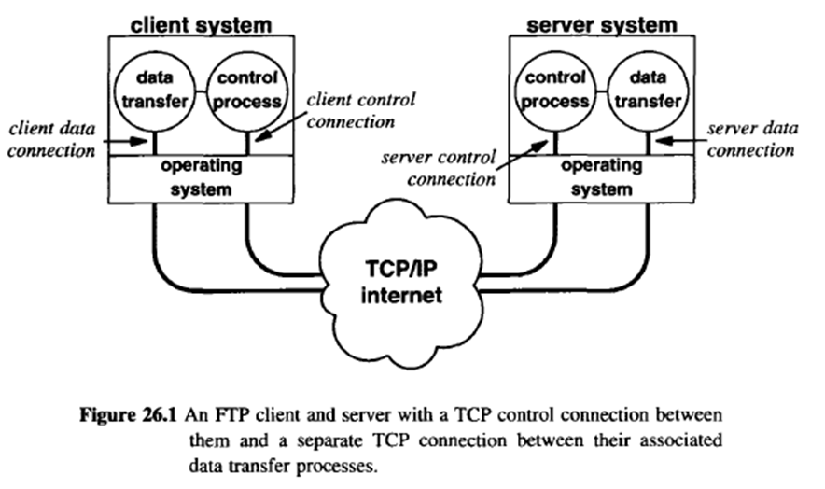
FTP Process Model:

Slide 4
Data transfer connections and the data transfer processes that use them can be created dynamically when needed, but the control connection persists throughout a session.
Once the control connection disappears, the session is terminated and the software at both ends terminates all data transfer processes.

Slide 5
TFTP (Trivial File Transfer Protocol):
The TCP/IP suite contains a second file transfer protocol that provides inexpensive, unsophisticated service.
Known as the Trivial File Transfer Protocol, or (TFTP), it is intended for applications that do not need complex interactions between the client and server.
TFTP restricts operations to simple file transfers and does not provide authentication. Because it is more restrictive, TFTP software is much smaller than FTP.
TFTP does not need a reliable stream transport service. It runs on top of UDP or any other unreliable packet delivery system, using timeout and retransmission to ensure that data arrives.

Slide 6
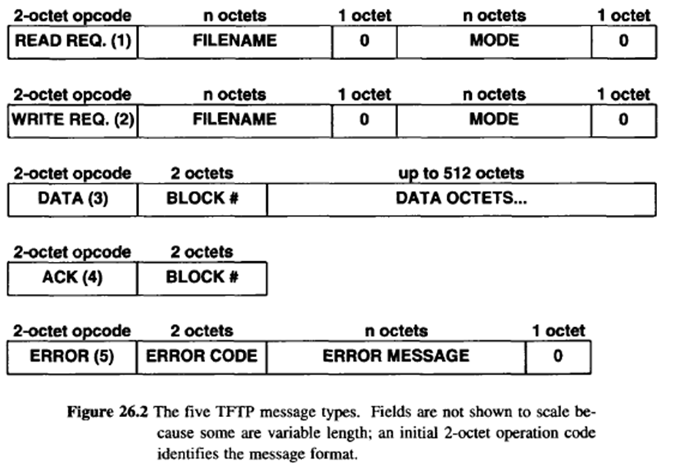
Figure shows the format of the five TFTP packet types.

Slide 7
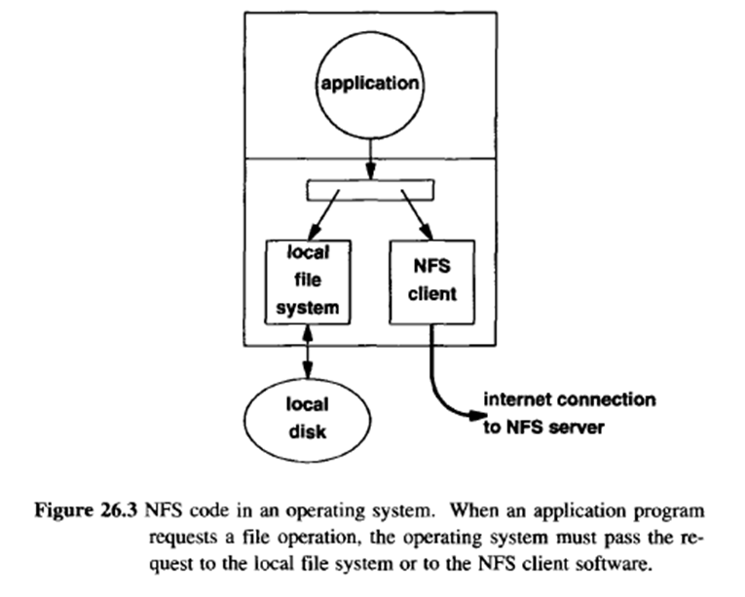
NFS (Network File System):
Initially developed by Sun Microsystems Incorporated, the Network File System (NFS) has been published as an IETF standard for transparent and integrated shared file access.
Figure illustrates how NFS is embedded in an operating system.

