Slide 1
Cost Sheet

Slide 2
Total Cost
Direct Cost Indirect Cost
Direct Materials Indirect Materials
Direct Expenses Indirect Expenses
Direct Wages Indirect Wages

Slide 3
Meaning of Cost Sheet:
Cost Sheet is a statement which presents detailed information relating to the various stages of cost. It also shows the total cost of the product manufactured during a particular period of time.
Thus, the cost sheet is prepared for a particular period of time monthly, quarterly, yearly etc.

Slide 4
Importance of cost sheet
1. Determining cost
2. Fixing selling price
3. Cost comparison
4. Cost control
5. Decision-making

Slide 5
Ram Material- Materials not yet used for production
Work-In-Process(W-I-P) –Semi-Finished products
Finished Goods – Materials which are ready for sales.
Opening Stock –Closing Stock of Previous Day/Week/Month
Closing Stock – Material leftout at the end of the day.

Slide 6
Elements of Cost Sheet
There are 4 major elements of Cost Sheet. These elements include
Direct Materials Consumed
Work Overheads/ Factory Overheads
Office and Administration Overheads
Selling and Distribution Overheads

Slide 7
Direct Materials Consumed
Direct Materials Consumed
Direct Expenses
Direct Wages
Step I | Direct Material= Material Purchased + Opening stock of raw material-Closing stock of raw material Prime Cost = Direct Material + Direct Expenses + Direct Wages

Slide 8
Work Overheads/ Factory Overheads
Work Overheads/ Factory Overheads include indirect expenses such as utilities, manages salaries, Factory expenses.
In simple terms, the sum of all the following expenses equals to Factory Costs or Work Costs:
Factory Rent, lighting
Factory Salary
Electricity Charges
Indirect Material Expenses
Other Indirect Wages
Salaries of Production Heads/Supervisors
Other Salaries
Factory Insurance
Power and Fuel
Drawing Office Expenses
R&D
Depreciation of Factory

Slide 9
Step II | Works Cost or Factory Cost = Prime Cost + Factory Overheads +opening Work in progress-Closing Work in progress Factory Overheads (Indirect Material + Indirect Labour + Indirect Expenses)

Slide 10
Office and Administration Overheads These expenses include
Office rent , Salary, lighting
Telephone and Postage
Printing and Stationary
Counting House Salary
Asset depreciation
Legal expenses
Audit fees
Bank charges
Subscription to Periodicals
Other miscellaneous office expenses.

Slide 11
Step III | Cost of Production = Works Cost + Office and Administration overheads

Slide 12
Step IV | Cost of Production = Works Cost + Office and Administration overheads + Opening finished goods-Closing finished goods

Slide 13
Selling and Distribution Overheads
Sales Costs are the direct and indirect expenses for selling and distribution of produced goods.
These expenses include
Commissions,
Salaries of sales staff,
Traveling expenses,
Advertisement,
Delivery expenses,
Sales tax,
Bad debts, etc.

Slide 14
Step IV | Total Cost = Cost of Production + Selling and Distribution Overheads
Profit | Sales – Total Cost

Slide 15
Cost Sheet template consists of six major sections
Prime Cost
Factory or Works Cost
Production Cost
Cost of Good Sold (COGS)
Cost of Sales and
Total Sales

Slide 16
Cost Sheet
Direct Materials XXX
(+) Opening Raw Materials XXX
(-) Closing Raw Materials XXX | XXX
Direct Expenses | XXX
Direct Wages/Labour | XXX
Prime Cost |  | XXX
Factory Overhead/Works Overhead | XXX
(+) Opening W-I-P | XXX
(-) Closing W-I-P | XXX | XXX
Factory Cost /Works Cost |  | XXX
Office and Administration Overhead | XXX | XXX
Cost Of Production | XXX
(+) Opening Finished Stock | XXX
(-) Closing Finished Stock | XXX | XXX
Cost Of Goods Sold |  | XXX
Selling and Distribution Overhead |  | XXX
Total Cost |  | XXX
(+) Profit |  | XXX
Sales |  | XXX

Slide 17
1. First Head ( Direct Materials Comsumed)
(+)Opening Stock of Raw Materials
(-) Closing Stock of Raw Materials
2.Works/ Factory Overheads
(+)Opening Stock of Work- In-Materials
(-) Closing Stock of Work- In-Materials
3. Office and Administration Overheads
(+)Opening Stock of Finished Goods
(-) Closing Stock of Finished Goods

Slide 18
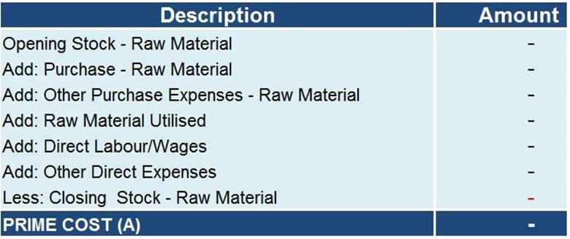
Prime Cost = Direct material + Direct Wages + Direct expenses
Direct material = Material purchased + Opening stock of material – Closing stock of material.

Slide 19
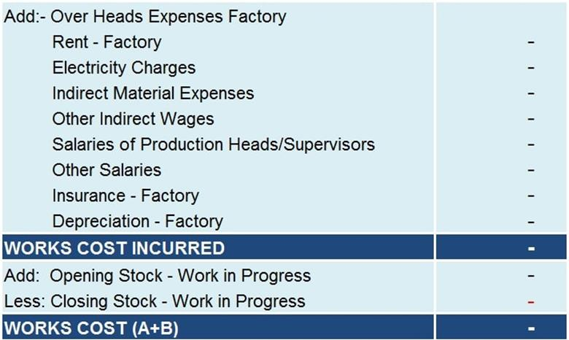
Factory Cost or Works Cost
The factory overheads consist of the cost of indirect material, indirect wages (Factory), and indirect Expenses(Factory)

Slide 20
Factory Cost = Prime cost + Factory overheads (+Opening Work-in-Process- Closing Work-in-Process)
Cost of production = Office and administrative overheads + Factory cost or work cost

Slide 21
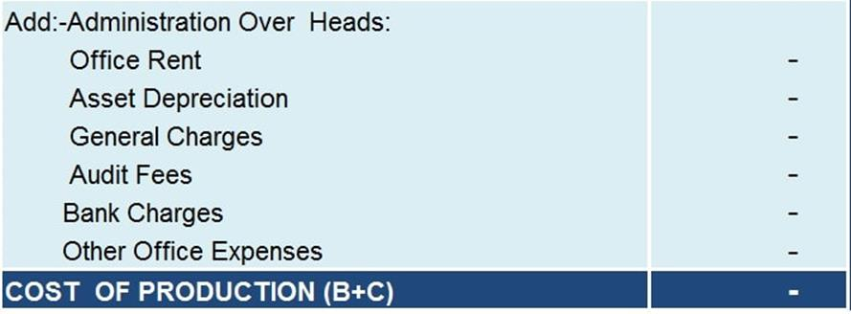
Cost of Production
.

Slide 22
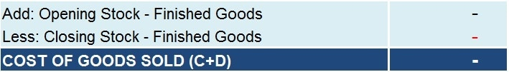
Cost of Goods Sold (COGS)
All the goods that a unit produces aren’t sold in the same period.
Cost Of Goods Sold = Cost of Production =Opening Stock of Finished Goods – Closing Stock of Finished Goods

Slide 23
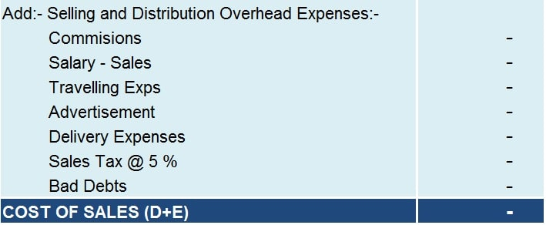
Cost of Sales= Cost of Goods sold + Selling and distribution overheads.

Slide 24
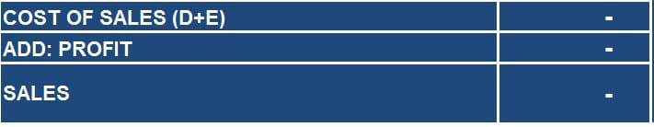
Sales
Sales = Total Cost + Profit.

Slide 25
What are the items excluded from the cost sheet?
Company’s Income tax or advance tax.
Dividends paid to shareholders.
Discounts on issues of shares and debentures.
Underwriting commission payment made.
Capital losses of the business.
Expenses related to the purchase of fixed assets by the company.
Losses made on the sale of fixed assets by the company.
Interest on capital.

Slide 26
Step I | Direct Material= Material Purchased + Opening stock of raw material-Closing stock of raw material
Step II | Works Cost = Prime Cost + Factory Overheads (Indirect Material + Indirect Labour + Indirect Expenses)+opening Work in progress-Closing Work in progress
Step III | Cost of Production = Works Cost + Office and Administration overheads + Opening finished goods-Closing finished goods
Step IV | Total Cost = Cost of Production + Selling and Distribution Overheads
Profit | Sales – Total Cost

