Slide 1
Types of sales Organization structure
Line Sales Organization.
Line and Staff Sales organization.
Functional Sales Organization.
Committee Sales Organization.

Slide 2
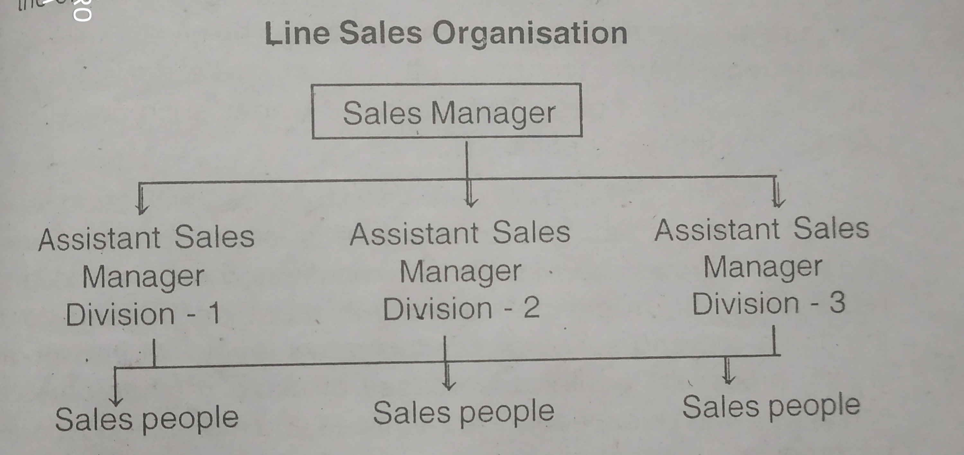
1) Line sales organization:
The line organization is the oldest and simplest sales organization structure. It is widely used is smaller firms and in firms with small numbers of selling personnel.

Slide 3
Advantages:
Simple method.
Discipline
Clear and logical.
Saves time.
Disadvantages:
Required highly qualified person.
Insufficient time for policy making.

Slide 4
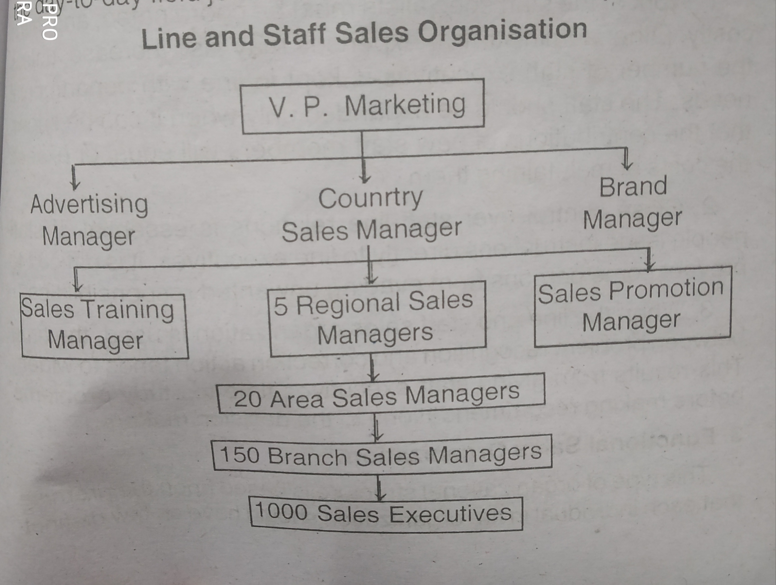
2) Line and staff sales organization:
The line and staff sales department is often found in large and medium-sized firms, employing substantial numbers of sales personnel, and selling diversified product line over wide geographical area.

Slide 5
Advantages:
Broader view of the department.
Easy to find out the problem.
Pool of experts.
Disadvantages:
Costly.
Time consuming/

Slide 6
3) Functional sales organization:
Here organization is divided into smaller groups based on special function.
Each individual in the organization should have as few distinct duties and responsibilities.
In the functional sales department, sales people receive instructions from several executives but on different aspects of their work.

Slide 7
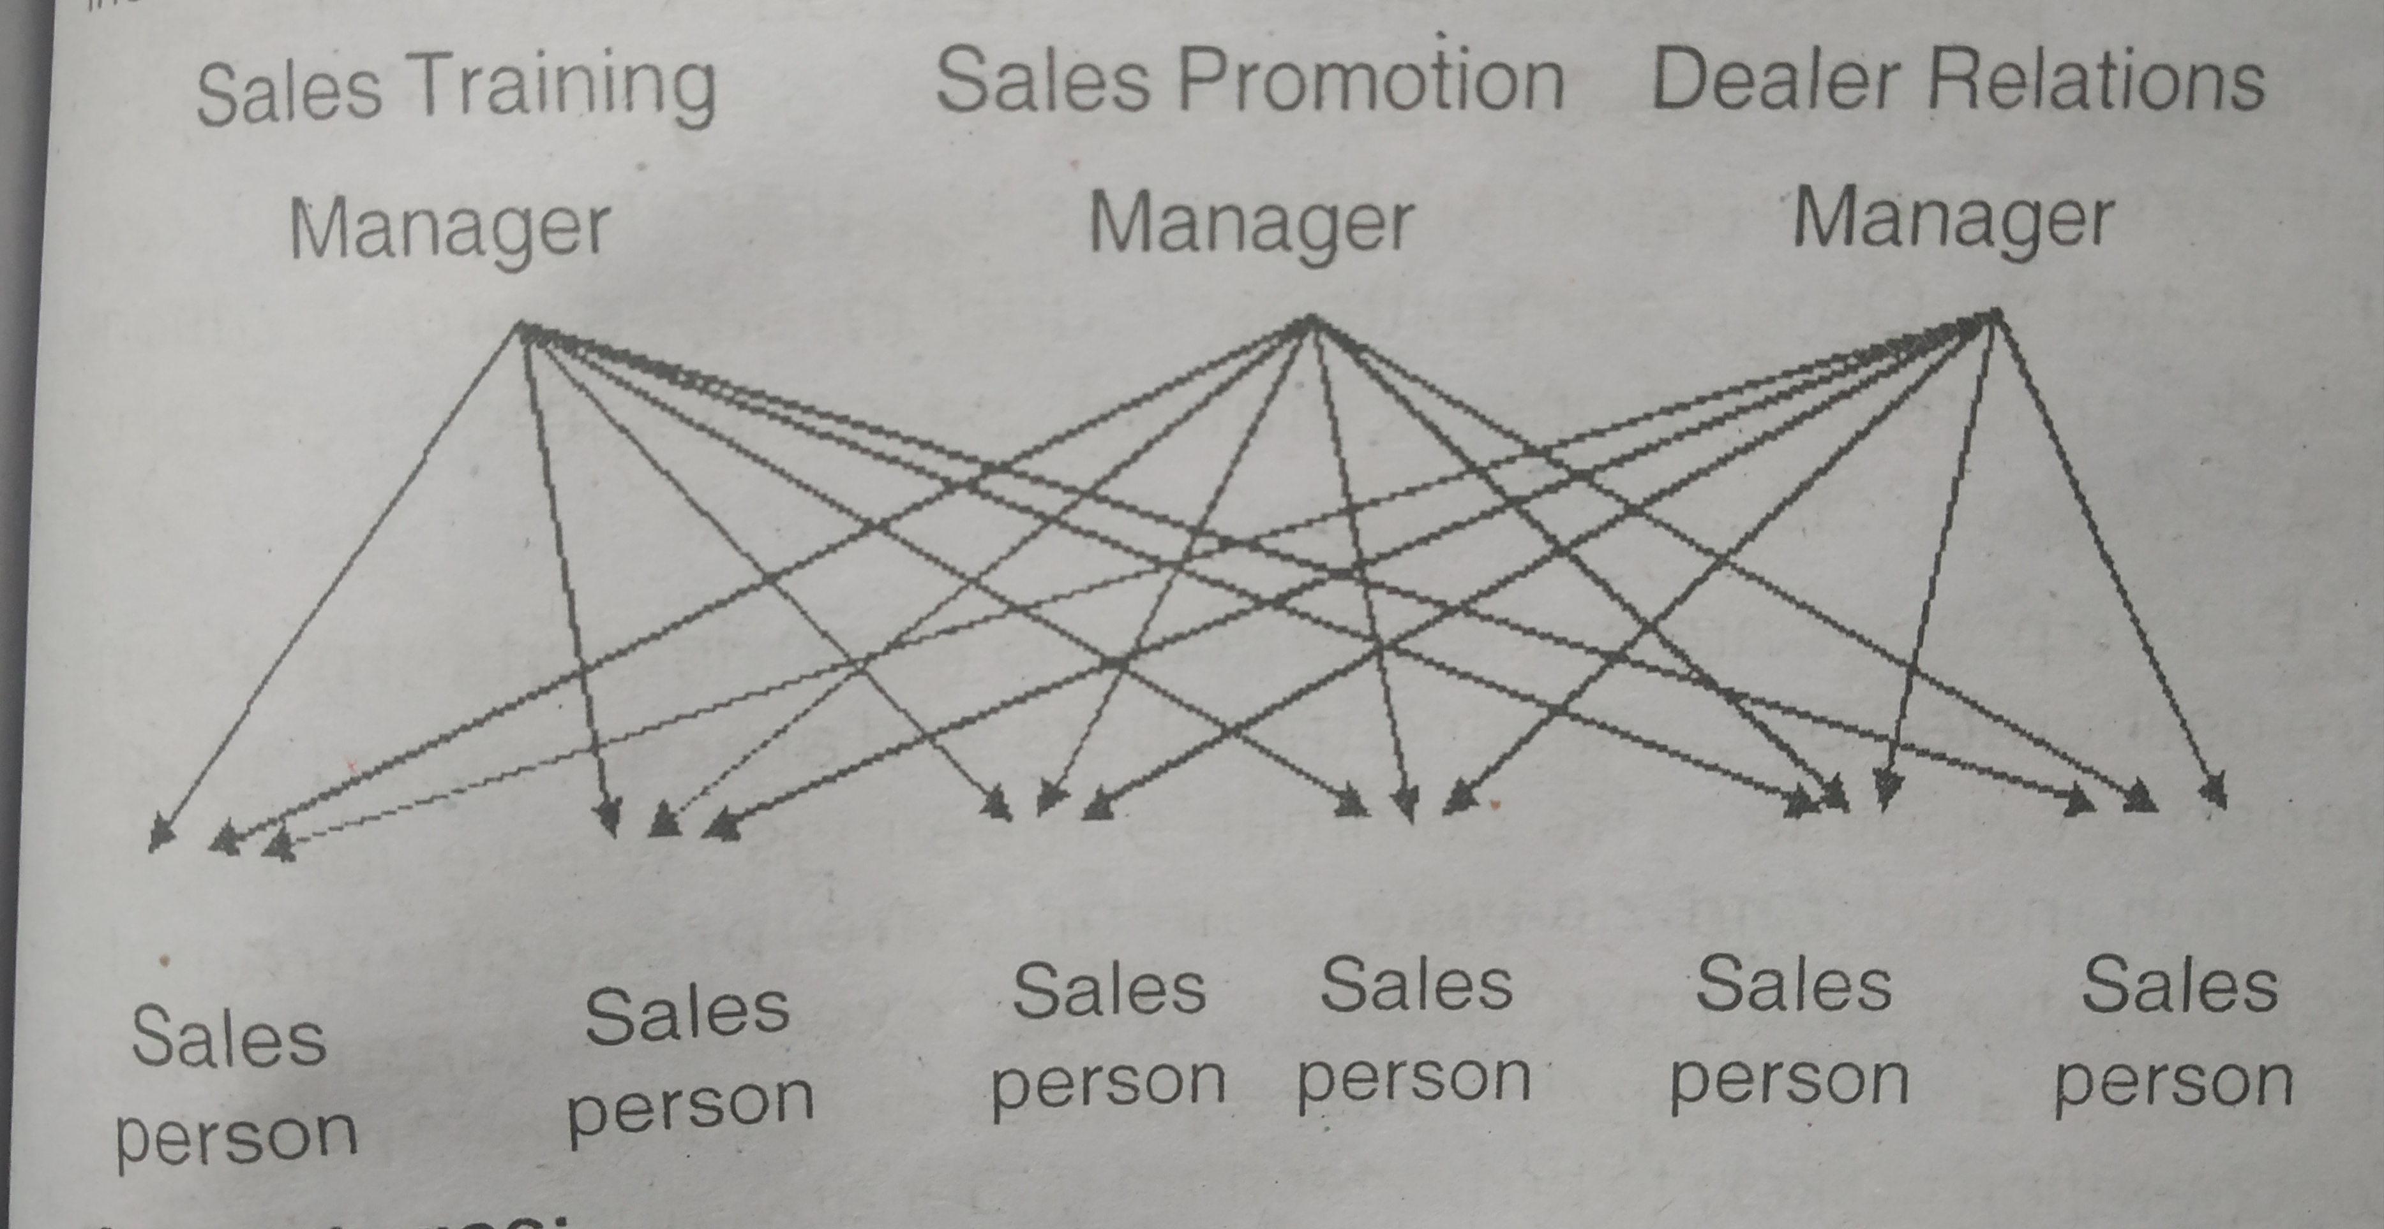

Slide 8
4) Committee sales organization
It is not sole basis for organizing a sales dept.
It is a method of organizing the executive group of planning and policy formation.
so, many firms have sales training committee.

