Slide 1
Dr. B. B. Hegde First Grade College, Kundapura.

Slide 2
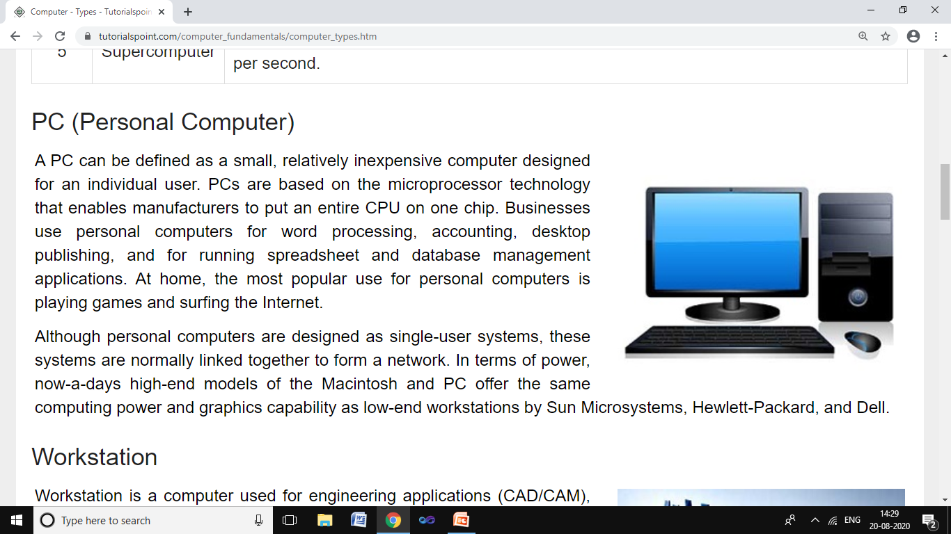
COMPUTER BASICS

Slide 3
INTRODUCTION
COMPUTER BASICS
What is Computer?
Commonly Operating Machine Particularly Used for Technology Education and Research.
In a simple way, Computer is a electronic device that:
Accepts input (Raw Data)
Processes the input
Stores data
Produces output (information)

Slide 4
Therefore, computer is an electronic machine for performing calculations and controlling operations that can be expressed in logically or in numeric terms.
COMPUTER BASICS
INPUT
PROCESS
OUTPUT
It is the simple processing model of computer.
For Example ;
2 + 3 =5
2 and 3
+
5

Slide 5
COMPUTER BASICS Characteristics of Computer
Computers are very accurate known as Garbage in Garbage Out
Performs huge task in few seconds & is calculated in MHz
SPEED
Computer is free from tiredness & lack of concentration
ACAURACY
REASOURCE SHARING
Sharing of library resources with other participating parties.
Characteristics
DELIGIENCY
VERSATALITY
RELIABILTY
STORAGE CAPACITY
It is the performance of a computer.
It can perform multiple tasks simultaneously.
It can store large amount of data with its capacity

Slide 6
Limitations of a Computers
COMPUTER BASICS
A computer can only perform what it is programmed to do.
Regular electric supply is necessary to work.
A computer’s use is limited to some restricted to some areas.

Slide 7
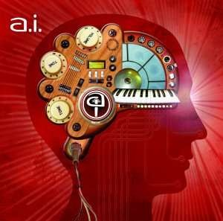
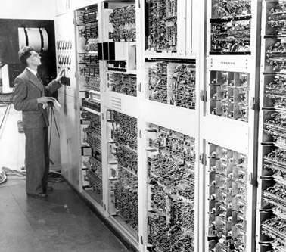
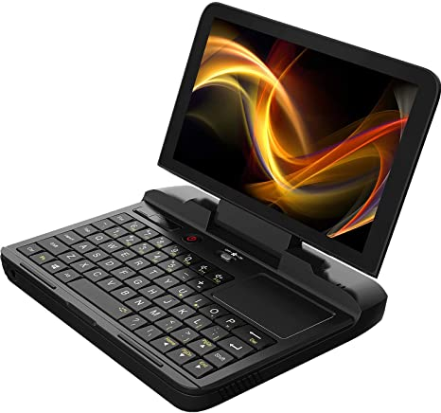
Evolution of Computers

Slide 8
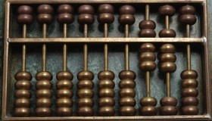
Evolution of Computers
COMPUTER BASICS
ABACUS
Abacus is known to be the first mechanical calculating device.
Which was used to be performed addition and subtraction easily and speedily

Slide 9
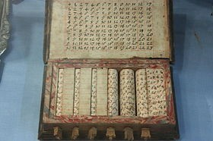
COMPUTER BASICS
NAPIER’S BONES
Napier’s of Scotland invented a calculating device, in the year 1617 called the Napier Bones.
In the device, Napier’s used the bone rods of the counting purpose where some no. is printed on these rods. These rods that one can do addition, subtraction, multiplication and division easily.

Slide 10
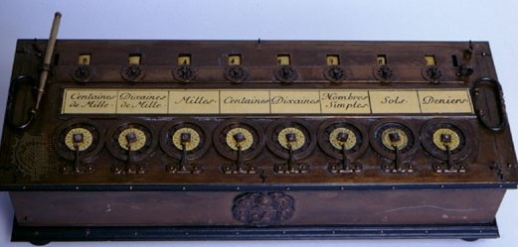
PASCAL’S CALCULATOR
In the year 1642, Blaise Pascal a French scientist invented an adding machine called Pascal’s calculator, which represents the position of digit with the help of gears in it.
Known as first calculator of the world.

Slide 11
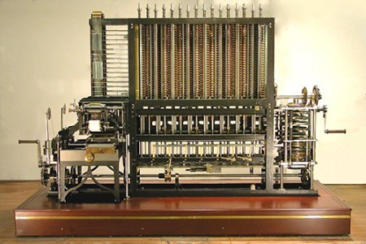
LEIBNZ CALCULATOR
In the year 1671, a German mathematics, Gottfried Leibniz modified the Pascal calculator and he developed a machine which could perform various calculation based on multiplication and division as well.

Slide 12
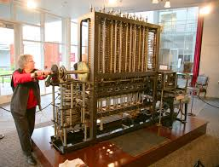
DIFFERENCE ENGINE
In 1822, Charles Babbage proposed a machine to perform a differential equations, called Difference Engine.
Who is also known as father of Computer.

Slide 13
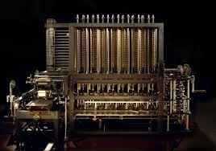
ANALYTICAL ENGINE
Charles Babbage also invented the first general purpose computer known as the Analytical Engine.
It had the basic element of modern computer : Input, Output, Memory devices.

Slide 14
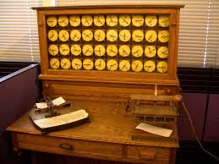
HOLLERITH’S TABULATOR
In 1889, Hermann Hollerith invented a machine called Hollerith’s tabulator.
His method used cards to store the data, which fed into the machine to obtain results.

Slide 15
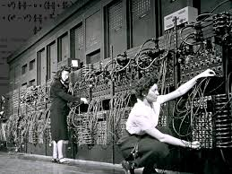
ENIAC
Electronic Numeric Integrator and Calculator was designed in 1984.
It was the first general purpose electronic computer which includes Large scale integration but has no internal memory.

Slide 16
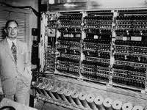
EDVAC
Electronic Discrete Variable Automatic Computer introduced by Jhon Von Nuemann, that is used to store both program and data in the main memory of the computer.

Slide 17
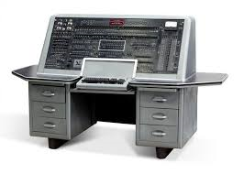
UNIVAC
It is the first digital computer developed in 1951.
It marked the arrival of digital computers business and scientific applications.

Slide 18
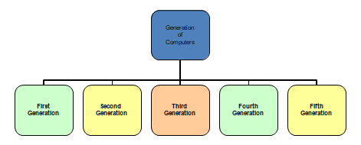
Generations of Computers
According to the type of “processor” installed in a machine, there are five generations of computer.

Slide 19
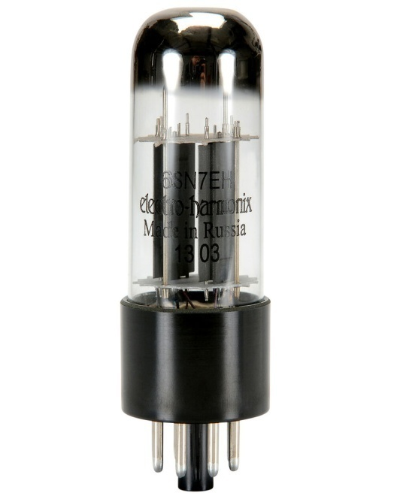
First generations (1940-1956)
COMPUTER BASICS
TECHNOLOGY: Vacuum Tubes or Valves
CHARACTERISTICS:
(1) The use vacuum tube technology
(2) They are huge in size
(3) The generate a lot of heat and uses machine
Language.
(4) They were slow and often unreliable
(5) They had limited internal storage capacity
(6) Input and output modes are punched cards and printouts
(7) They are very expensive
Examples:
(1) ENIAC – Electronic Numerical Integrator and Computer
(2) EDVAC – Electronic Discrete Variable Automatic Computer
(3) EDSAC – Electronic Delay Storage Automatic Control

Slide 20
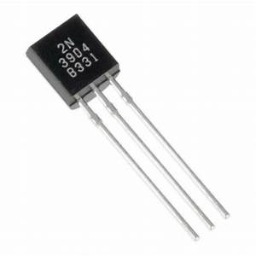
Second generations (1956-1963)
COMPUTER BASICS
Technology: Transistors
Characteristics:
1. They used transistor technology
2. They generate lesser amount of heat
3. They are smaller than first generation computer
4. Instructions are coded in assembly language
5. Instructions are written in high level language
6. They were less expensive to buy
7. The consume lesser power
8. They had limited external storage
9. They used magnetic tapes and disk as storage devices
Examples:
ATLAS and IBM’s 1401, 1790,704, 709 and 7094; UNIVAC 1004 and
CDC 160

Slide 21
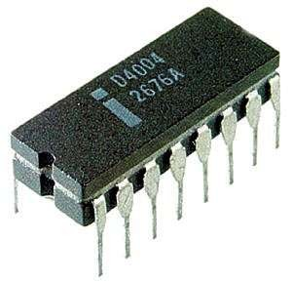
Third generations (1964-Early 1970’s)
COMPUTER BASICS
Technology: Integrated circuit (IC)
Characteristics:
1. They use integrated circuit technology
2. They generate lesser amount of heat
3. The are smaller in size than earlier generations
4. The input and output modes are keyboard and monitor
5. They are faster and more reliable
6. The consume lesser power
7. They are cheaper to buy
Examples:
PDP-8, IBM 1401 and IBM 7090.

Slide 22
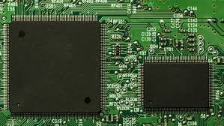
Fourth generations (Early 1970’s to Till date)
COMPUTER BASICS
Technology : Microprocessors
Characteristics :
1. They use microchip/microprocessor technology
2. They generate lesser amount of heat
3. They are smaller in size
4. Instructions are coded in high level languages
5. They have graphic user interface
6. They come in various sizes
7. They are faster
8. They are more reliable
9. They also cheaper to buy
Examples : Desktops , Laptops, PDAs, Intel’s 8080, 80286, 80386, 80486;

Slide 23
Fifth generations (Present and Beyond)
COMPUTER BASICS
Technology: Artificial intelligence (AI)
Artificial intelligence(AI) is the term used to link human behaviour and characteristics in man-made machines.
Characteristics:
1. They will have artificial intelligence
2. They will have very high speed
3. They can perform multitasking
4. They can emulate human behaviours generations.
Examples :
Wallet PC, Wearable PC, PUMA, Cog, DANTE, WABOT-2 and HELPMATE.

Slide 24
Characteristics of Fifth generation computers
Mega Chips
Parallel Processing
Artificial Intelligence
Mega Chips :
Mega Chips is a semiconductor leader whose technology transforms the world we live in by helping each one of us achieve healthier, safer and more fulfilling lives.

Slide 25
Characteristics of Fifth generation computers
2. Parallel Processing :
  Parallel Processing is a method in computing in which separate parts of an overall complex task are broken up and run simultaneously on multiple CPU’s therby reducing the amount of time processing.
  3. Artificial Intelligence :
  It is the branch of computer science that ideals with the studying creation of systems that exhibit some form of intelligence or human kind of intelligence.

Slide 26
GENERATION TABLE
1stGeneration
2ndGeneration 3rdGeneration 4thGeneration
5thGeneration
Duration
1940-1956
1956-1964
1964-1971
1971-1981
1981-present
Internal component
Integrated circuit (IC_{S})
Artificial intelligence
Vacuum tubes
Transistors
Micro-processor
Smaller than 1stgeneration
Much smaller than previous generations
Size of computer
Very huge
Micro- computers
Tiny computers
Hard disk &
floppy disk
Hard disk, floppy
and optical storage
Storage devices
Magnetic tape
Magnetic tape
Magnetic tape
Assembly language
High level languages such as BASIC, PASCAL
Very high level languages C, C⁺⁺ etc
Natural language like SQL, PROLOG etc
Programming languages
Machine language
ENIAC, UNIVAC, IBM
705 etc
IBM-400, IBM- 1600, UNIVAC III
etc
IBM 360, IBM
370, UNIVAC
9000 etc
IBM 3033, IBM
system 36, CRAY- I etc
Pentium series, LAPTOP, PALMTOP etc
Famous computers

Slide 27
The Computer System
COMPUTER BASICS
A computer can be viewed as a system, which consist of number of interrelated components that work together with the aim of converting data into information.
Programs :
The instruction given to the computer.
Hardware :
The physical parts that makes the computer.
Software :
It is a collection of data or computer instructions that tell the computer how to work.
Peripherals :
Any hardware device connected to the computer or any part of the computer outside the CPU and working memory.

Slide 28
Classification of Computers
COMPUTER BASICS
Classifications of computers
Micro
Mini
Mainframe
Super
Desktop
Laptop
Hand-Held

Slide 29
Microcomputers:
COMPUTER BASICS
These were small in size, low cost digital computers.
A PC can be defined as a small, relatively inexpensive computer designed for an individual user.
Consists of MP, a storage unit, an input channel and an output channel.
And also connecting cables, appropriate peripherals, an OS and Software programs.
At home, the most popular use for personal computers is playing games and surfing the Internet.

Slide 30
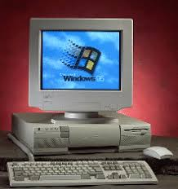
Microcomputers:
Examples:
IBM PC Pentium 100, IBM PC Pentium 200, Apple Macintosh etc

Slide 31
Desktop Computers
It is one of the type of micro computers.
It is also known as PC, intended for stand – alone applications used by an individuals.
These computers typically consists of a system unit, monitor, a keyboard, an internal hard disk storage and other peripherals.
They are not expensive and fit for small business.

Slide 32
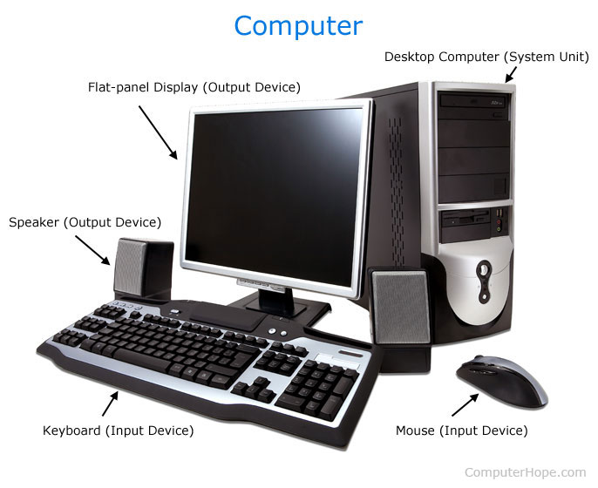
Desktop Computers
Examples:
IBM, Apple, Dell and Hp.

Slide 33
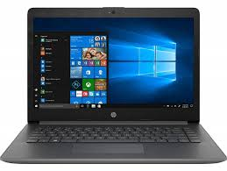
Laptop
It is portable, and also known as notebook computers.
It has same features of desktop computers and small in size.
They do not contain any external power supply.
Advantages:
Small in size
Lightweight
Disadvantages:
Expensive

Slide 34
Hand- Held Computers
Handheld computers also known as personal digital assistants (PDAs).
They are small, portable devices.
We can use the terms “handheld computer” and “PDA” are often used interchangeably,
  handhelds tend to be larger and feature miniature keyboards
  PDAs tend to be smaller and rely on a touch screen and stylus for data entry.
The size of handheld computers ranges from credit card to small notebook computer
The most popular size for the devices is palm size.
Most handheld computers utilize a liquid crystal display (LCD).

Slide 35
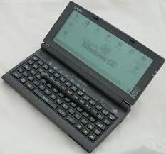
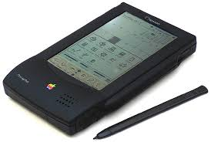
Hand- Held Computers
Examples:
Apple Newton, Casio Cassiopeia and Franklin EbookMan

Slide 36
Mini Computer
COMPUTER BASICS
These computers are smaller in size but larger as compared to Micro Computers.
Less expensive.
Primary memory is usually in GIGA Bytes
Designed to meet the computing needs in a small to medium sized business environment.
Initially, it capable of supporting 4 to 200 users.
Mini computer usually fills a small shelf. Its about the size of two drawer filling cabinet.
Disks are used for secondary storage

Slide 37
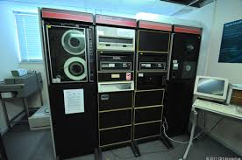
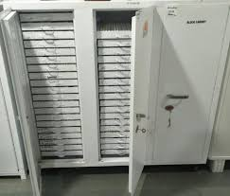
Mini Computer
Examples: -
PDP 11, IBM 8000 series and VAX 7500.

Slide 38
Main Frame Computers
COMPUTER BASICS
These computers are very powerful.
Large in size, large in memory and powerful.
These computers are used in networked environment and mainly as network servers.
Mainframe computers are very expansive. \
They are usually designed for the computerization of huge business organizations, universities, banks, scientific laboratories etc.
Multiple Input/ Output devices are normally attached with a Mainframe computer.
These computers also allow different users to work on it at the same time like Mini computers but the number of users can be much more than that of the Mini computers.

Slide 39
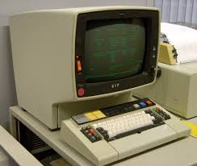
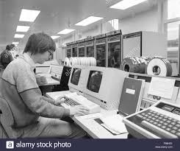
Main Frame Computers
Examples:-
IBM-4381, IBM-360, ICL-2900,NEC-610 etc…

Slide 40
Super Computers
Supercomputers are the most powerful computers.
They are used for problems requiring complex calculations.
Super Computers are very difficult to design, it requires lot of research and development and at the same time they are very much expansive to manufacture.
But now, The speed of a supercomputer is measured in "FLOPS“
Example of floating point operation is the calculation of mathematical equations in real numbers.
In terms of computational ability, Supercomputers are more powerful.

Slide 41
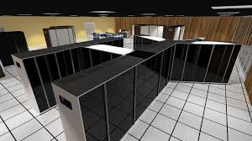
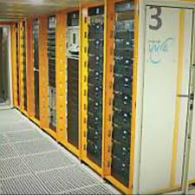
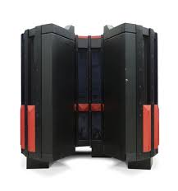
Super Computers
Examples :
CRAY- 3, Cyber 205, PARAM

Slide 42
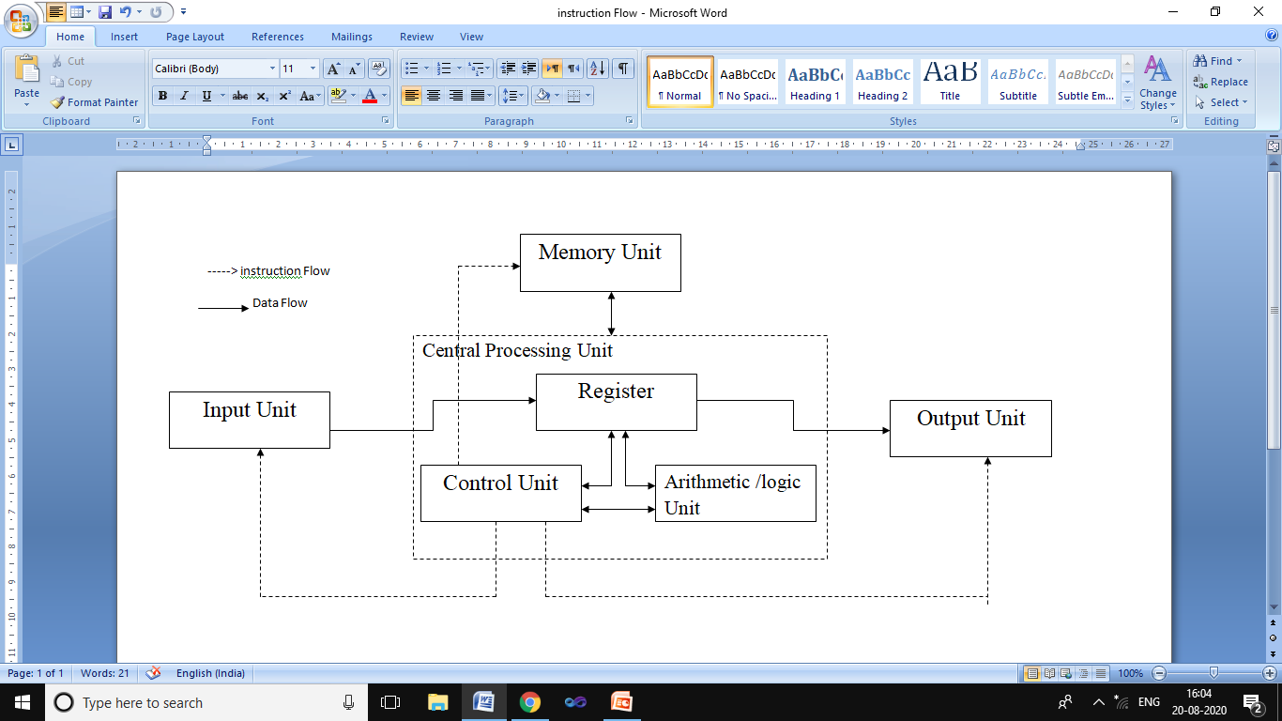
Components of a Computer System
COMPUTER BASICS

Slide 43
Components of a Computer System
COMPUTER BASICS
A Computer has following components:
CPU
Input Unit
Output Unit
Storage Unit

Slide 44
Central Processing Unit
COMPUTER BASICS
It is also known as processor and is the brain of the computer system.
It process the data into meaningful information.
It is the administrative section of the computer system.
It has three parts.
Arithmetic and Logical Unit
Control Unit
Registers

Slide 45
COMPUTER BASICS
Arithmetic logic Unit(ALU):
Performs arithmetic and logical operations.
Performs transferring data from memory to the ALU.
Stores the result back to memory.
Control Unit
Checks the correctness of the sequence of operations.
Fetches the instructions, interprets them and execute the correctness.
Controls the I/O devices and directs the overall functioning of the computer.

Slide 46
Registers :
These are special purpose high speed, temporary memory unit.
It holds the information that the CPU is currently working.
It can be considered as the CPU’s working memory.
Contains additional storage location, provides speed for execution of data.

Slide 47
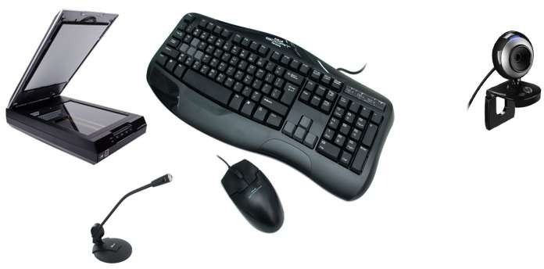
Input , Output and Storage Unit
Input Unit
Input Unit consists of devices that allows the user to feed the computer raw data.
In other words, an input device is a piece of computer hardware equipment used to provide data and control signals to an information processing system such as a computer or information appliance.
Examples : Mouse, Keyboard, Microphone, Webcam, joysticks, etc

Slide 48
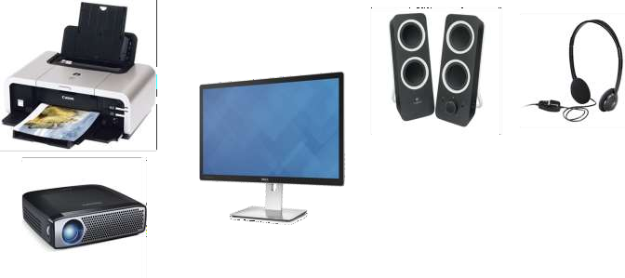
Output Unit
Output Unit consist of devices that allows the computer to relay or display processed data (information) to the user.
In other words, output device is any piece of computer hardware equipment which converts information into human-readable form.
Examples :
Monitors, projectors, speakers, headphones, printers etc.

Slide 49
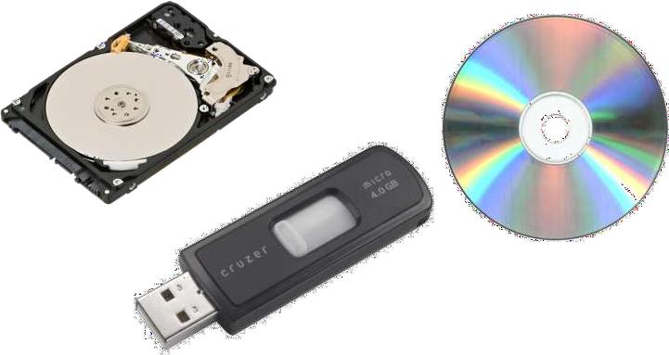
Storage Unit:
It is used to store the input and output of data.
Memory classified into two:
Primary Memory(Main Memory)
Secondary Memory

Slide 50
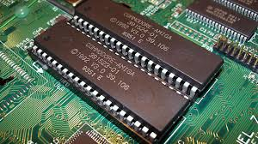
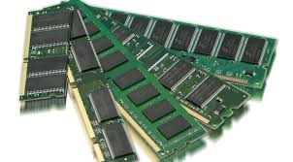
Primary Memory(Main Memory)
It is also called as Main Memory which holds,
  The instruction and data currently being processed by the CPU.
  The intermediate results.
Expensive and had limited storage capacity.
Examples:
RAM- Read Only Memory
ROM- Random Access Memory

Slide 51
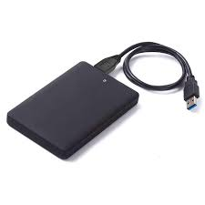
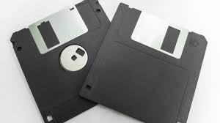
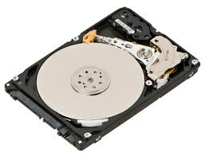
Secondary Memory
The Memory which can store data or information permanently for future use is called secondary storage devices (secondary memory).
Less expensive and has high storage capacity.
Examples :
Floppy Disk, Hard Disk, Tape Drives etc

Slide 52
Applications of computer
Science
Banking
Publishing
Education
Applications of Computers
Business Application
Medicine and Health care
Communication
Engineering/Architecture/ Manufacturing
Entertainment

Slide 53
THANK YOU

