Slide 1
POLAR COORDINATES
Ms. Nirusha Shetty
Asst. Professor
Dept. of Mathematics

Slide 2
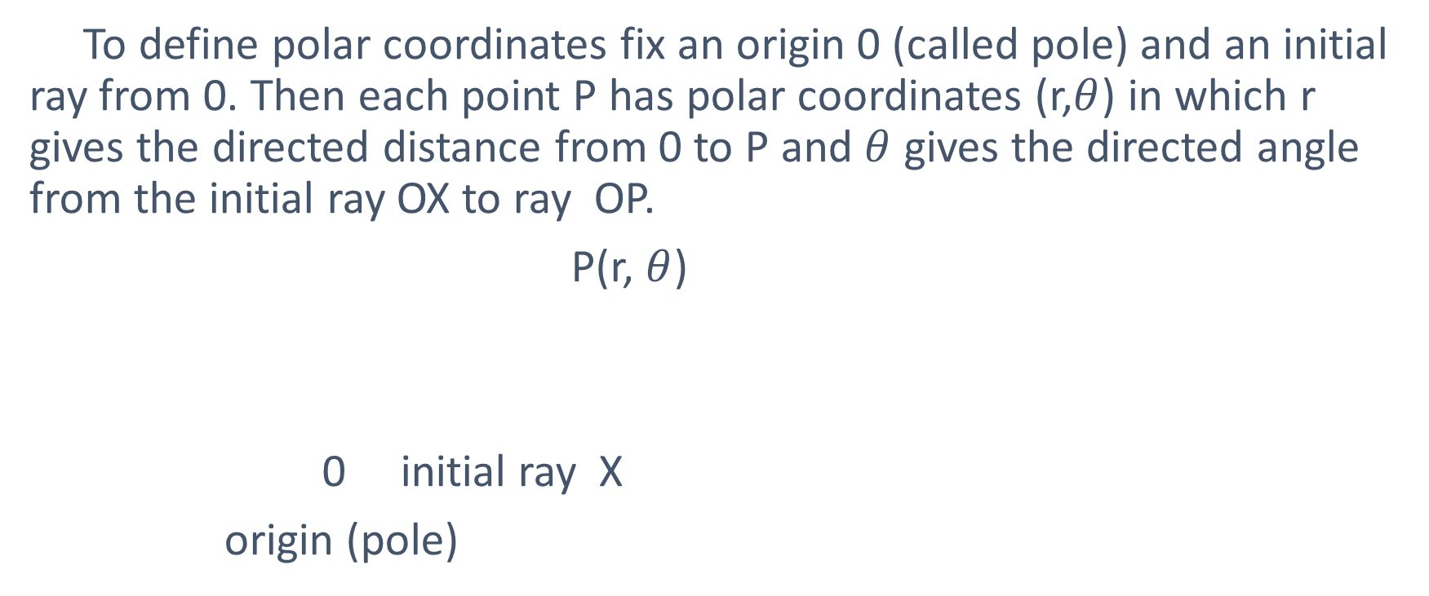
Polar coordinates :
To define polar coordinates fix an origin 0 (called pole) and an initial ray from 0. Then each point P has polar coordinates (r,$θ$) in which r gives the directed distance from 0 to P and $θ$ gives the directed angle from the initial ray OX to ray OP.
P(r, $θ$)
0 initial ray X
origin (pole)

Slide 3
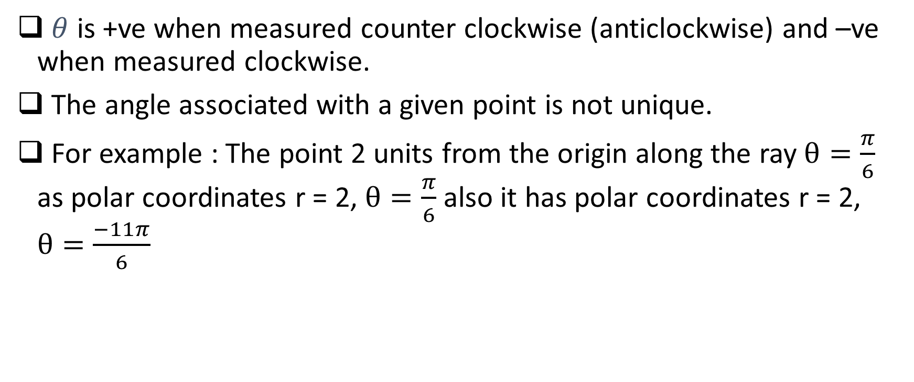
Note :
$θ$ is +ve when measured counter clockwise (anticlockwise) and –ve when measured clockwise.
The angle associated with a given point is not unique.
For example : The point 2 units from the origin along the ray $θ=\frac{π}{6}$ as polar coordinates r = 2, $θ=\frac{π}{6}$ also it has polar coordinates r = 2, $θ=\frac{−11π}{6}$

Slide 4

P(2, $\frac{π}{6}$)= P(2, $\frac{−11π}{6}$)

Slide 5
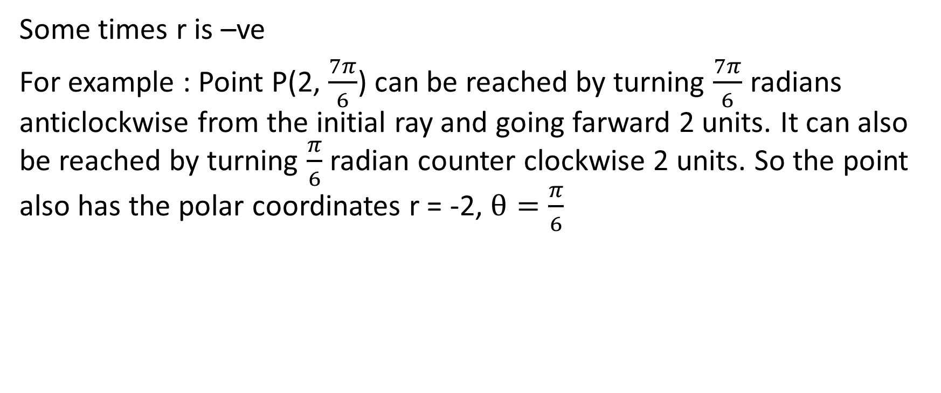
Some times r is –ve
For example : Point P(2, $\frac{7π}{6}$) can be reached by turning $\frac{7π}{6}$ radians anticlockwise from the initial ray and going farward 2 units. It can also be reached by turning $\frac{π}{6}$ radian counter clockwise 2 units. So the point also has the polar coordinates r = -2, $θ=\frac{π}{6}$

Slide 6

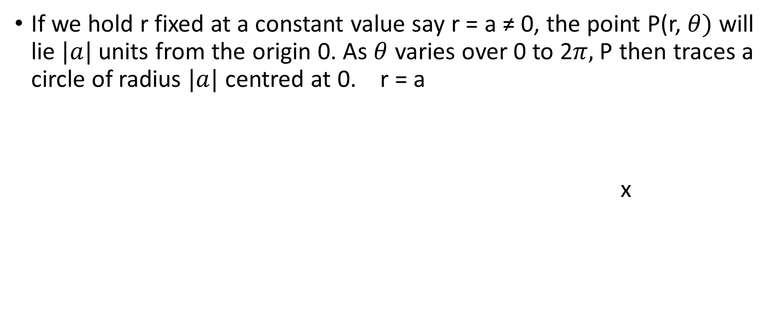
Polar equations :
If we hold r fixed at a constant value say r = a ≠ 0, the point P(r, $θ)$ will lie $|a|$ units from the origin 0. As $θ$ varies over 0 to 2$π,$P then traces a circle of radius $|a|$ centred at 0. r = a
x
$|a|$
0

Slide 7
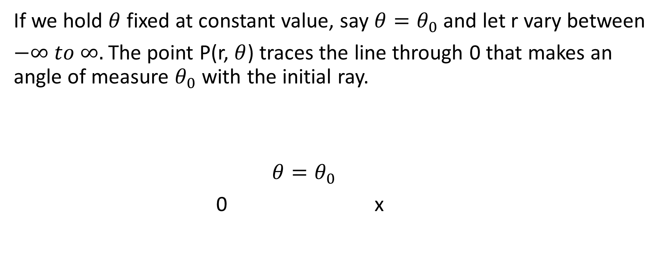
If we hold $θ$ fixed at constant value, say $θ=θ_{0}$ and let r vary between
$−∞ to ∞.$The point P(r, $θ$) traces the line through 0 that makes an angle of measure $θ_{0}$ with the initial ray.
$θ=θ_{0}$
0 x

