Slide 1
UNIT - III
FUNCTIONS OF
SEVERAL VARIABLES
Ms. Nirusha Shetty
Asst. Professor
Department of Mathematics

Slide 2
Definition :
Suppose D is a set of n-tuples of real numbers
(x₁ , x₂ ,….., x_{n} ) a real valued function f on D is defined as a rule which assigns a unique real number w = f(x₁ , x₂ ,….., x_{n}) to each element in D. The set D is called the Domain, the set of all w values is called the functions Range.
Hence w is the independent variable of f and f is said to be a function of n independent variables x₁ to x_{n} .
The values (x₁ , x₂ ,….., x_{n} ) is called the functions input variable and w is called the functions output variable.

Slide 3

Definitions :
A point (x₀ , y₀) is called an interior point of a region R in the xy plane if it is the center of a disc of +ve radius that lies entirely in R as shown in the figure
R
$${(x}_{0}, y_{0})$$

Slide 4


A point (x₀ , y₀) is boundary point of R if every disc centered at (x₀ , y₀) contains point that lie outside of R as well as point that lie inside R as shown in the figure
$${(x}_{0}, y_{0})$$
R
$${(x}_{0}, y_{0})$$

Slide 5
The interior points of a region, as a set, make up the interior of the region.
The regions boundary points is called boundary of the region.
A region is open, if it consist entirely of interior point
(i.e. infinitely many interior points)
A region is closed, if it contains all interior points and all its boundary points.

Slide 6
A region on the plane is bounded if it lies inside a disc of positive radius.
A region which is not bounded is called unbounded region.

Slide 7

Example :
Describe the domain of the function

Slide 8
Definitions :
The set of points on the plane where f(x,y) has a constant value that is f(x,Y) = c is called the level curve of f.
The set of all points (x, y, f(x,y)) in space for (x,y) in the domain of f is called the graph of f.
The graph of f is also called the surface z = f(x,y)

Slide 9
Example :
Graph f(x,y) = 100 – x² – y² and plot the level curves f(x,y) = 0, f(x,y) = 51, f(x,y) = 75 in the domain of f in the plane.

Slide 10

Definition :
The set of points (x,y,z) in space where a function of three independent variables has a constant value f(x,y,z) = c is called a level surface of f.
Example :
Describe the level surfaces of the function

Slide 11


Limits and Continuity
Definition :
A function f(x,y) approaches the limit ‘L’ as (x,y) ―> (x₀, y₀) and we write
For every ϵ > 0, there exist a corresponding number δ > 0 such that for all (x,y) in the domain of f, |f(x,y) – L| < ϵ, whenever
δ

Slide 12
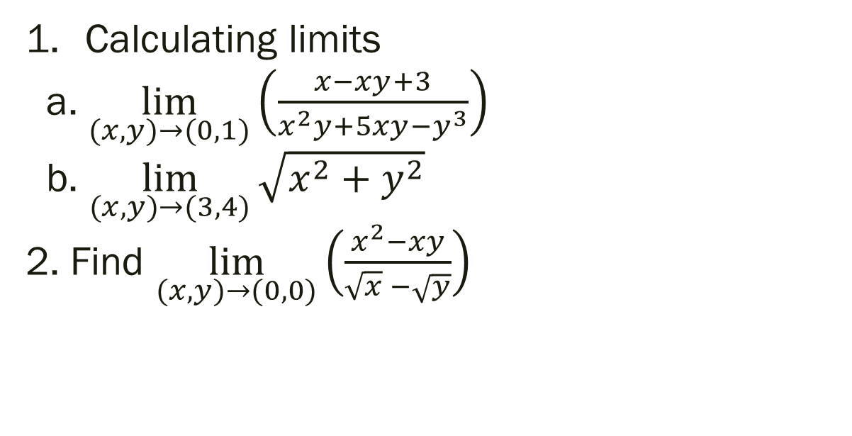
Examples
Calculating limits
a. $\lim_{(x,y)→(0,1)}\left(\frac{x−xy+3}{x^{2}y+5xy−y^{3}}\right)$
b. $\lim_{(x,y)→(3,4)}{\sqrt{x^{2}+y^{2}}}$
2. Find $\lim_{(x,y)→(0,0)}\left(\frac{x^{2}−xy}{\sqrt{x} −\sqrt{y}}\right)$

Slide 13

3. Applying the limit definition find $\lim_{(x,y)→(0,0)}\left(\frac{4xy^{2}}{x^{2}+y^{2}}\right)$if it exists.

Slide 14
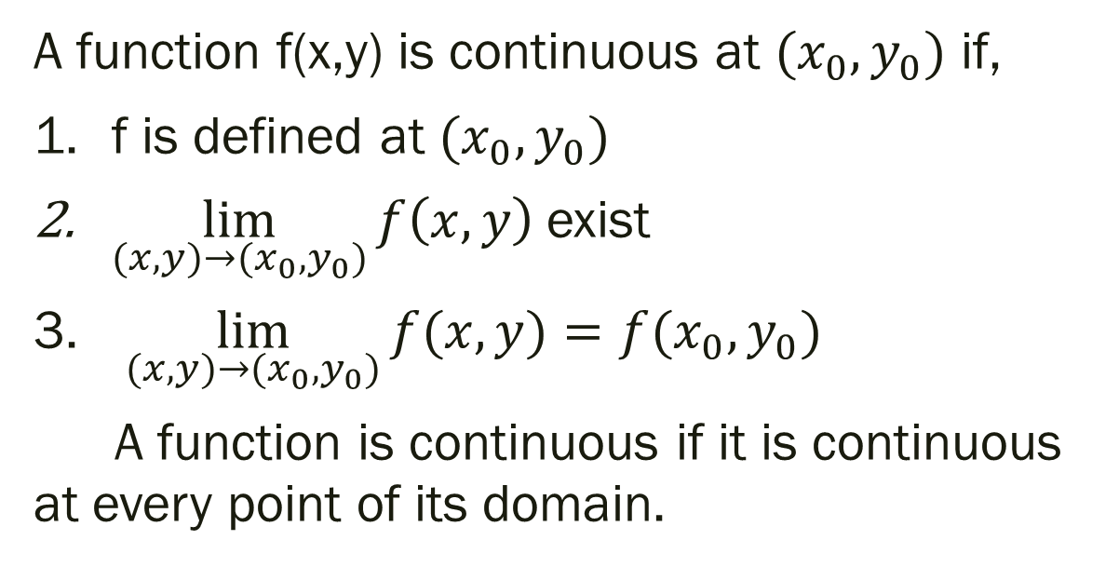
Continuous functions of 2 variables :
A function f(x,y) is continuous at $(x_{0},y_{0})$ if,
f is defined at $(x_{0},y_{0})$
$\lim_{(x,y)→(x_{0},y_{0})}{f\left(x,y\right) }$exist
$\lim_{(x,y)→(x_{0},y_{0})}{f(x,y)}=f(x_{0},y_{0})$
A function is continuous if it is continuous at every point of its domain.

Slide 15

Example :
Show that, $f\left(x,y\right)=\left\{\begin{aligned}\frac{2xy}{x^{2}+y^{2}}, (x,y)≠(0,0) \\ 0 \left(x,y\right)=(0,0)\end{aligned}\right.$

Slide 16
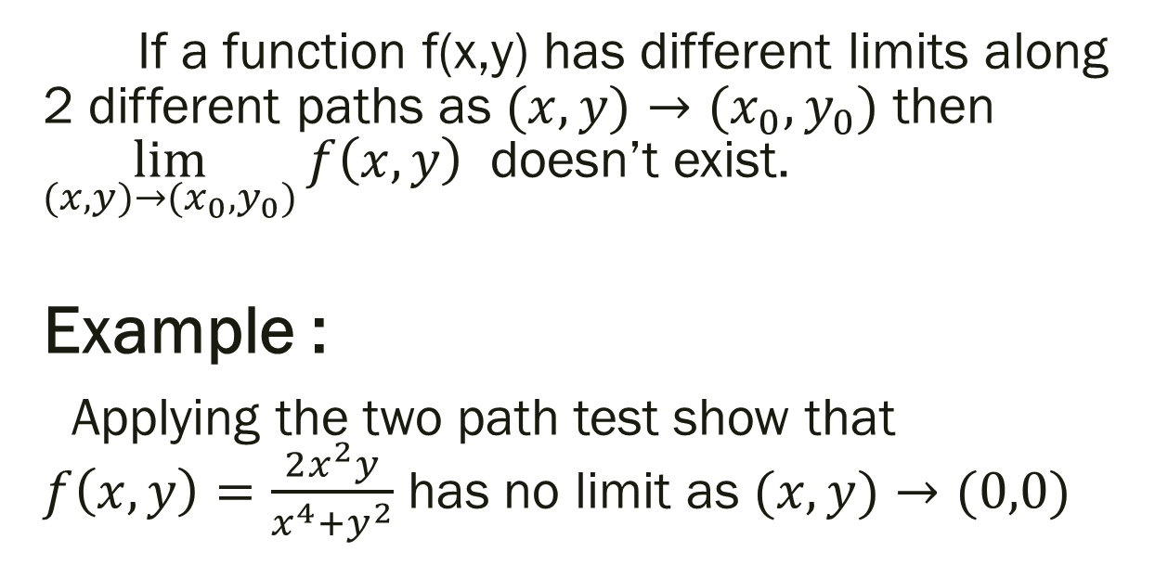
Two-path test for non-existence of a limit :
If a function f(x,y) has different limits along 2 different paths as $(x,y)→(x_{0},y_{0})$ then $\lim_{(x,y)→(x_{0},y_{0})}{f\left(x,y\right) }$ doesn’t exist.
Example :
Applying the two path test show that $f\left(x,y\right)=\frac{2x^{2}y}{x^{4}+y^{2}}$ has no limit as $(x,y)→(0,0)$

