Slide 1

RING THOERY
PAPER - V
UNIT : IV

Slide 2
Definition:
A non-empty set R is said to be to a ring if there are defined two operations denoted by ‘+’ and ‘ . ’ subject to the following conditions for all a, b, c ϵ R
I. R is an abelian group with respect to an addition
1. a+ b ϵ R (closure law)
2. a + (b + c) = (a + b) + c (associative law)
3. There is an element zero in R such that a+0=0+a=a(identity law)
(zero is called as additive identity )
4. For every a ϵ R, -a ϵ R such that a + (-a) = (-a) + a = 0 (inverse law)
5. a + b = b + a (commutative law )

Slide 3
II. R is a semigroup with respect to multiplication
1. a.b ϵ R (closure law)
2. a(bc) = (ab)c (associative law)
III. Distributive property (law)
(a + b)c = a.c + b.c
a(b+c) = a.b + a.c

Slide 4
Definitions :
R is called a ring with unit element if there exist an element e ϵ R such that ae = ea = a, Ɐ a ϵ R
R is called a commutative ring if ab = ba Ɐ a, b ϵ R

Slide 5
Examples:
R = Z, the set of integers is a ring for usual addition and multiplication also Z is a commutative ring with unit element 1.
R = 2Z, the set of even integer is also a ring with usual addition and multiplication. It is a commutative ring without unit element.
Let R = C[0,1] be the set of all real valued continuous functions on [0,1] defined addition and multiplication as
(x + y)(t) = x(t) + y((t) and (xy)(t) = x(t)y(t), tϵ[0,1]
R is a commutative ring with unit element as a constant function 1

Slide 6
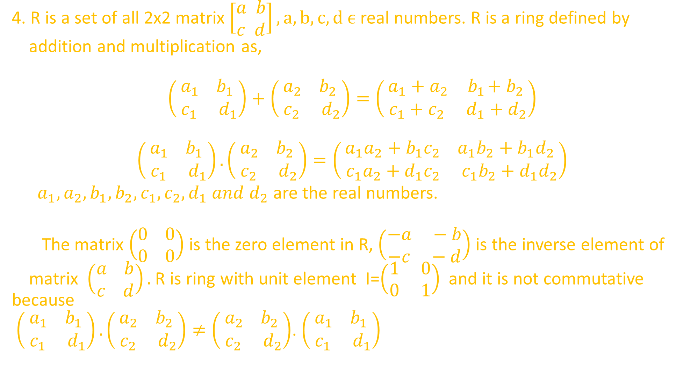
4. R is a set of all 2x2 matrix $\left[\begin{aligned}a b \\ c d\end{aligned}\right], a,b,c,d ϵ$ real numbers. R is a ring defined by
addition and multiplication as,
$$\left(\begin{aligned}a_{1} { b}_{1} \\ c_{1} d_{1}\end{aligned}\right)+\left(\begin{aligned}a_{2} { b}_{2} \\ c_{2} d_{2}\end{aligned}\right)=\left(\begin{aligned}a_{1}+a_{2} { b}_{1}+b_{2} \\ c_{1}+c_{2} d_{1}+d_{2}\end{aligned}\right)$$
$$\left(\begin{aligned}a_{1} { b}_{1} \\ c_{1} d_{1}\end{aligned}\right).\left(\begin{aligned}a_{2} { b}_{2} \\ c_{2} d_{2}\end{aligned}\right)=\left(\begin{aligned}a_{1}a_{2}+{b_{1}c}_{2} { a}_{1}b_{2}+b_{1}d_{2} \\ c_{1}a_{2}+d_{1}c_{2} c_{1}b_{2}+d_{1}d_{2}\end{aligned}\right)$$
$a_{1}, a_{2}, b_{1}, b_{2}, c_{1}, c_{2}, d_{1} and d_{2}$ are the real numbers.
The matrix $\left(\begin{aligned}0 0 \\ 0 0\end{aligned}\right)$ is the zero element in R, $\left(\begin{aligned}−a −b \\ −c −d\end{aligned}\right)$ is the inverse element of
matrix $\left(\begin{aligned}a b \\ c d\end{aligned}\right).$R is ring with unit element I=$\left(\begin{aligned}1 0 \\ 0 1\end{aligned}\right)$and it is not commutative because
$\left(\begin{aligned}a_{1} { b}_{1} \\ c_{1} d_{1}\end{aligned}\right).\left(\begin{aligned}a_{2} { b}_{2} \\ c_{2} d_{2}\end{aligned}\right)≠\left(\begin{aligned}a_{2} { b}_{2} \\ c_{2} d_{2}\end{aligned}\right)$.$\left(\begin{aligned}a_{1} { b}_{1} \\ c_{1} d_{1}\end{aligned}\right)$

Slide 7
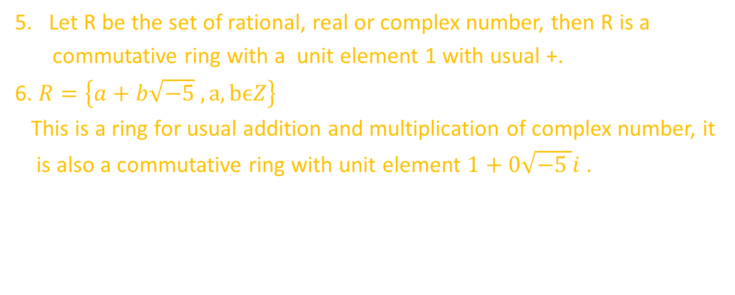
Let R be the set of rational, real or complex number, then R is a
commutative ring with a unit element 1 with usual +.
6. $R=\left\{a+b\sqrt{−5} , a,bϵZ\right\}$
This is a ring for usual addition and multiplication of complex number, it
is also a commutative ring with unit element $1+0\sqrt{−5 }i$.

Slide 8
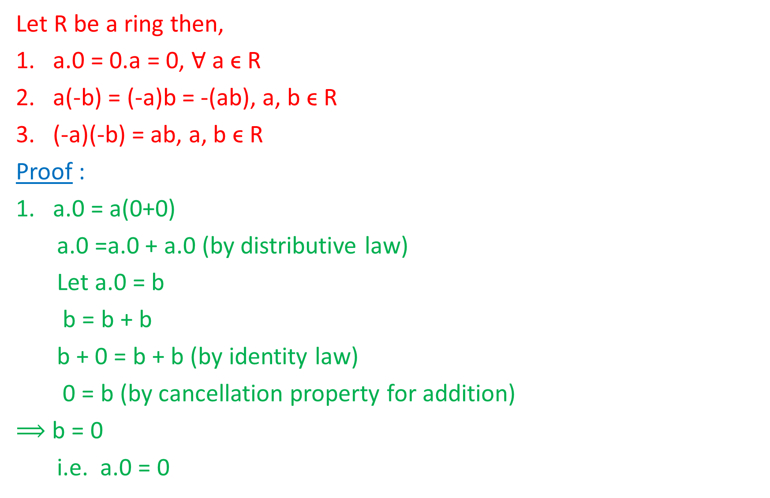
Proposition:
Let R be a ring then,
a.0 = 0.a = 0, Ɐ aϵ R
a(-b) = (-a)b = -(ab), a, bϵ R
(-a)(-b) = ab, a, b ϵ R
Proof :
a.0 = a(0+0)
a.0 =a.0 + a.0 (by distributive law)
Let a.0 = b
b = b + b
b + 0 = b + b (by identity law)
0 = b (by cancellation property for addition)
$⟹$ b = 0
i.e. a.0 = 0

Slide 9
Similarly 0.a = 0
Therefore, a.0 = 0.a =0
2. 0 = 0.b (from property 1)
0 = [a + (-a)]b (by inverse law for addition)
0 = a.b + (-a).b (by distributive law)
Therefore, (-a)b additive inverse of a.b
-(ab) = (-a)b
Therefore, (-a)b = -(ab)
Similarly, a(-b) = -(ab)
3. (-a)(-b) = -(ax) (let –b = x) [by property 2]
= -[a(-b)]
= -[-ab] (by Property 2)
(-a)(-b) = ab

Slide 10
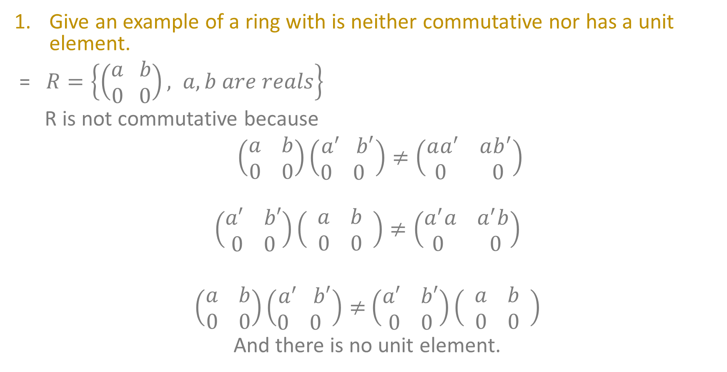
Exercises:
Give an example of a ring with is neither commutative nor has a unit element.
= $R=\left\{\left(\begin{aligned}a b \\ 0 0\end{aligned}\right), a,b are reals\right\}$
R is not commutative because
$$\left(\begin{aligned}a b \\ 0 0\end{aligned}\right)\left(\begin{aligned}a^{′} b′ \\ 0 0 \end{aligned}\right)≠\left(\begin{aligned}aa^{′} ab^{′} \\ 0 0\end{aligned}\right)$$
$$\left(\begin{aligned}a′ b′ \\ 0 0\end{aligned}\right)\left(\begin{aligned}a b \\ 0 0 \end{aligned}\right)≠\left(\begin{aligned}a^{′}a a^{′}b \\ 0 0\end{aligned}\right)$$
$$\left(\begin{aligned}a b \\ 0 0\end{aligned}\right)\left(\begin{aligned}a^{′} b′ \\ 0 0 \end{aligned}\right)≠\left(\begin{aligned}a′ b′ \\ 0 0\end{aligned}\right)\left(\begin{aligned}a b \\ 0 0 \end{aligned}\right)$$
And there is no unit element.

Slide 11
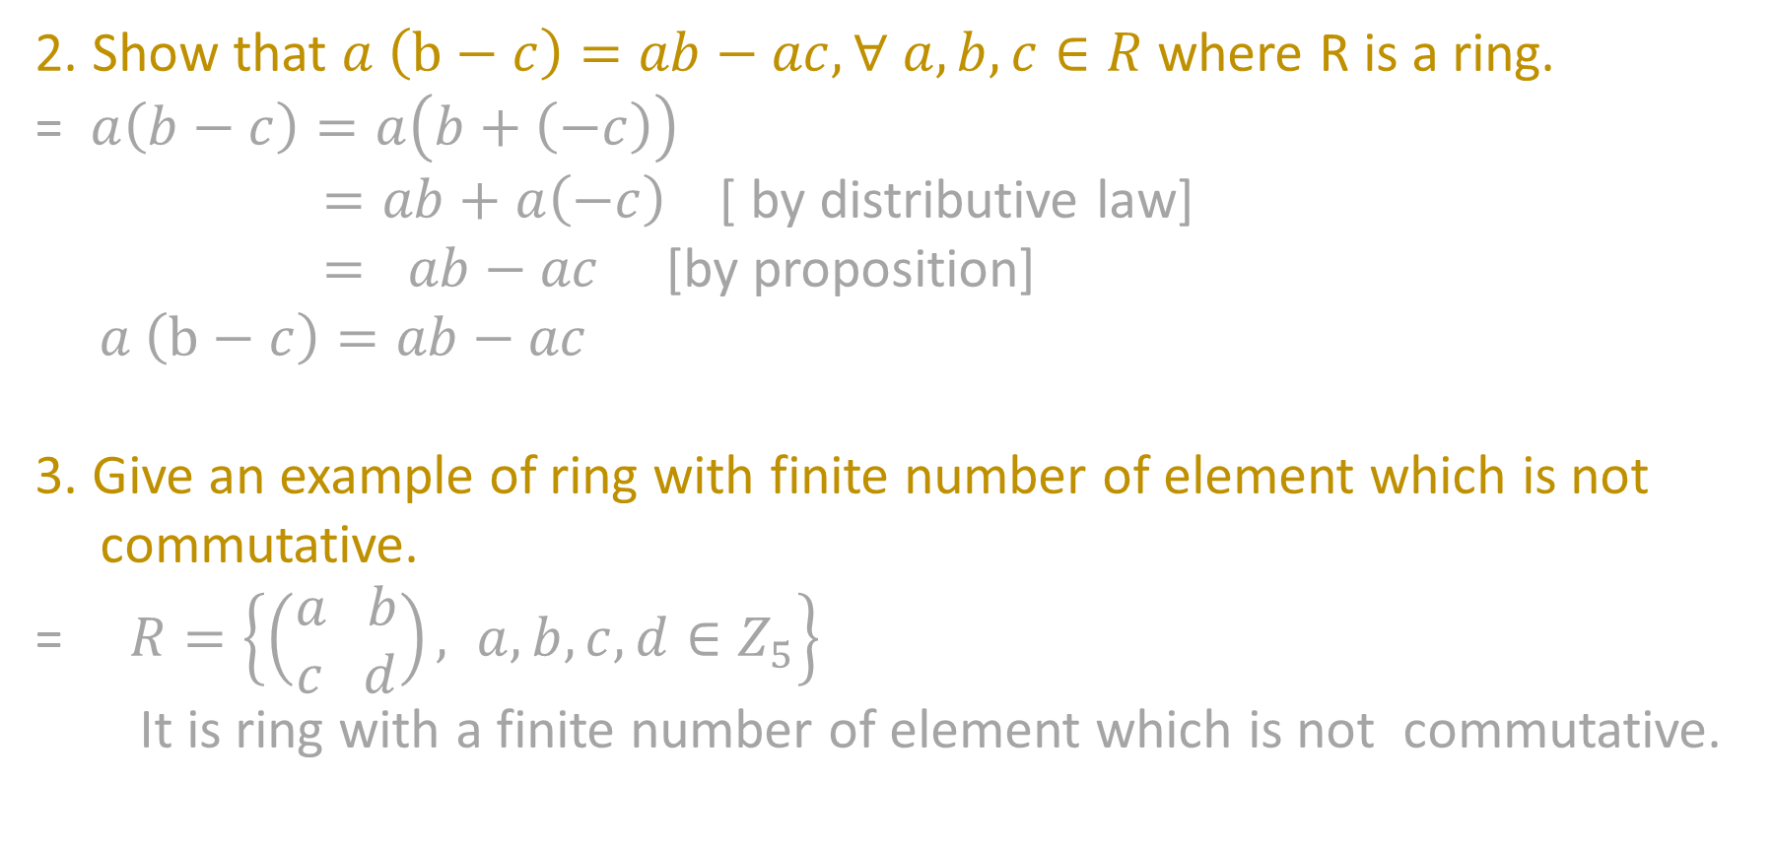
2. Show that $a \left(b−c\right)=ab−ac,∀ a,b,c∈R$ where R is a ring.
= $a\left(b−c\right)=a\left(b+\left(−c\right)\right)$
$=ab+a\left(−c\right)$ [ by distributive law]
$= ab−ac$ [by proposition]
$$a \left(b−c\right)=ab−ac$$
3.Give an example of ring with finite number of element which is not
commutative.
= $R=\left\{\left(\begin{aligned}a b \\ c d\end{aligned}\right), a,b,c,d∈Z_{5}\right\}$
It is ring with a finite number of element which is not commutative.

Slide 12
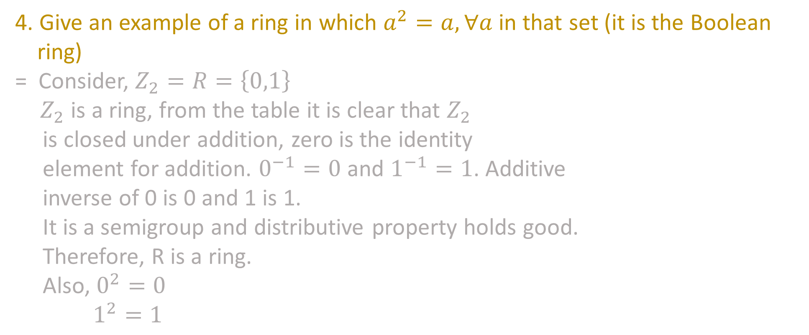
4. Give an example of a ring in which $a^{2}=a,∀a$in that set (it is the Boolean
ring)
= Consider, $Z_{2}=R=\left\{0,1\right\}$
$Z_{2}$ is a ring, from the table it is clear that $Z_{2}$
is closed under addition, zero is the identity
element for addition. $0^{−1}=0$ and $1^{−1}=1$. Additive
inverse of 0 is 0 and 1 is 1.
It is a semigroup and distributive property holds good.
Therefore, R is a ring.
Also, $0^{2}=0$
$$1^{2}=1$$
+ | 0 | 1
0 | 0 | 1
1 | 1 | 0
X | 0 | 1
0 | 0 | 0
1 | 0 | 1

Slide 13
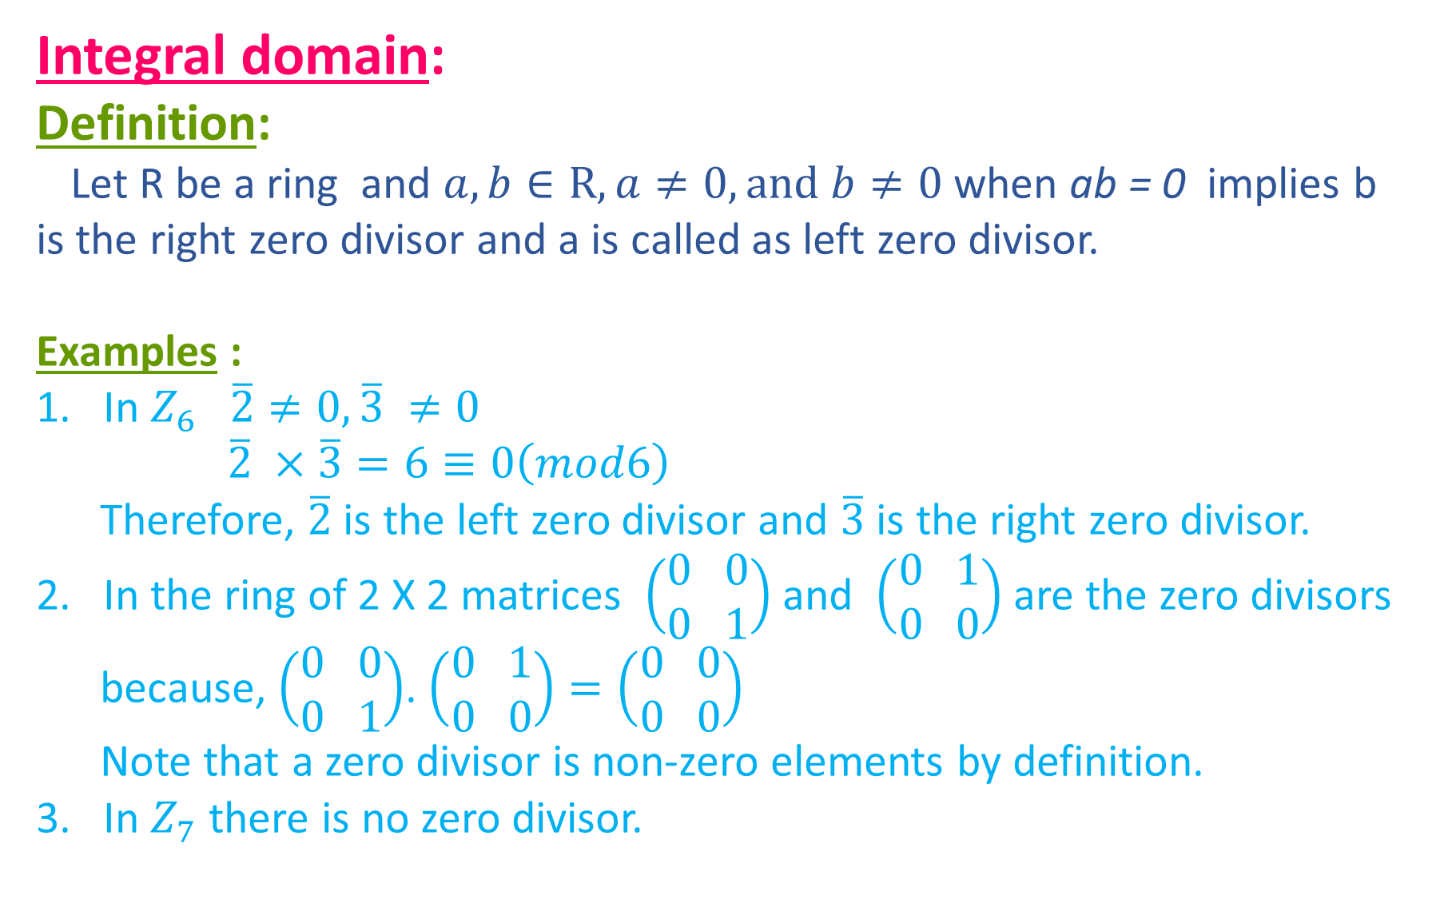
Integral domain:
Definition:
Let R be a ring and $a,b∈R, a≠0,and b≠0$ when ab = 0 implies b is the right zero divisor and a is called as left zero divisor.
Examples :
In $Z_{6} \overline{2}≠0,\overline{3} ≠0$
$$\overline{2} ×\overline{3}=6≡0\left(mod6\right)$$
Therefore, $\overline{2}$ is the left zero divisor and $\overline{3}$ is the right zero divisor.
In the ring of 2 X 2 matrices $\left(\begin{aligned}0 0 \\ 0 1\end{aligned}\right)$and $\left(\begin{aligned}0 1 \\ 0 0\end{aligned}\right)$are the zero divisors
because, $\left(\begin{aligned}0 0 \\ 0 1\end{aligned}\right)$.$\left(\begin{aligned}0 1 \\ 0 0\end{aligned}\right)=\left(\begin{aligned}0 0 \\ 0 0\end{aligned}\right)$
Note that a zero divisor is non-zero elements by definition.
3. In $Z_{7}$ there is no zero divisor.

Slide 14
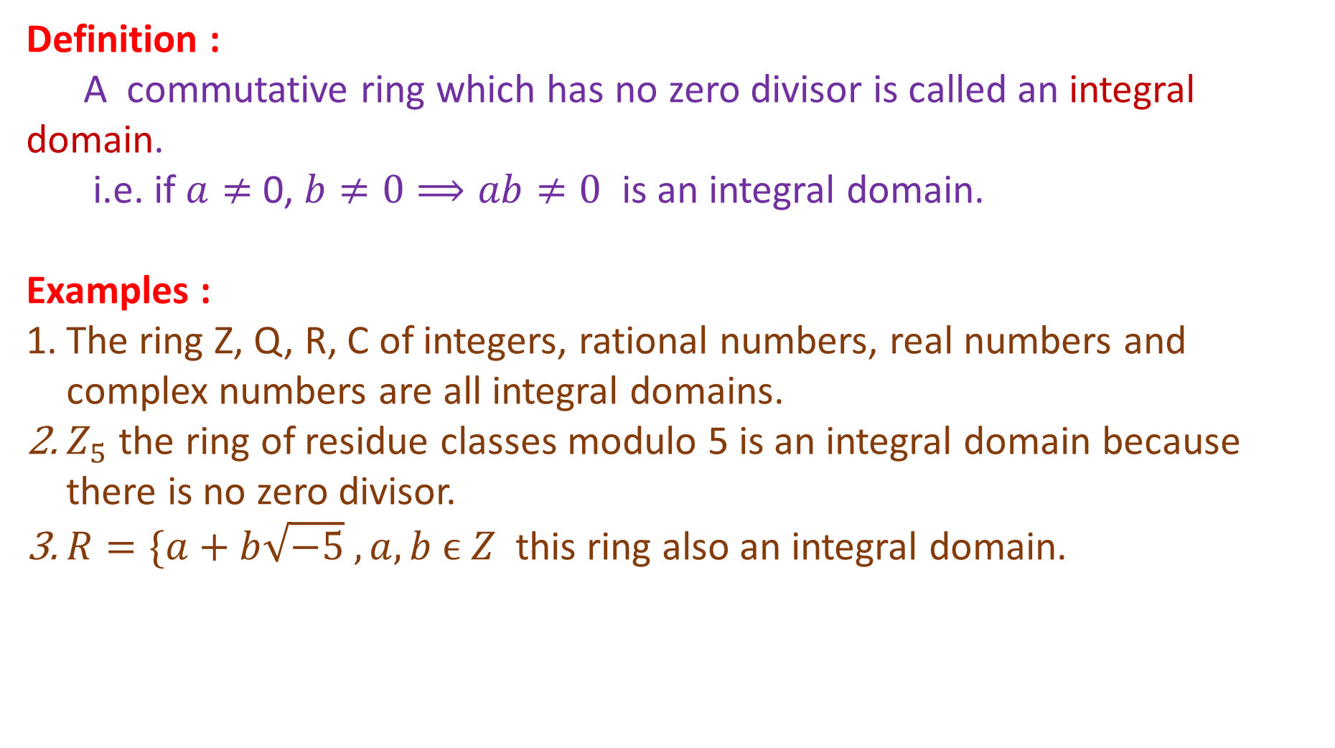
Definition :
A commutative ring which has no zero divisor is called an integral domain.
i.e. if $a≠$ 0, $b≠0⟹ab≠0$ is an integral domain.
Examples :
The ring Z, Q, R, C of integers, rational numbers, real numbers and complex numbers are all integral domains.
$Z_{5}$ the ring of residue classes modulo 5 is an integral domain because there is no zero divisor.
$R=\{a+b\sqrt{−5} , a,b ϵ Z$ this ring also an integral domain.

Slide 15
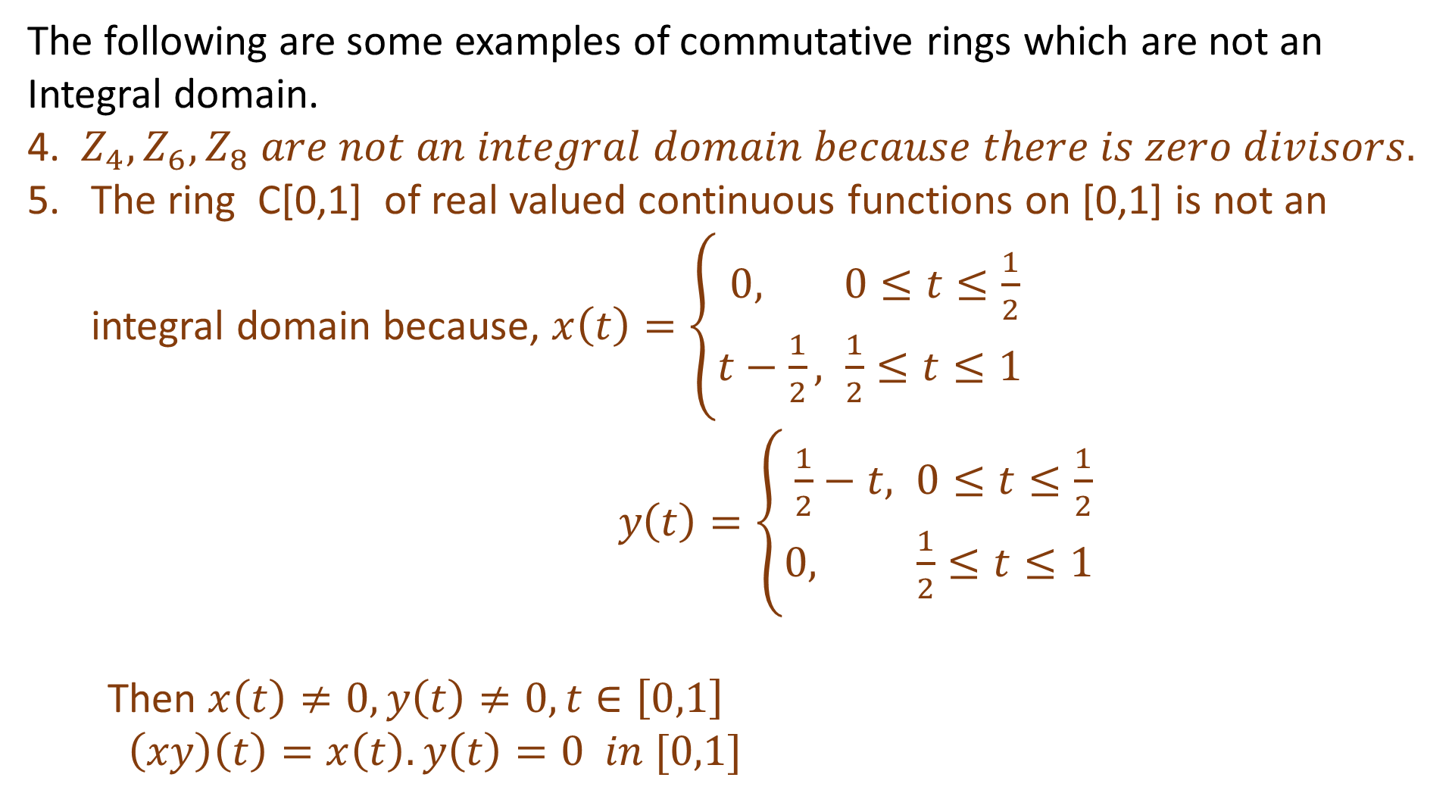
The following are some examples of commutative rings which are not an Integral domain.
4. $Z_{4}, Z_{6}, Z_{8} are not an integral domain because there is zero divisors.$
The ring C[0,1] of real valued continuous functions on [0,1] is not an integral domain because, $x\left(t\right)=\left\{\begin{aligned}0, 0≤t≤\frac{1}{2} \\ t−\frac{1}{2}, \frac{1}{2}≤t≤1 \end{aligned}\right.$
$$y\left(t\right)=\left\{\begin{aligned}\frac{1}{2}−t, 0≤t≤\frac{1}{2} \\ 0, \frac{1}{2}≤t≤1 \end{aligned}\right.$$
Then $x\left(t\right)≠0,y\left(t\right)≠0, t∈\left[0,1\right]$
$$\left(xy\right)\left(t\right)=x\left(t\right).y\left(t\right)=0 in [0,1]$$

Slide 16
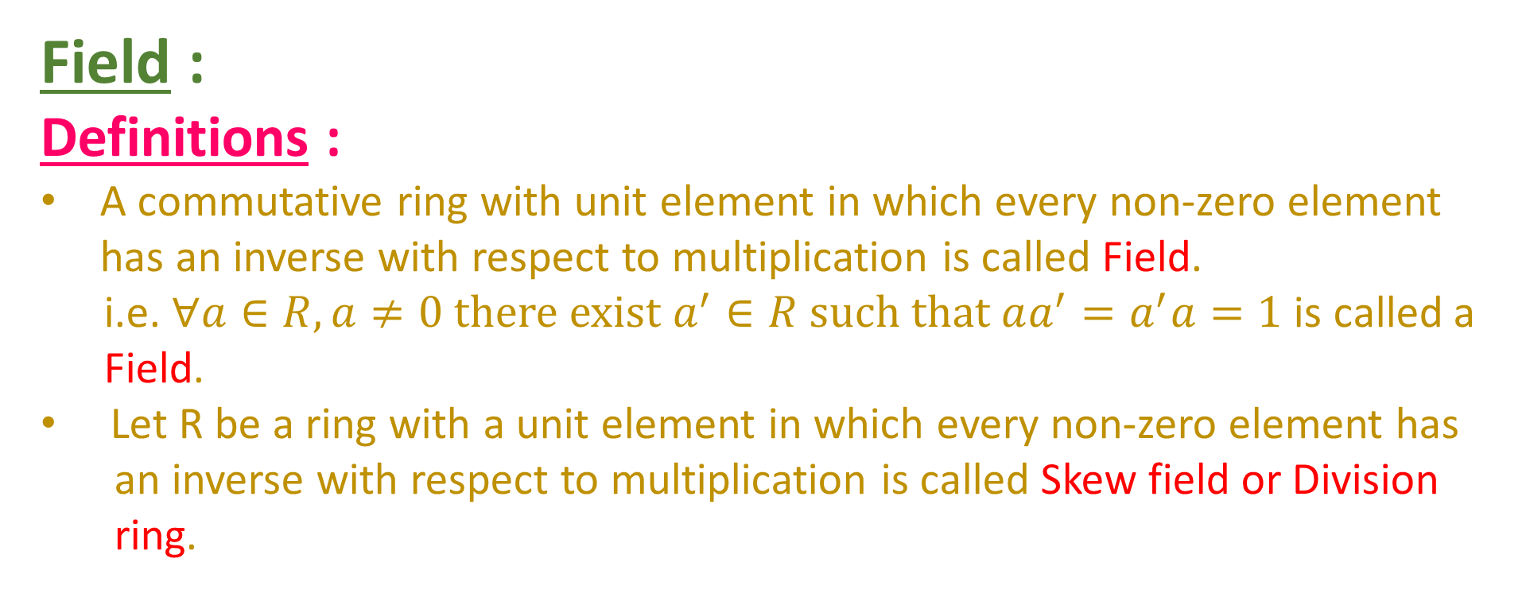
Field :
Definitions :
A commutative ring with unit element in which every non-zero element has an inverse with respect to multiplication is called Field.
i.e. $∀a∈R, a≠0 there exist a^{′}∈R such that aa^{′}=a^{′}a=1$ is called a
Field.
Let R be a ring with a unit element in which every non-zero element has
an inverse with respect to multiplication is called Skewfieldor Division
ring.

Slide 17
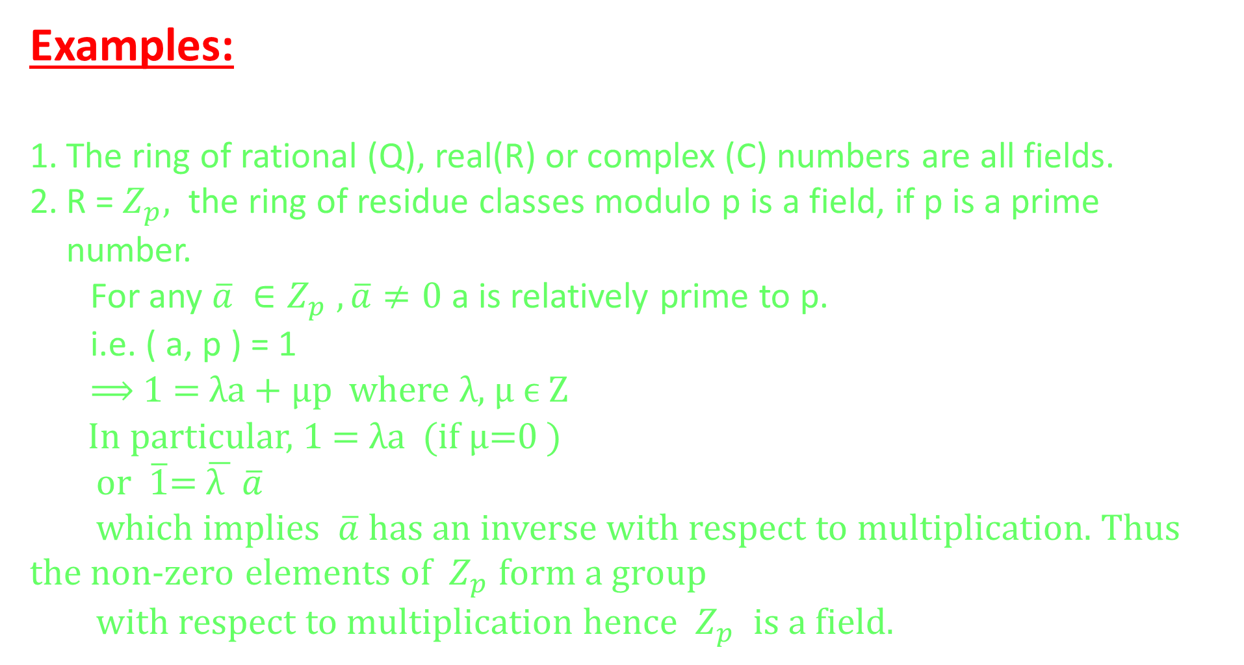
Examples:
The ring of rational (Q), real(R) or complex (C) numbers are all fields.
R = $Z_{p},$ the ring of residue classes modulo p is a field, if p is a prime number.
For any $\overline{a} ∈Z_{p} , \overline{a}≠0$ a is relatively prime to p.
i.e. ( a, p ) = 1
⟹ 1 = λa + µp where λ, µϵ Z
In particular, 1 = λa (if µ=0 )
or $\overline{1}$= $\overline{\text{λ} } \overline{a}$
which implies $\overline{a}$ has an inverse with respect to multiplication. Thus the non-zero elements of $Z_{p}$ form a group
with respect to multiplication hence $Z_{p}$ is a field.

Slide 18
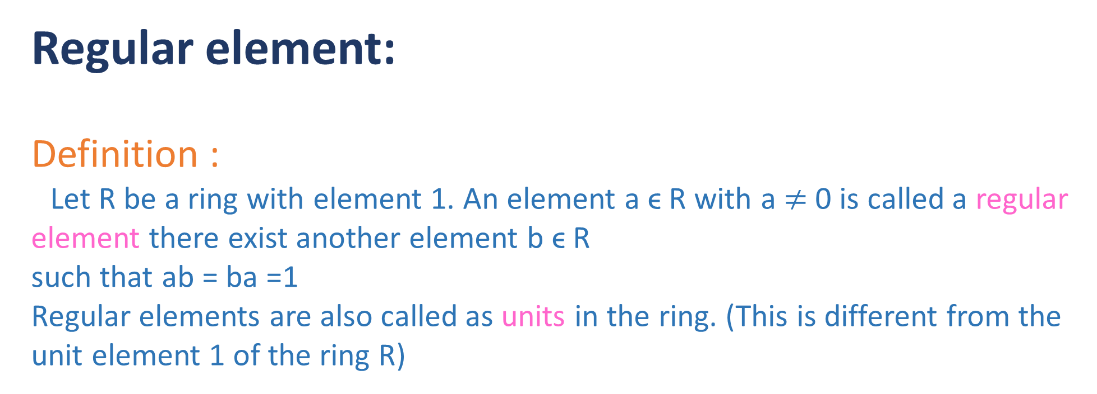
Regular element:
Definition :
Let R be a ring with element 1. An element a ϵ R with a $≠$ 0 is called a regular element there exist another element b ϵR
such that ab = ba =1
Regular elements are also called as units in the ring. (This is different from the unit element 1 of the ring R)

Slide 19
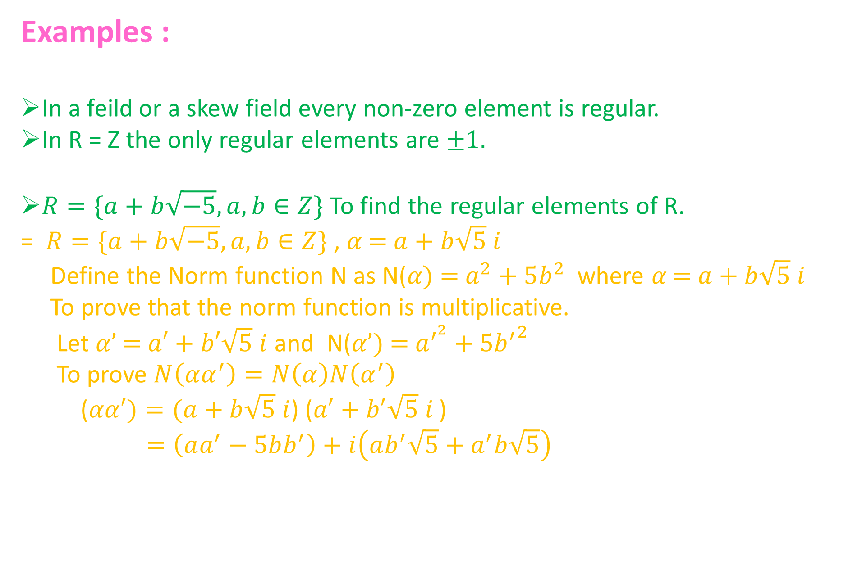
Examples :
In a feild or a skew field every non-zero element is regular.
In R = Z the only regular elements are $±1.$
$R=\{a+b\sqrt{−5}, a,b∈Z\}$ To find the regular elements of R.
= $R=\{a+b\sqrt{−5}, a,b∈Z\}$, 𝛼 = $a+b\sqrt{5} i$
Define the Norm function N as N(𝛼) = $a^{2}+5b^{2}$ where 𝛼 = $a+b\sqrt{5} i$
To prove that the norm function is multiplicative.
Let 𝛼’ = $a′+b′\sqrt{5} i$ and N(𝛼’) = $a^{′^{2}}+5{b^{′}}^{2}$
To prove $N\left(αα^{′}\right)=N\left(α\right)N\left(α^{′}\right)$
($αα′)=(a+b\sqrt{5} i$) ($a′+b′\sqrt{5} i$)
$$=\left(aa^{′}−5bb^{′}\right)+i\left(ab^{′}\sqrt{5}+a^{′}b\sqrt{5}\right)$$

Slide 20
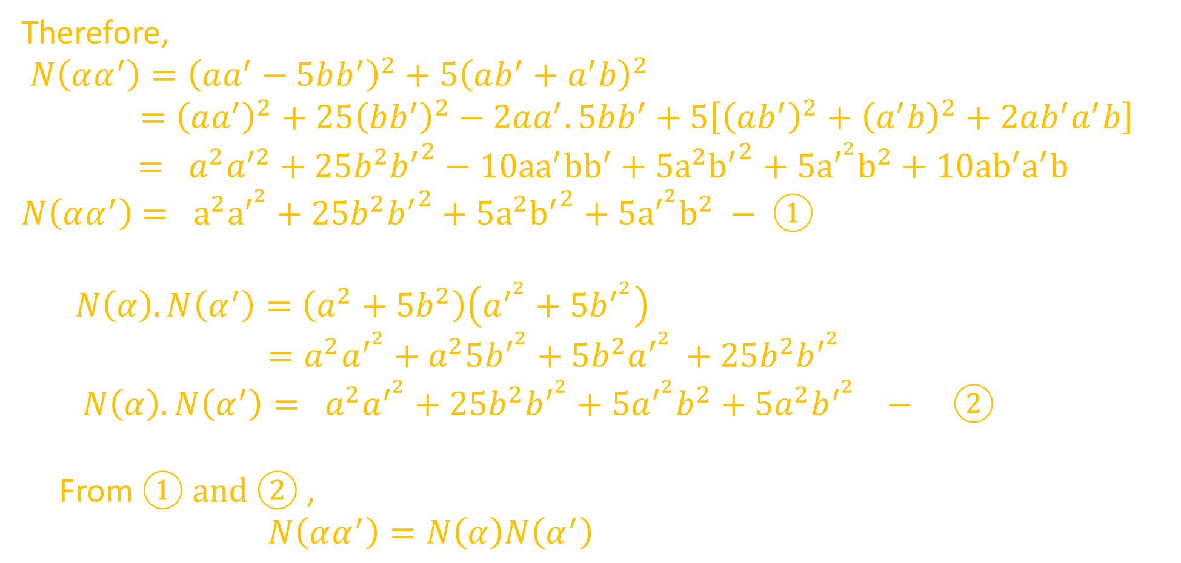
Therefore,
$$N\left(αα^{′}\right)={\left(aa^{′}−5bb^{′}\right)}^{2}+5{\left(ab^{′}+a^{′}b\right)}^{2}$$
$$={\left(aa^{′}\right)}^{2}+25{\left(bb^{′}\right)}^{2}−2aa^{′}.5bb^{′}+5\left[{\left(ab^{′}\right)}^{2}+{\left(a^{′}b\right)}^{2}+2ab^{′}a^{′}b\right] = a^{2}a^{′2}+25b^{2}{b^{′}}^{2}−10{aa}^{′}{bb}^{′}+5a^{2}{b^{′}}^{2}+5a^{′^{2}}b^{2}+10{ab}^{′}a^{′}b$$
$$N\left(αα^{′}\right)= a^{2}a^{′^{2}}+25b^{2}{b^{′}}^{2}+5a^{2}{b^{′}}^{2}+5a^{′^{2}}b^{2} − ①$$
  $$N\left(α\right).N\left(α^{′}\right)=\left(a^{2}+5b^{2}\right)\left(a^{′^{2}}+{5b}^{′^{2}}\right)$$
  $$=a^{2}a^{′^{2}}+a^{2}5b^{′^{2}}+5b^{2}a^{′^{2} }+25b^{2}b^{′^{2}}$$
  $$N\left(α\right).N\left(α^{′}\right)= a^{2}a^{′^{2}}+25b^{2}b^{′^{2}}+5a^{′^{2}}b^{2}+5a^{2}b^{′^{2}} − ②$$
  From $① and ②$ ,
  $$N\left(αα^{′}\right)=N\left(α\right)N\left(α^{′}\right)$$

Slide 21
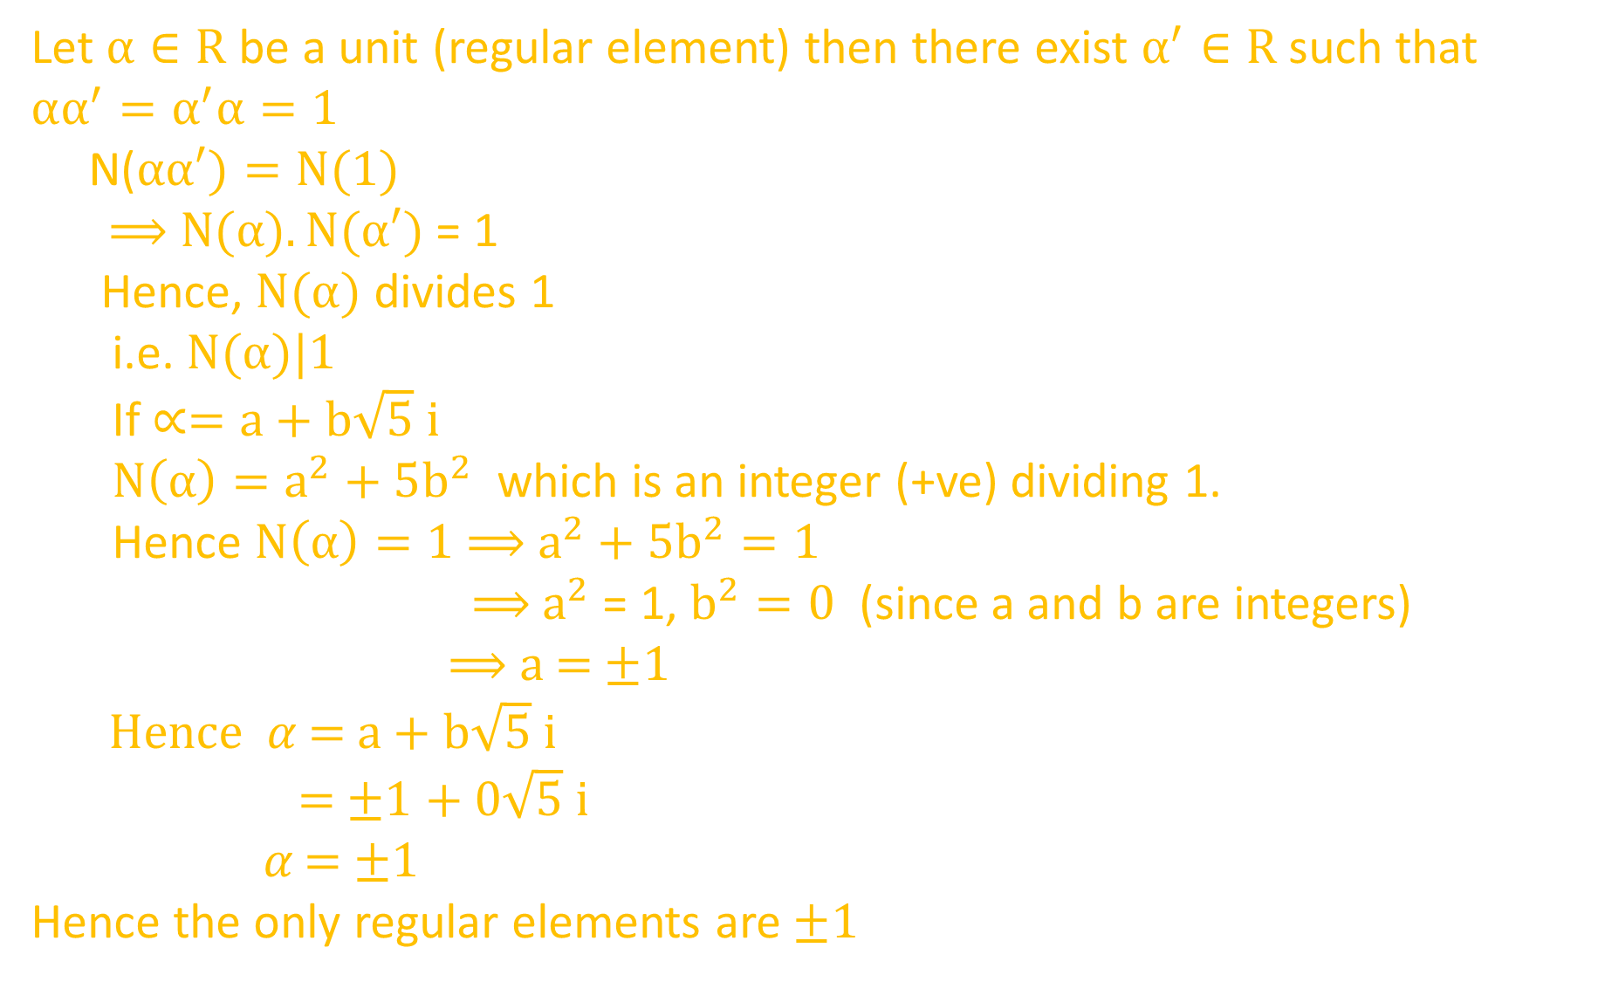
Let $α∈R$ be a unit (regular element) then there exist $α^{′}∈R$ such that $αα^{′}=α^{′}α=1$
N($αα′)=N(1)$
⟹ $N(α).N(α′)$ = 1
Hence, $N(α)$ divides 1
i.e. $N(α)|1$
If $∝=a+b\sqrt{5} i$
$N\left(α\right)=a^{2}+5b^{2}$ which is an integer (+ve) dividing 1.
Hence $N\left(α\right)=1$⟹ $a^{2}+5b^{2}=1$
⟹ $a^{2}$ = 1, $b^{2}=0$ (since a and b are integers)
⟹ a = $±1$
Hence 𝛼 = $a+b\sqrt{5} i$
= $±1+ 0\sqrt{5} i$
𝛼 = $±1$
Hence the only regular elements are $±1$

Slide 22
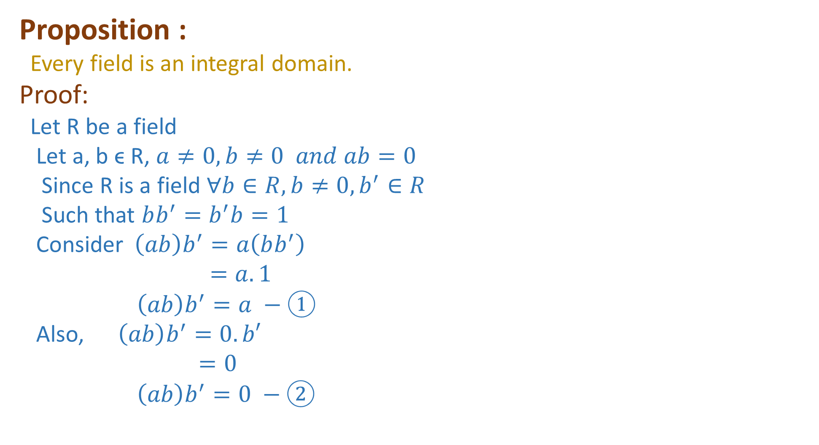
Proposition :
Every field is an integral domain.
Proof:
Let R be a field
Let a, b ϵ R, $a≠0, b≠0 and ab=0$
Since R is a field $∀b∈R, b≠0,b^{′}∈R$
Such that $bb^{′}=b^{′}b=1$
Consider$\left(ab\right)b^{′}=a\left(bb^{′}\right)$
$$=a.1$$
$$\left(ab\right)b^{′}=a −①$$
Also, $\left(ab\right)b^{′}=0.b′$
$$=0$$
$$\left(ab\right)b^{′}=0 −②$$

Slide 23
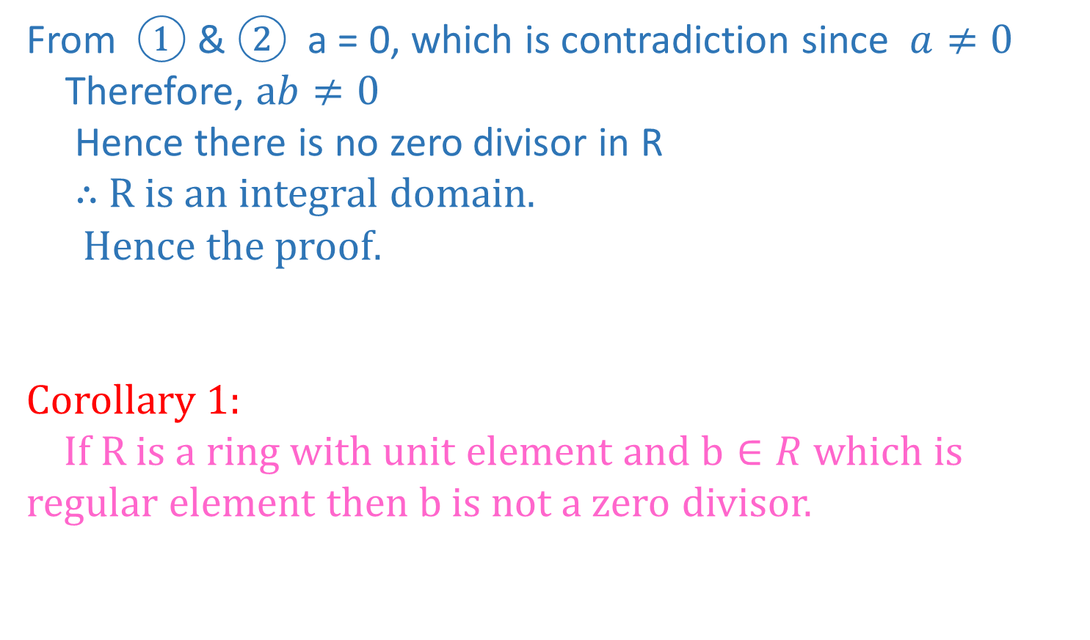
From $①$&$②$ a = 0, which is contradiction since $a≠0$
Therefore, $ab≠0$
Hence there is no zero divisor in R
∴ R is an integral domain.
Hence the proof.
Corollary 1:
If R is a ring with unit element and $b∈R$ which is regular element then b is not a zero divisor.

Slide 24
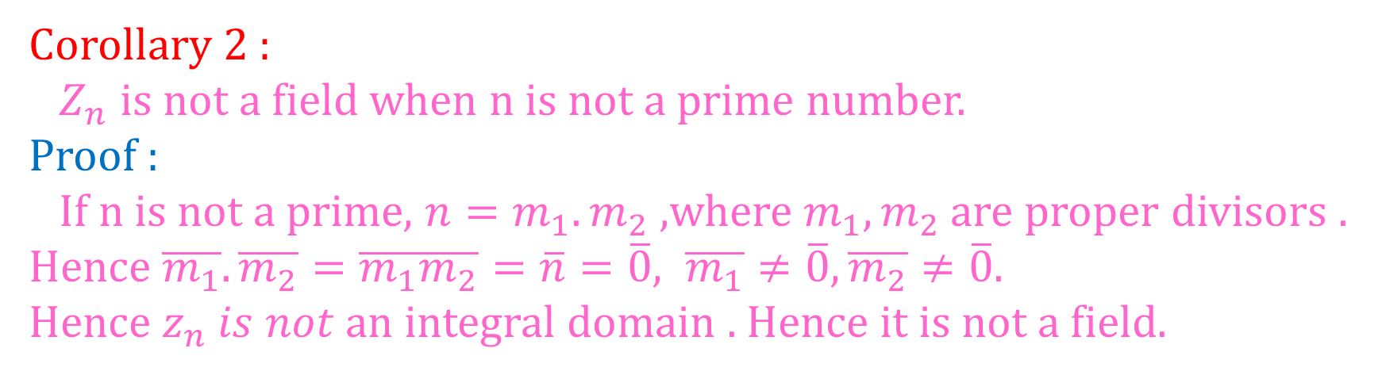
Corollary 2 :
$Z_{n}$ is not a field when n is not a prime number.
Proof :
If n is not a prime, $n=m_{1}.m_{2}$,where $m_{1},m_{2}$are proper divisors . Hence $\overline{m_{1}}.\overline{m_{2}}=\overline{m_{1}m_{2}}=\overline{n}=\overline{0}, \overline{m_{1}}≠\overline{0},\overline{m_{2}}≠\overline{0}.$
Hence $z_{n} is not$an integral domain . Hence it is not a field.

Slide 25
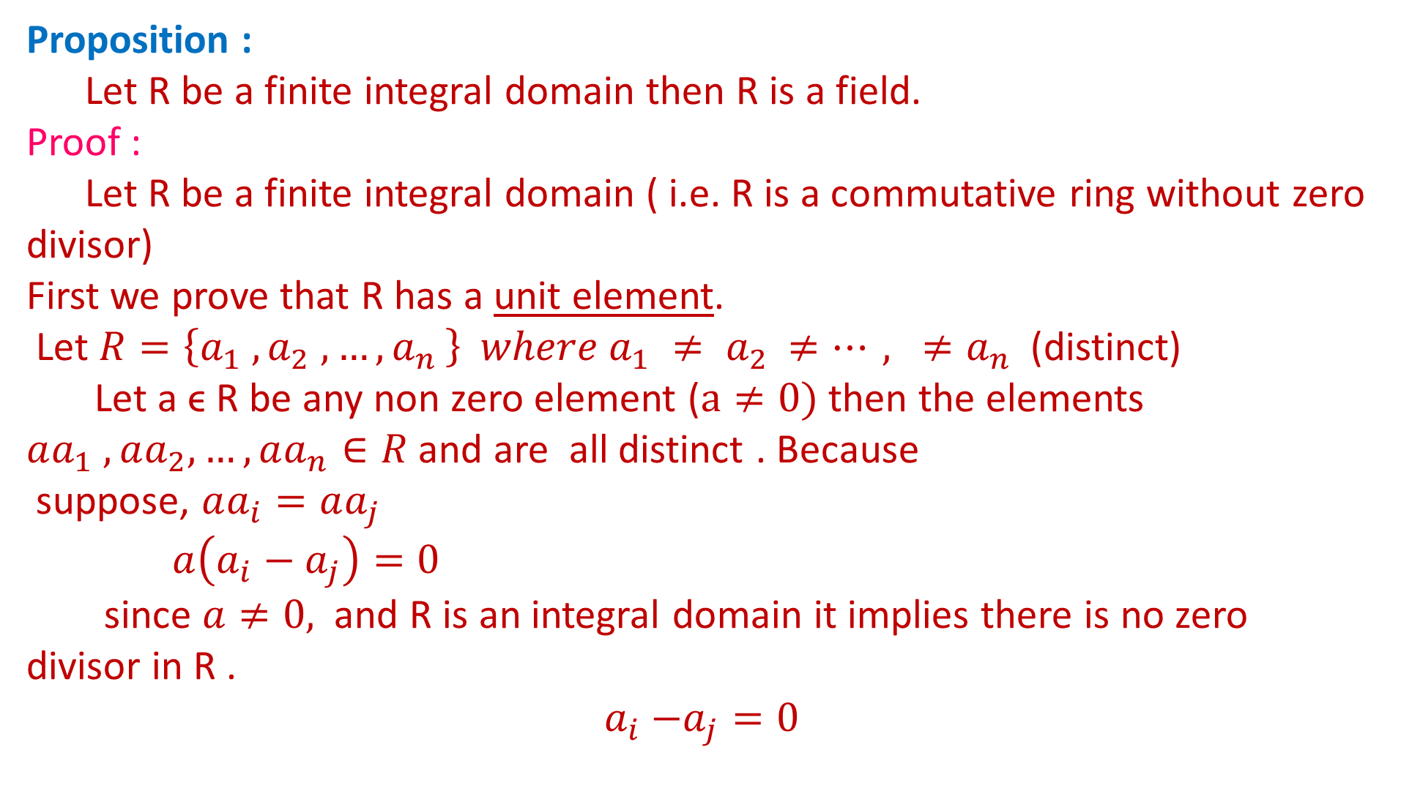
Proposition:
Let R be a finite integral domain then R is a field.
Proof :
Let R be a finite integral domain ( i.e. R is a commutative ring without zero divisor)
First we prove that R has a unit element.
Let $R=\left\{a_{1} , a_{2} , {…,a}_{n}\right\} where a_{1} ≠ a_{2 }≠…, ≠a_{n}$(distinct)
Let a ϵ R be any non zero element ($a≠0)$ then the elements $aa_{1} ,aa_{2},…,aa_{n}∈R$ and are all distinct . Because
suppose, $aa_{i}=aa_{j}$
$$a\left(a_{i}−a_{j}\right)=0$$
since $a≠0,$ and R is an integral domain it implies there is no zero divisor in R .
$${ a}_{i} −a_{j}=0$$

Slide 26
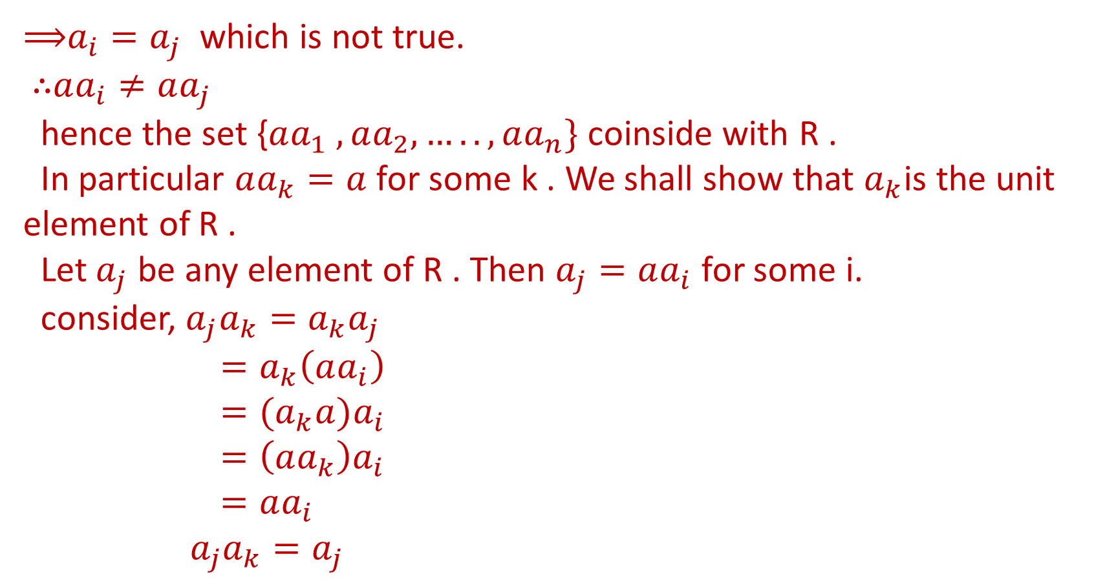
⟹$a_{i}=a_{j}$ which is not true.
∴$aa_{i}≠aa_{j}$
hence the set {$aa_{1} , aa_{2}, …..,aa_{n}\}$ coinside with R .
In particular $aa_{k}=a$ for some k . We shall show that $a_{k}$is the unit element of R .
Let $a_{j}$ be any element of R . Then $a_{j}=aa_{i}$ for some i.
consider, $a_{j}a_{k}=a_{k}a_{j}$
$$=a_{k}\left(aa_{i}\right)$$
$$={(a}_{k}a)a_{i}$$
$$=\left(aa_{k}\right)a_{i}$$
$$=aa_{i}$$
$${ a}_{j}a_{k}=a_{j}$$

Slide 27
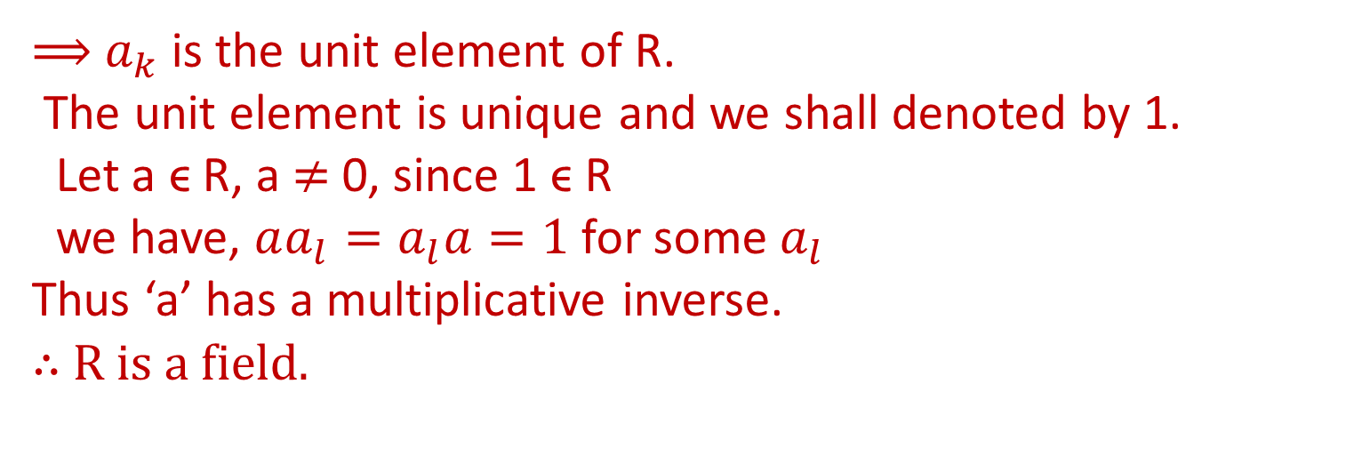
⟹ $a_{k}$ is the unit element of R.
The unit element is unique and we shall denoted by 1.
Let a ϵ R, a$≠$ 0, since 1 ϵ R
we have, $aa_{l}=a_{l}a=1$for some $a_{l}$
Thus ‘a’ has a multiplicative inverse.
∴ R is a field.

Slide 28
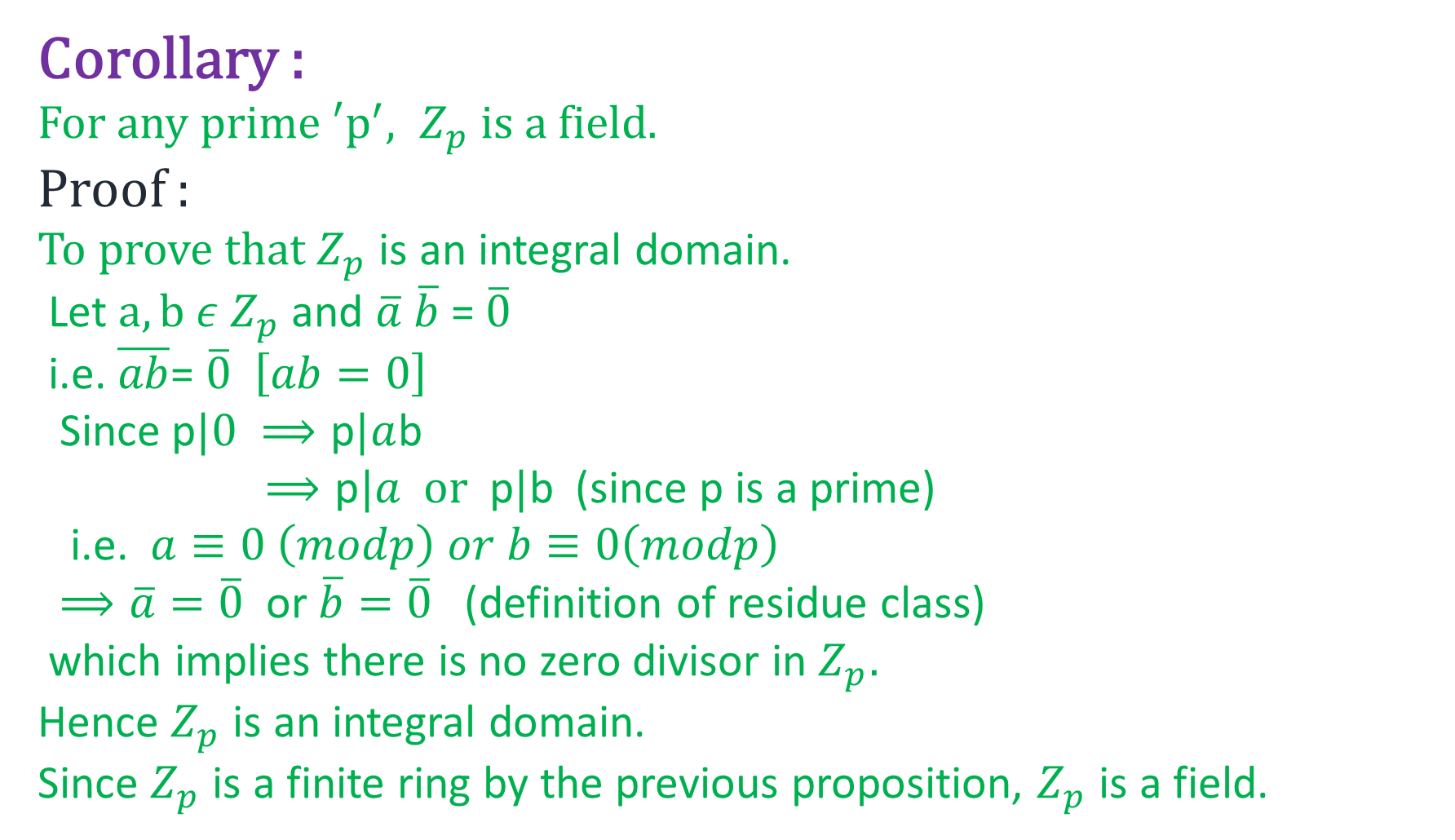
Corollary :
For any prime $′p^{′}, Z_{p}$is a field.
Proof :
To prove that $Z_{p}$ is an integral domain.
Let $a,b ε{ Z}_{p}$and $\overline{a} \overline{b}$ = $\overline{0}$
i.e. $\overline{ab}$= $\overline{0} \left[ab=0\right]$
Since p$|0 ⟹\text{p}|a$b
$⟹\text{p}|a or \text{p}|\text{b}$ (since p is a prime)
i.e. $a≡0 \left(modp\right) or b≡0\left(modp\right)$
$⟹\overline{a}=\overline{0}$ or $\overline{b}=\overline{0}$(definition of residue class)
which implies there is no zero divisor in $Z_{p}.$
Hence $Z_{p}$ is an integral domain.
Since $Z_{p}$ is a finite ring by the previous proposition, $Z_{p}$ is a field.

Slide 29
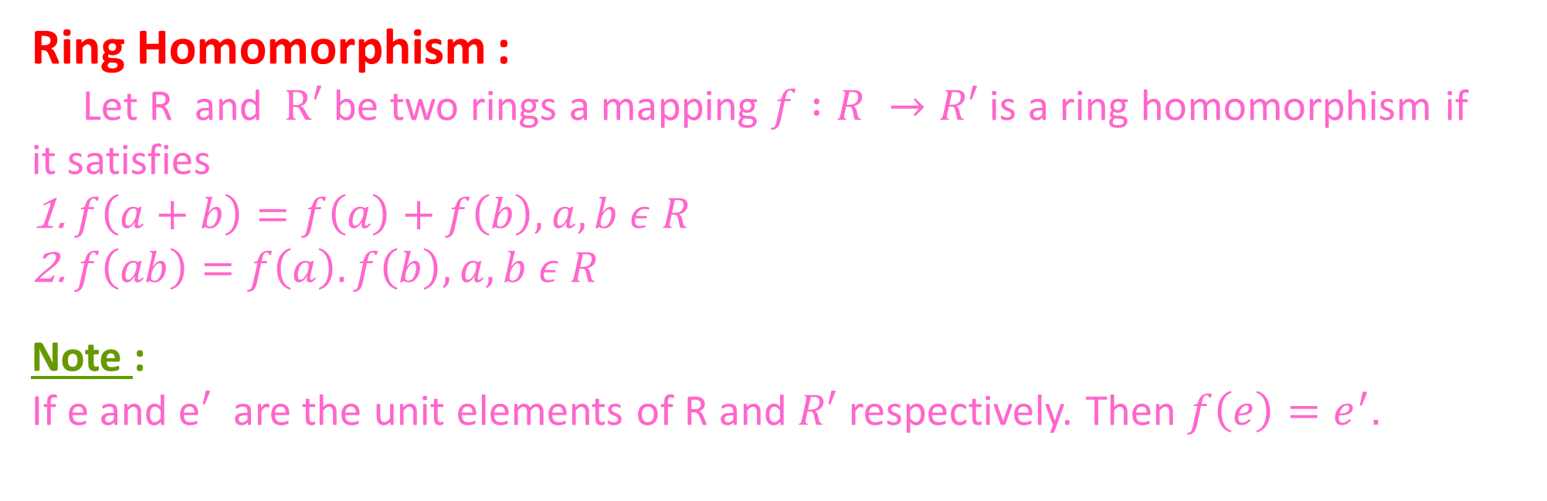
Ring Homomorphism :
Let R and $R′$ be two rings a mapping $f :R →R′$ is a ring homomorphism if it satisfies
$f\left(a+b\right)=f\left(a\right)+f\left(b\right), a,b ε R$
$f\left(ab\right)=f\left(a\right).f\left(b\right),a,b ε R$
Note :
If e and e$′$ are the unit elements of R and $R′$ respectively. Then $f\left(e\right)=e^{′}.$

Slide 30
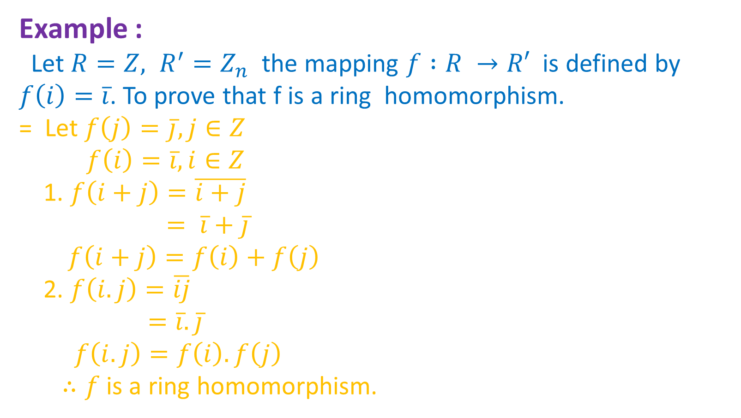
Example :
Let $R=Z, R^{′}=Z_{n}$the mapping $f :R →R′$ is defined by $f\left(i\right)=\overline{i}$. To prove that f is a ring homomorphism.
= Let $f\left(j\right)=\overline{j}, j∈Z$
$$f\left(i\right)=\overline{i}, i∈Z$$
1. $f\left(i+j\right)=\overline{i+j}$
$$= \overline{i}+\overline{j}$$
$$f\left(i+j\right)=f\left(i\right)+f\left(j\right)$$
2. $f\left(i.j\right)=\overline{ij}$
$$=\overline{i}.\overline{j}$$
$$f\left(i.j\right)=f\left(i\right).f\left(j\right)$$
$∴f$is a ring homomorphism.

Slide 31
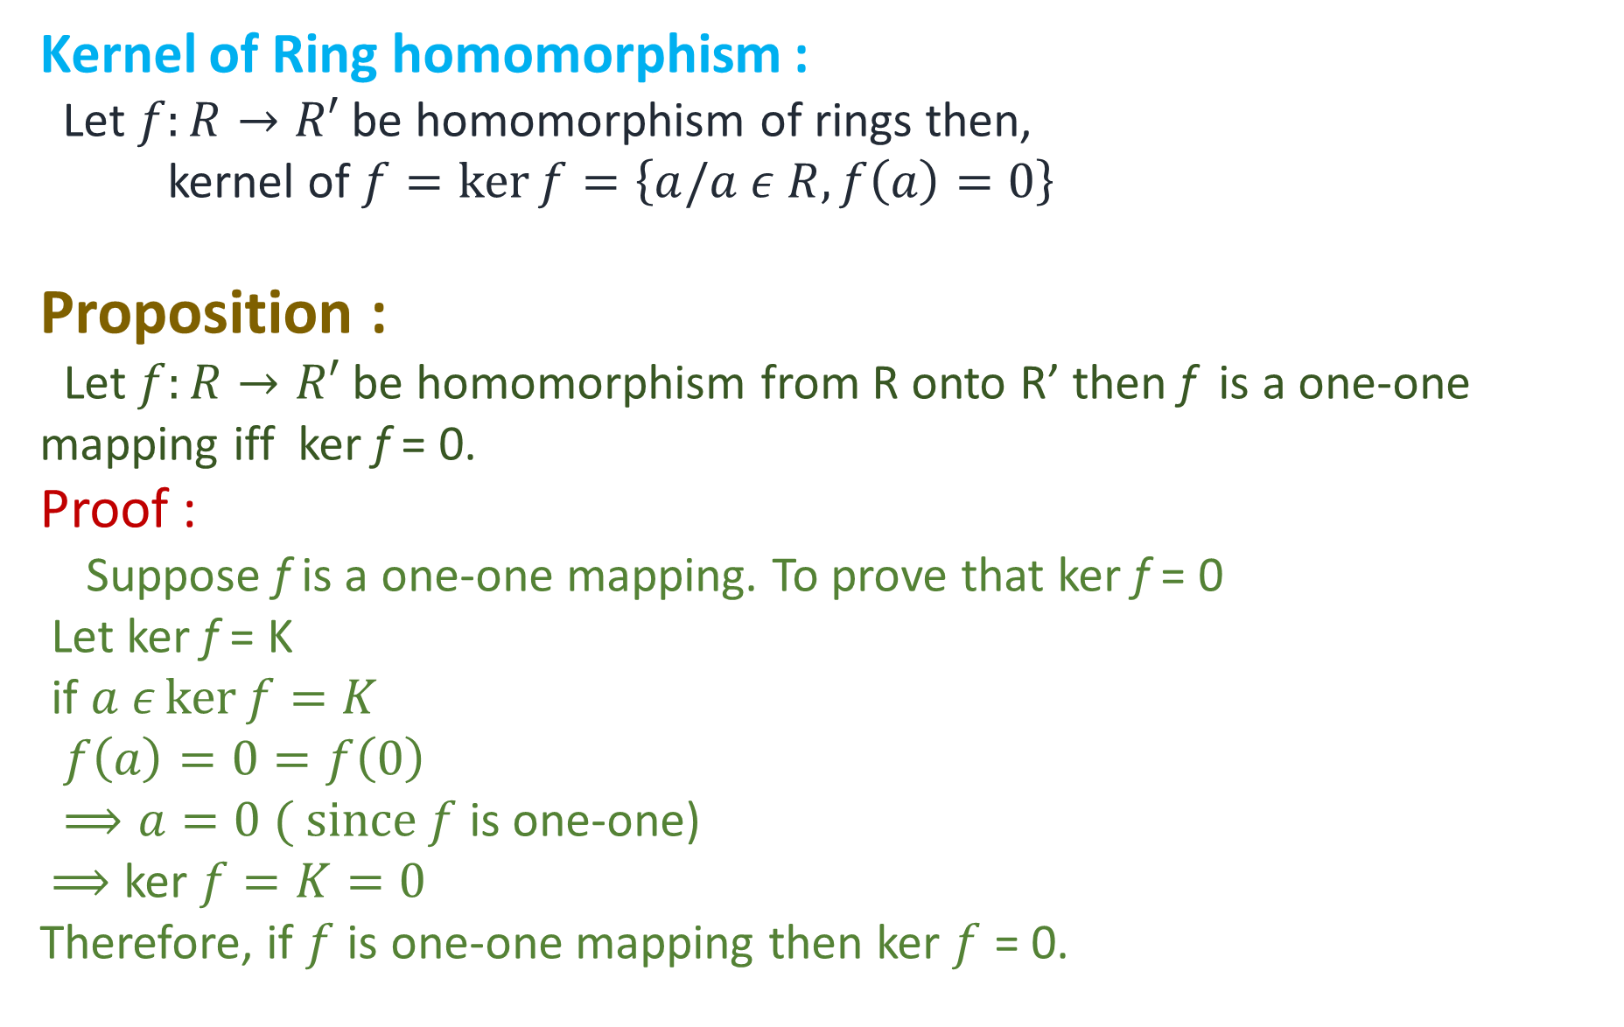
Kernel of Ring homomorphism :
Let $f:R→R′$ be homomorphism of rings then,
kernel of $f=\ker{f}=\left\{a/a ε R, f\left(a\right)=0\right\}$
Proposition :
Let $f:R→R′$ be homomorphism from R onto R’ then f is a one-one mapping iffkerf = 0.
Proof :
Suppose f is a one-one mapping. To prove that kerf = 0
Let kerf = K
if $a ε\ker{f=K}$
$$f\left(a\right)=0=f\left(0\right)$$
$⟹a=0 ( since f$ is one-one)
$⟹$ker $f=K=0$
Therefore, if $f$ is one-one mapping then ker$f$ = 0.

Slide 32
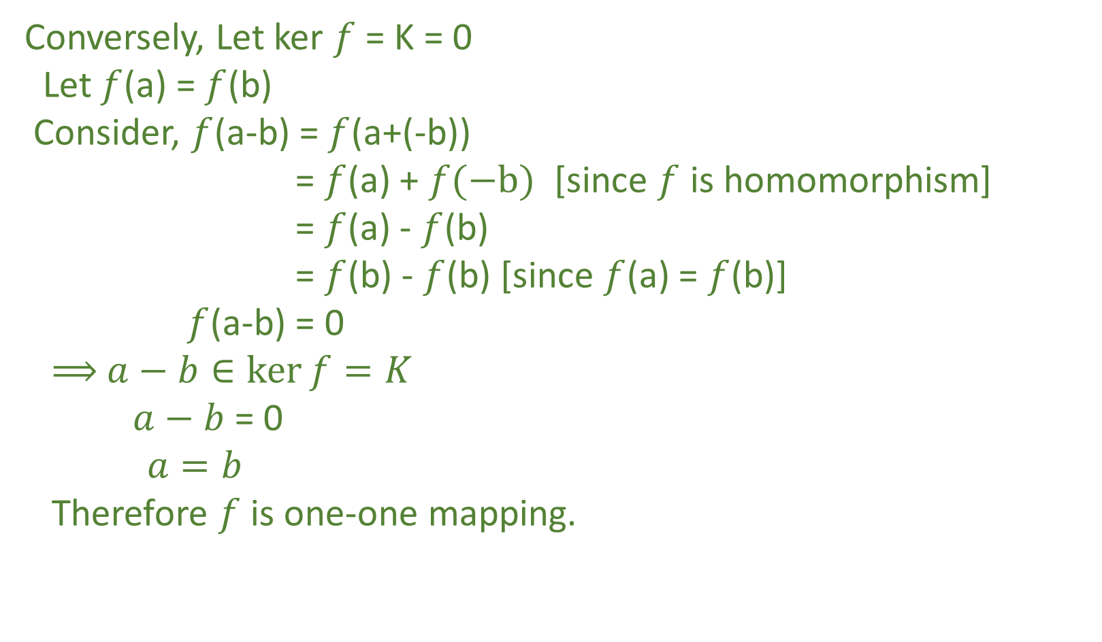
Conversely, Let ker$f$ = K = 0
Let $f$(a) = $f$(b)
Consider, $f$(a-b) = $f$(a+(-b))
= $f$(a) + $f(−b)$ [since $f$ is homomorphism]
= $f$(a) - $f$(b)
= $f$(b) - $f$(b) [since $f$(a) = $f$(b)]
$f$(a-b) = 0
⟹ $a−b∈\ker{f}=K$
$a−b$ = 0
$$a=b$$
Therefore $f$ is one-one mapping.

Slide 33
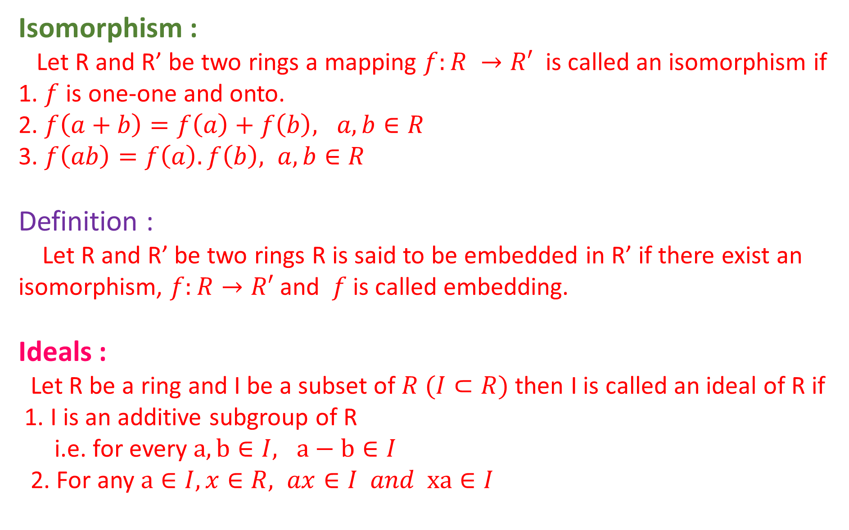
Isomorphism :
Let R and R’ be two rings a mapping $f:R →R′$ is called an isomorphism if
1. $f$ is one-one and onto.
2. $f\left(a+b\right)=f\left(a\right)+f\left(b\right), a,b∈R$
3. $f\left(ab\right)=f\left(a\right).f\left(b\right), a,b∈R$
Definition :
Let R and R’ be two rings R is said to be embedded in R’ if there exist an isomorphism, $f:R→R′$ and $f$is called embedding.
Ideals :
Let R be a ring and I be a subset of $R (I⊂R)$ then I is called an ideal of R if
1. I is an additive subgroup of R
i.e. for every $a,b∈I, a−b∈I$
2. For any $a∈I, x∈R, ax∈I and xa∈I$

Slide 34
Examples :
For any ring R, {0} and R are ideal of R and these are called improper ideals and other ideals are called proper ideals.
If R = Z, I = mZ, m ≥ 0. Prove that I is an ideal of R.
= Clearly I ⊂ R
1. Let mx, my ϵ mZ = I
mx – my = m(x - y) ϵ mZ = I (since x – y ϵ Z)
I is an additive subgroup of R = Z.
2. mx ϵ I, u ϵ R
(mx)u = m(xu) ϵ mZ = I (since xu ϵ Z)
u(mx) = (um)x [Associative law]
= (mu)x [ Commutative law]
= m(ux) ϵ mZ = I
Therefore, I is an ideal of R [ mZ is an ideal of Z]

Slide 35
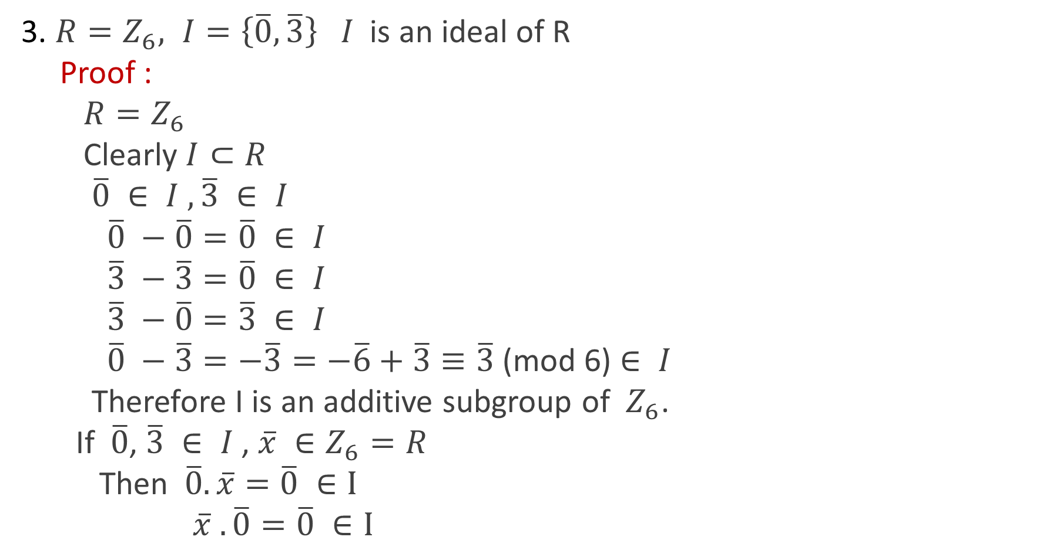
3. $R=Z_{6}, I=\left\{\overline{0},\overline{3}\right\} I$ is an ideal of R
Proof :
$$R=Z_{6}$$
Clearly $I⊂R$
$$\overline{0} ∈ I ,\overline{3} ∈ I$$
$$\overline{0} −\overline{0}=\overline{0} ∈ I$$
$$\overline{3} −\overline{3}=\overline{0} ∈ I$$
$$\overline{3} −\overline{0}=\overline{3} ∈ I$$
$\overline{0} −\overline{3}=−\overline{3}=−\overline{6}+\overline{3}≡\overline{3}$(mod 6) $∈ I$
Therefore I is an additive subgroup of $Z_{6}$.
If $\overline{0}$, $\overline{3} ∈ I$, $\overline{x} ∈Z_{6}=R$
Then $\overline{0}.\overline{x}=\overline{0} ∈I$
$$\overline{x} .\overline{0}=\overline{0} ∈I$$

Slide 36
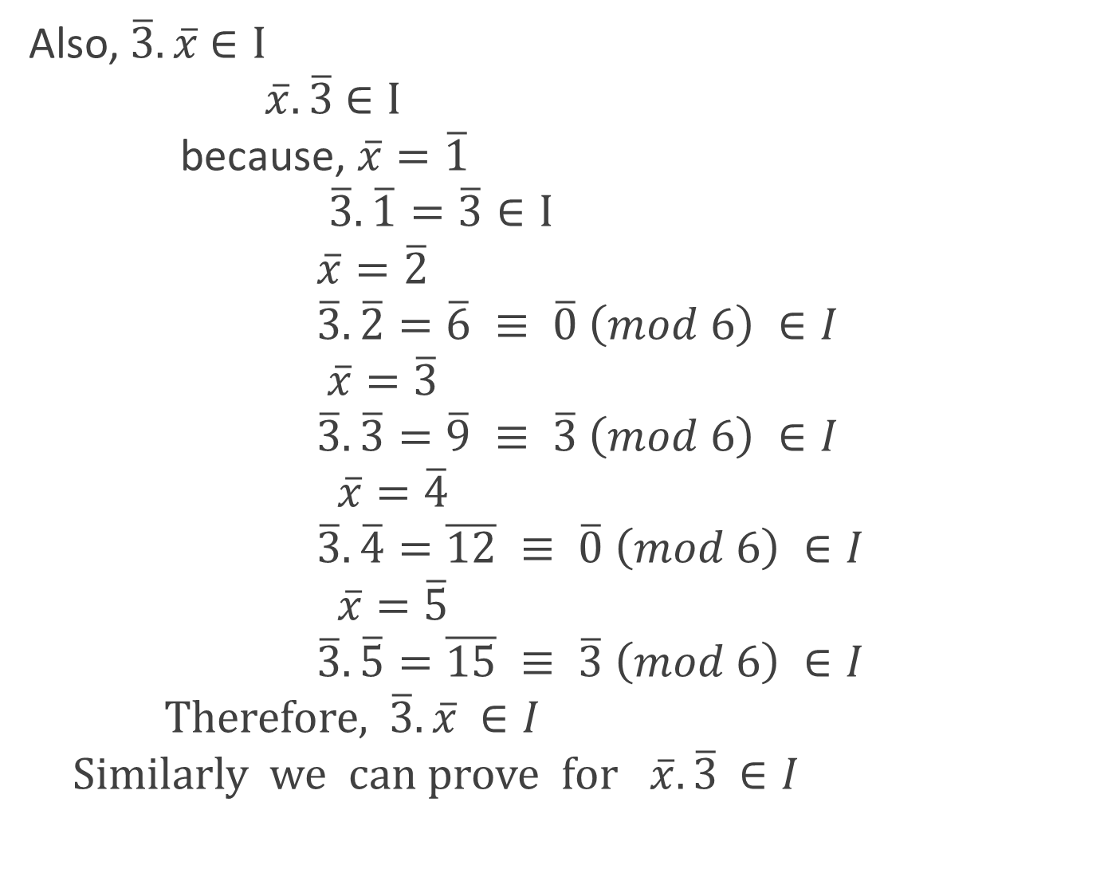
Also, $\overline{3}.\overline{x}∈I$
$$\overline{x}.\overline{3}∈I$$
because, $\overline{x}=\overline{1}$
$$\overline{3}.\overline{1}=\overline{3}∈I$$
$$\overline{x}=\overline{2}$$
$$\overline{3}.\overline{2}=\overline{6} ≡ \overline{0} \left(mod 6\right) ∈I$$
$$\overline{x}=\overline{3}$$
$$\overline{3}.\overline{3}=\overline{9} ≡ \overline{3} \left(mod 6\right) ∈I$$
$$\overline{x}=\overline{4}$$
$$\overline{3}.\overline{4}=\overline{12} ≡ \overline{0} \left(mod 6\right) ∈I$$
$$\overline{x}=\overline{5}$$
$$\overline{3}.\overline{5}=\overline{15} ≡ \overline{3} \left(mod 6\right) ∈I$$
Therefore,$\overline{3}.\overline{x} ∈I$
Similarly we can prove for $\overline{x}.\overline{3} ∈I$

Slide 37
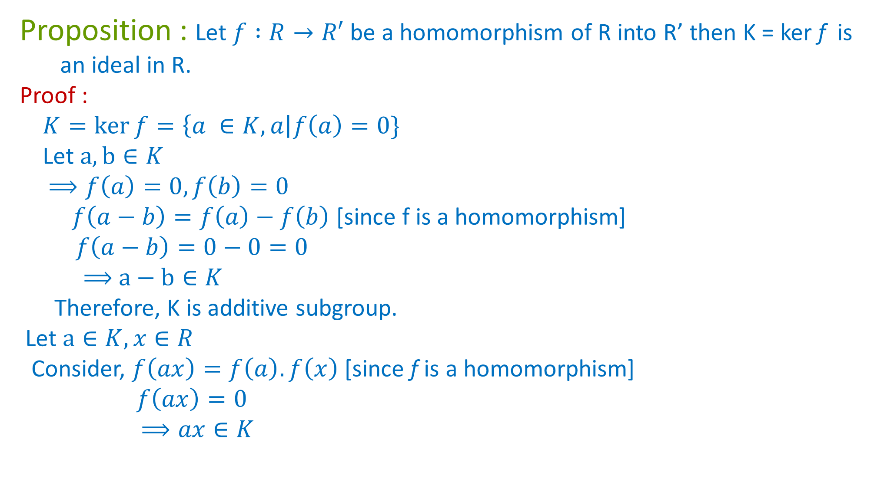
Proposition : Let $f :R→R′$ be a homomorphism of R into R’ then K = kerf is
an ideal in R.
Proof :
$$K=\ker{f}=\left\{a ∈K,a\right|f\left(a\right)=0\}$$
Let $a,b∈K$
$$⟹f\left(a\right)=0, f\left(b\right)=0$$
$f\left(a−b\right)=f\left(a\right)−f\left(b\right)$ [since f is a homomorphism]
$$f\left(a−b\right)=0−0=0$$
⟹ $a−b∈K$
Therefore, K is additive subgroup.
Let $a∈K, x∈R$
Consider, $f\left(ax\right)=f\left(a\right).f\left(x\right)$ [since f is a homomorphism]
$$f\left(ax\right)=0$$
$$⟹ax∈K$$

Slide 38
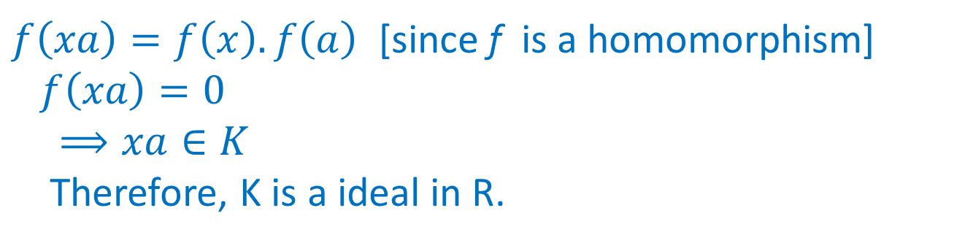
$f\left(xa\right)=f\left(x\right).f\left(a\right)$ [since f is a homomorphism]
$$f\left(xa\right)=0$$
$$⟹xa∈K$$
Therefore, K is a ideal in R.

Slide 39
Simple ring :
A ring R is called a Simple ring if it has no proper ideals [i.e. the only ideals of R are {0} and R which are improper ideals]

Slide 40
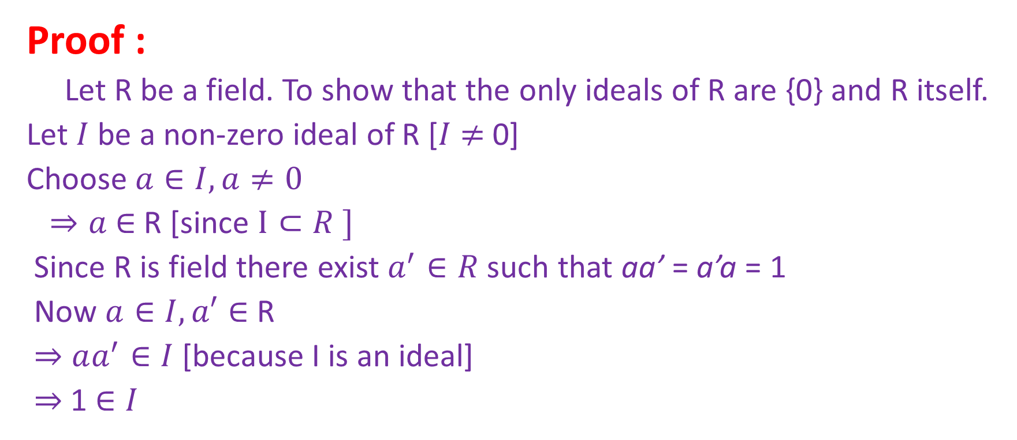
Proposition :
Any field is a Simple ring.
Proof :
Let R be a field. To show that the only ideals of R are {0} and R itself.
Let $I$ be a non-zero ideal of R [$I$ $≠$ 0]
Choose $a∈I, a≠0$
$⇒a$ $∈$ R [since $I⊂R ]$
Since R is field there exist $a^{′}∈R$such that aa’ = a’a = 1
Now $a∈I, a′∈$ R
$⇒$ $aa^{′}∈I$ [because I is an ideal]
$⇒$1 $∈I$

Slide 41

Now for any $x ε R, 1 ε I$
⟹ $x.1 ε I$ [$I$ is an ideal of R]
⟹ $x ε I$
∴ R ⊂ I
Since I ⊂ R
We get I = R
Therefore, R is a simple Ring.

Slide 42
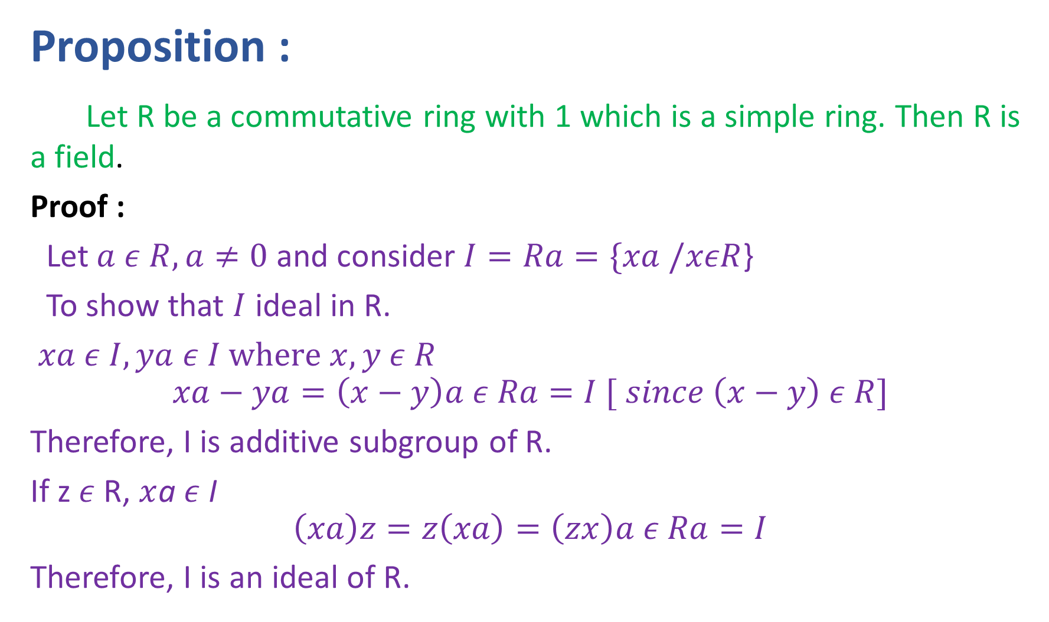
Proposition :
Let R be a commutative ring with 1 which is a simple ring. Then R is a field.
Proof :
Let $a ε R, a≠0$ and consider $I=Ra=\{xa /xεR$}
To show that $I$ ideal in R.
$$xa ε I, ya ε I where x,y ε R$$
$$xa−ya=\left(x−y\right)a ε Ra=I [ since \left(x−y\right) ε R]$$
Therefore, I is additive subgroup of R.
If z $ε$ R, $x$a $ε$ I
$$\left(xa\right)z=z\left(xa\right)=\left(zx\right)a ε Ra=I$$
Therefore, I is an ideal of R.

Slide 43
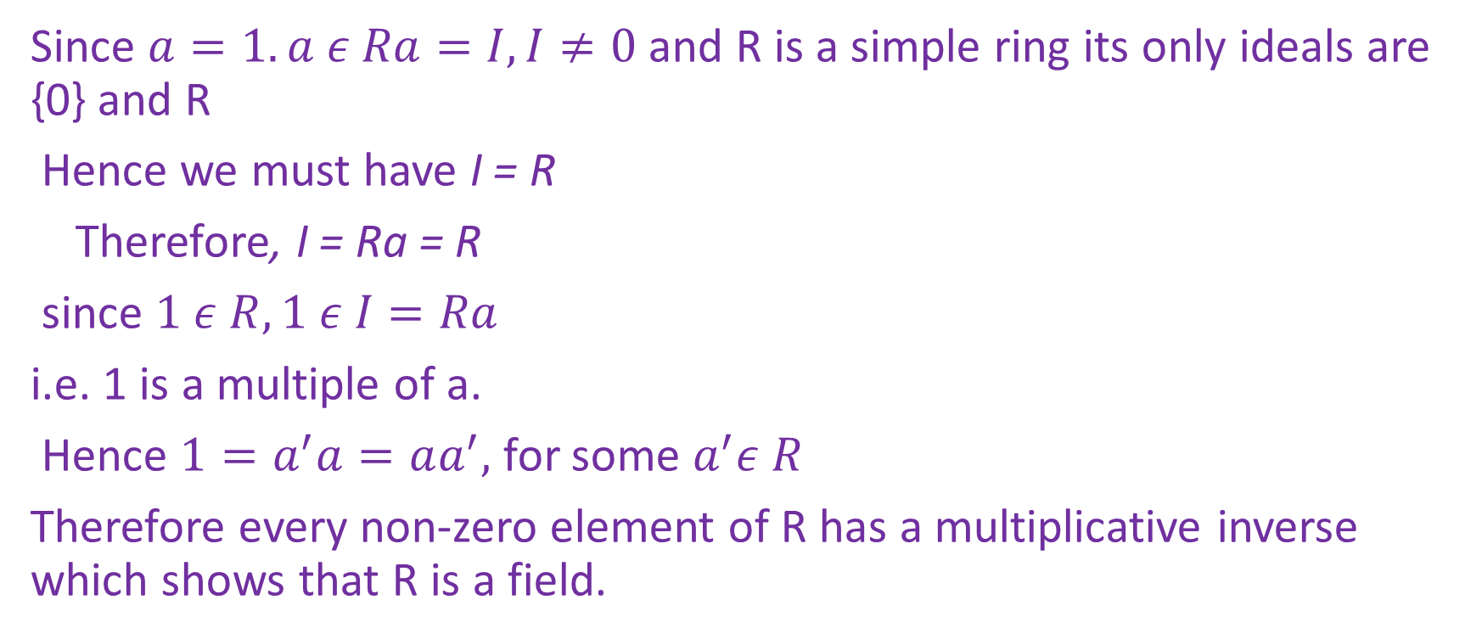
Since $a=1.a ε Ra=I, I≠0$ and R is a simple ring its only ideals are {0} and R
Hence we must have I = R
Therefore, I = Ra = R
since $1 ε R, 1 ε I=Ra$
i.e. 1 is a multiple of a.
Hence $1=a^{′}a=aa^{′},$ for some $a^{′}ε R$
Therefore every non-zero element of R has a multiplicative inverse which shows that R is a field.

Slide 44
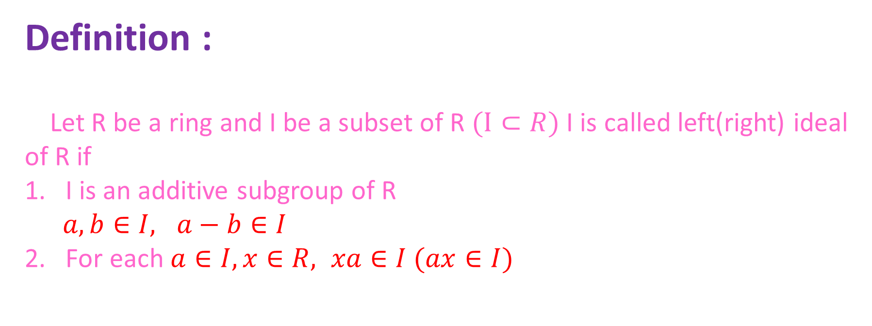
Definition :
Let R be a ring and I be a subset of R $(I⊂R)$ I is called left(right) ideal of R if
I is an additive subgroup of R
$a,b∈I, a−b∈I$
2. For each $a∈I, x∈R, xa∈I (ax∈I)$

Slide 45
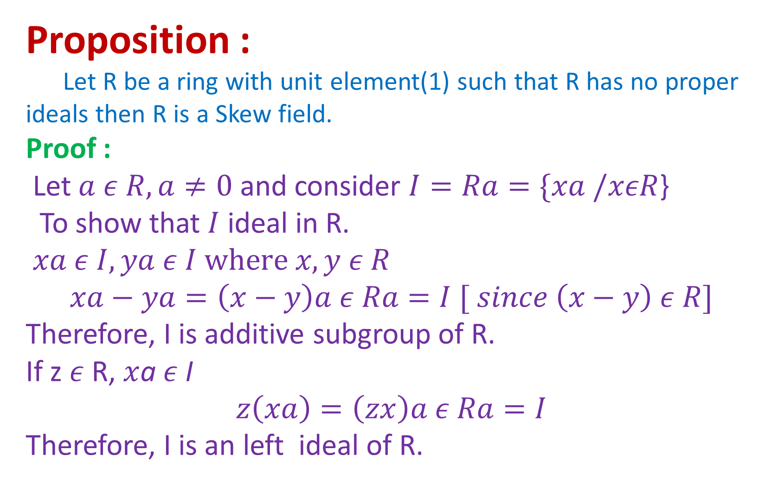
Proposition :
Let R be a ring with unit element(1) such that R has no proper ideals then R is a Skew field.
Proof :
Let $a ε R, a≠0$ and consider $I=Ra=\{xa /xεR$}
To show that $I$ ideal in R.
$$xa ε I, ya ε I where x,y ε R$$
$$xa−ya=\left(x−y\right)a ε Ra=I [ since \left(x−y\right) ε R]$$
Therefore, I is additive subgroup of R.
If z $ε$ R, $x$a $ε$ I
$$z\left(xa\right)=\left(zx\right)a ε Ra=I$$
Therefore, I is an left ideal of R.

Slide 46
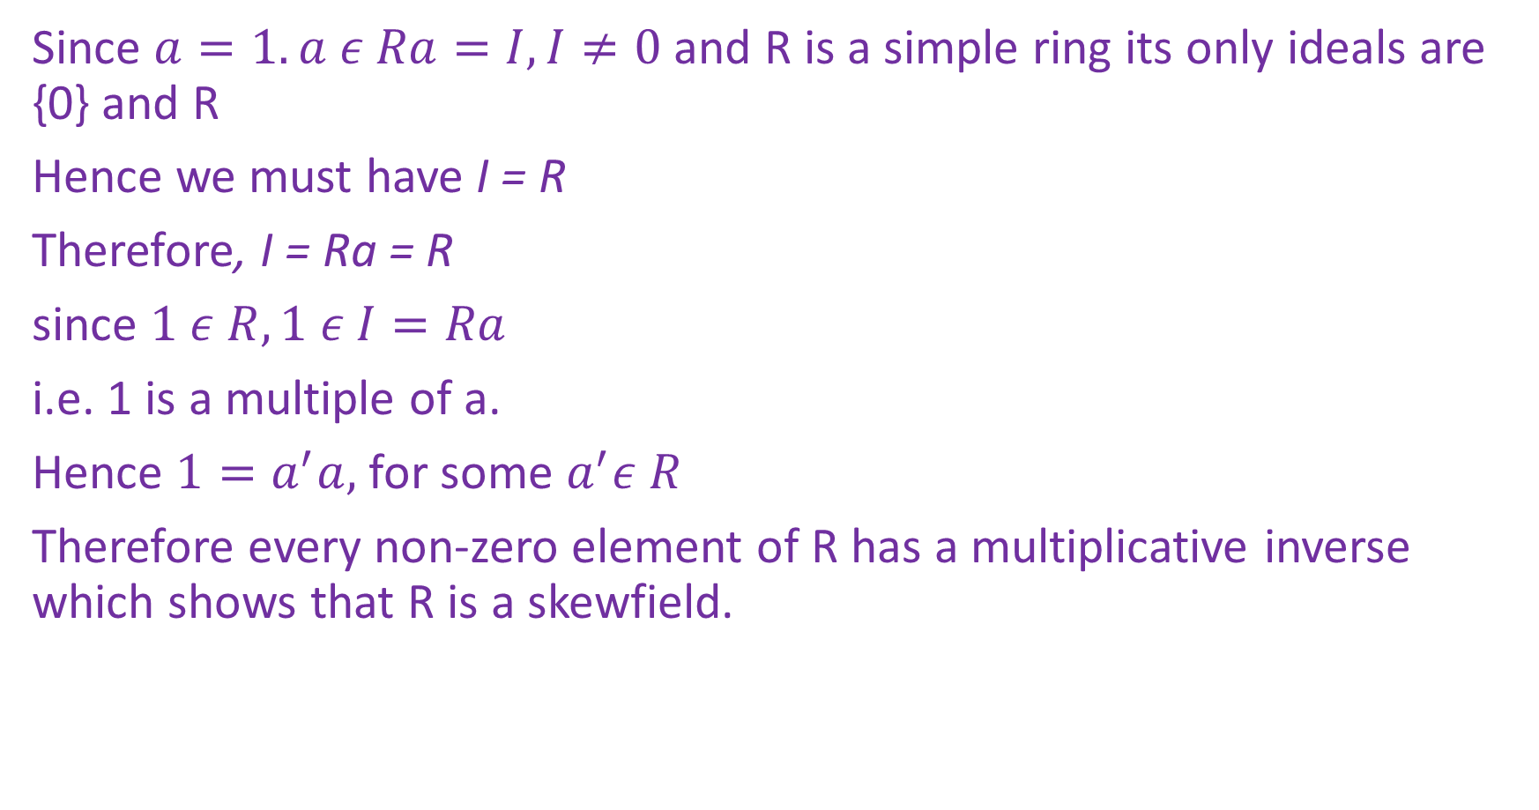
Since $a=1.a ε Ra=I, I≠0$ and R is a simple ring its only ideals are {0} and R
Hence we must have I = R
Therefore, I = Ra = R
since $1 ε R, 1 ε I=Ra$
i.e. 1 is a multiple of a.
Hence $1=a^{′}a,$ for some $a^{′}ε R$
Therefore every non-zero element of R has a multiplicative inverse which shows that R is a skewfield.

Slide 47
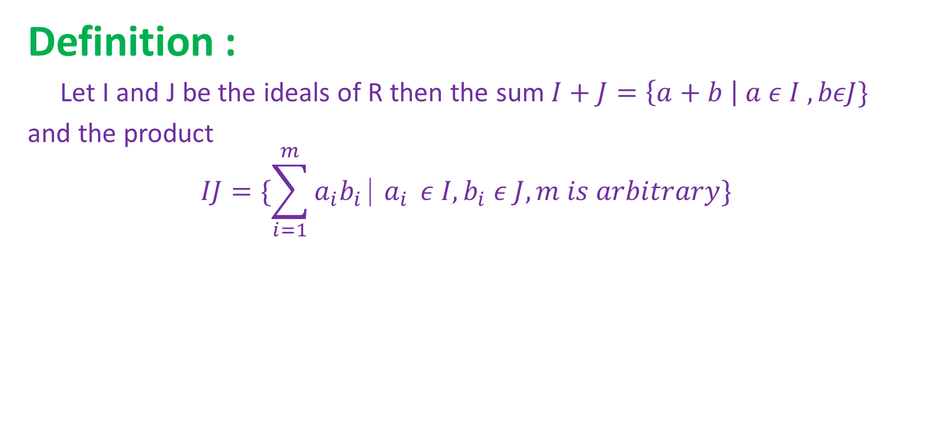
Definition :
Let I and J be the ideals of R then the sum$I+J=\left\{a+b \right| a ε I ,bεJ\}$
and the product
$$IJ=\{\sum_{i=1}^{m}{a_{i}b_{i} ⎸a_{i} }ε I, b_{i} ε J, m is arbitrary\}$$

Slide 48
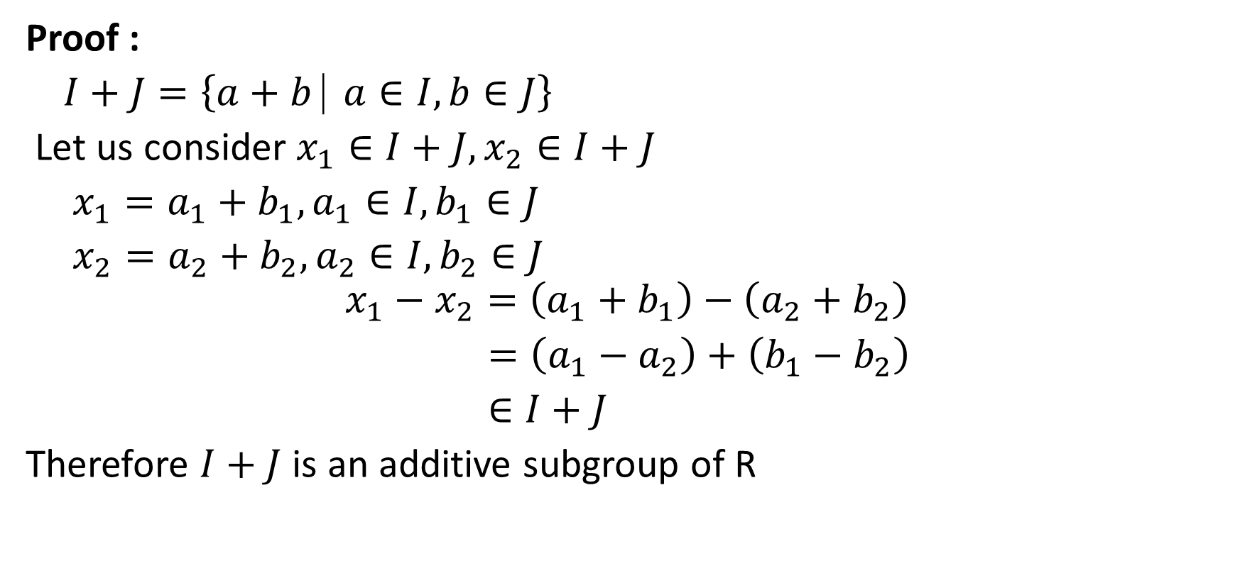
Proposition :
For any ideals I and J, the sum I + J is also an ideal of R.
Proof :
$I+J=\left\{a+b ⎸a∈I,b∈J\right\}$
Let us consider $x_{1}∈I+J, x_{2}∈I+J$
$x_{1}=a_{1}+b_{1}, a_{1}∈I, b_{1}∈J$
$x_{2}=a_{2}+b_{2}, a_{2}∈I, b_{2}∈J$
$$x_{1}−x_{2}=\left(a_{1}+b_{1}\right)−\left(a_{2}+b_{2}\right)$$
$=\left(a_{1}−a_{2}\right)+\left(b_{1}−b_{2}\right)$
$∈I+J$
Therefore $I+J$ is an additive subgroup of R

Slide 49

Let z $∈R, { x}_{1}∈I+J$
$zx_{1}=z\left(a_{1}+b_{1}\right)=za_{1}+zb_{1}∈I+J$
$x_{1}z=\left(a_{1}+b_{1}\right)z=a_{1}z+b_{1}z∈I+J$
Therefore $I+J$ is also an ideal of R.

Slide 50




Exercise :
1. Show that the intersection of 2 ideals is an ideal.
2. Show that if I and J are ideals in R, is not an ideal in general also
show that is an ideal iff
3. Let R be a ring and a ϵ R show that, is a left ideal
of R (left annihilator of a)
Similarly, is a right ideal of R (right annihilator of a)

Slide 51
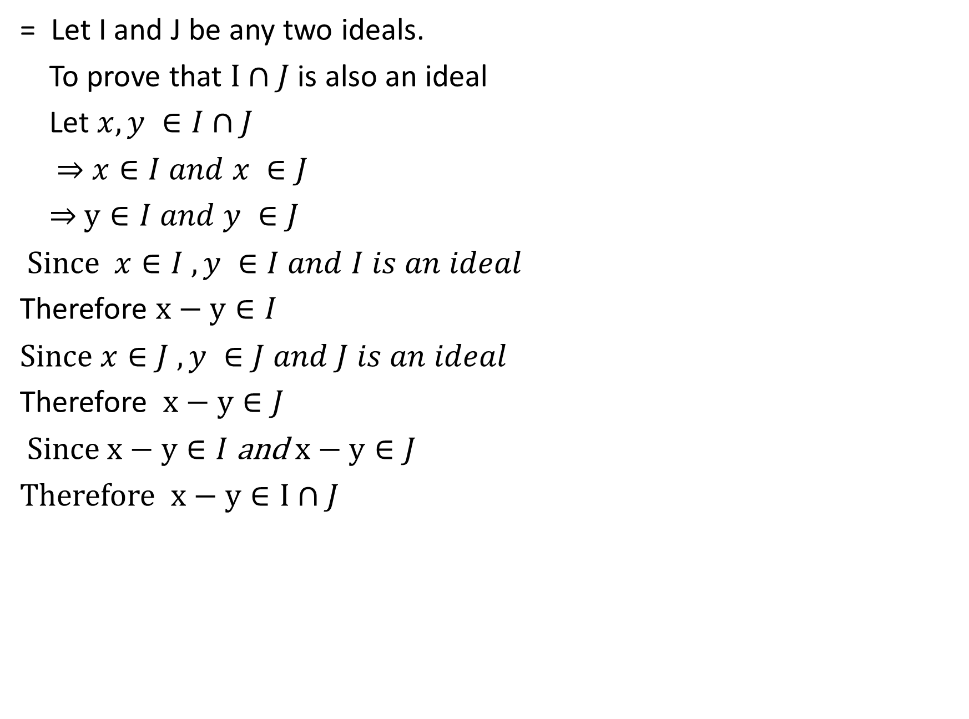
1. Show that the intersection of 2 ideals is an ideal.
= Let I and J be any two ideals.
To prove that $I∩J$ is also an ideal
Let $x,y ∈I∩J$
⇒ $x∈I and x ∈J$
⇒ $y∈I and y ∈J$
Since $x∈I , y ∈I and I is an ideal$
Therefore $x−y∈I$
Since $x∈J , y ∈J and J is an ideal$
Therefore $x−y∈J$
Since $x−y∈I$ and $x−y∈J$
Therefore $x−y∈I∩J$

Slide 52
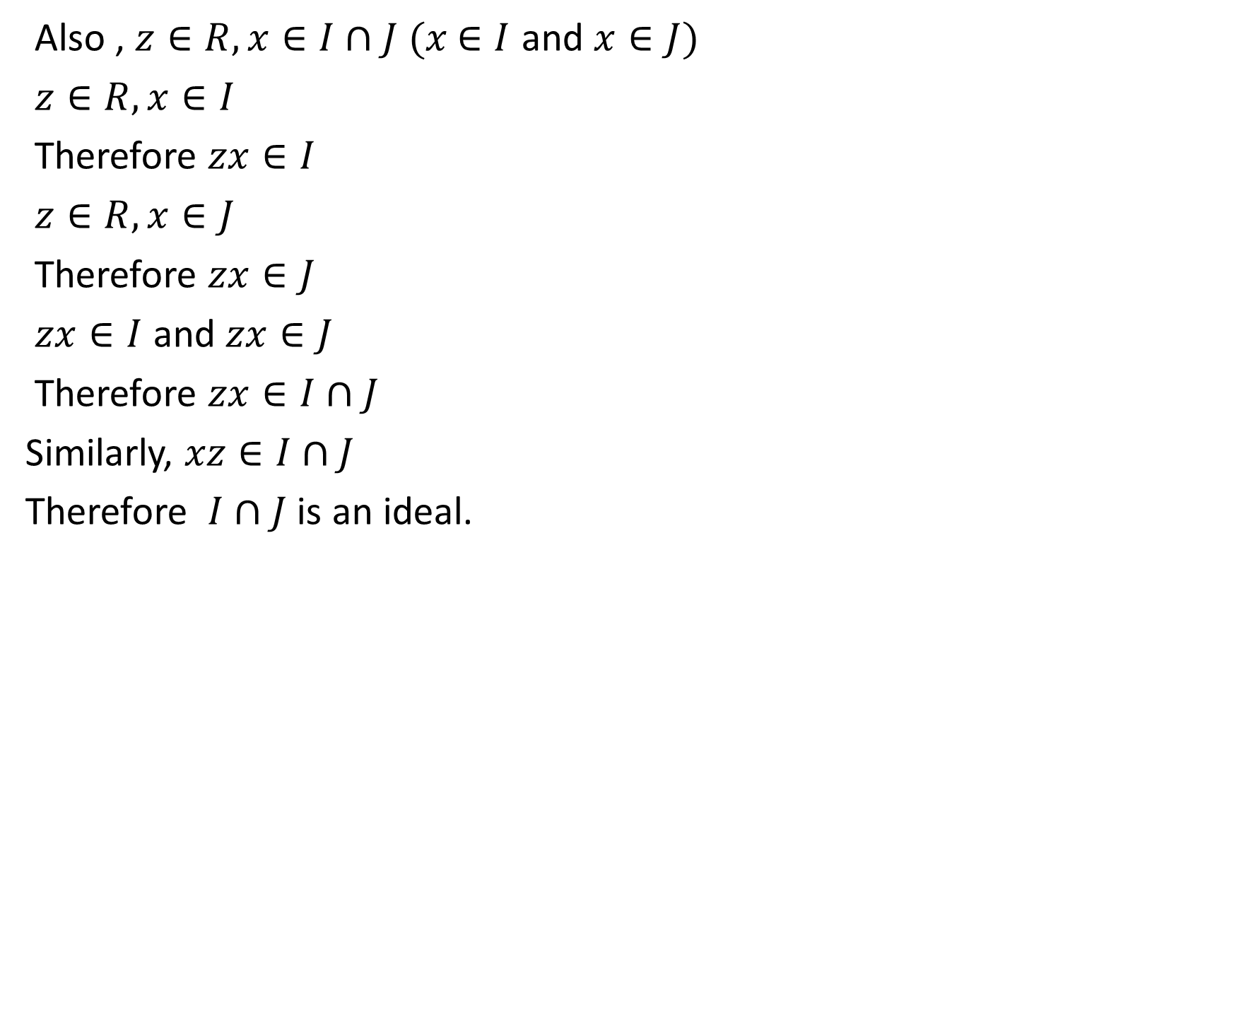
Also , $z∈R, x∈I∩J (x$ $∈I$ and $x∈J)$
$z∈R, x∈I$
Therefore $zx∈I$
$z∈R, x∈J$
Therefore $zx∈J$
$zx∈I$ and $zx∈J$
Therefore $zx∈I∩J$
Similarly, $xz∈I∩J$
Therefore $I∩J$ is an ideal.

Slide 53

2. Show that if I and J are ideals in R, is not an ideal in general also show that is an ideal iff $I⊂J or J⊂I$

Slide 54



Quotient ring :
Let R be a ring and be an ideal in R. Consider,
In addition and multiplications are defined as,
is a ring and it is a ring of R by the ideal
is called as Quotient ring.

Slide 55
Example :
If R = Z, I = nZ then the quotient ring is the ring Z_{n} of residue classes modulo n.

Slide 56




First Isomorphism Theorem :
Let be a homomorphism of R onto . Let then is an ideal in R and

