Slide 1
Dr. B. B. Hegde First Grade College, Kundapura
Mrs, Vanitha G.
Asst. Professor
Dept. of computer science

Slide 2
GENERAL OVERVIEW OF THE SYSTEM
Introduction:
Unix is an operating system.
A set of programs that act as a link between the computer and the user.
UNIX is a multi-user, multi-tasking operating system.

Slide 3
History of UNIX
Introduction to Linux
In 1965 Bell telephone Labs developed a new OS called MULTICS.
First Version was created in Bell Labs in 1969.
Some of the Bell Labs programmers who had worked on this project, Ken Thompson, Dennis Ritchie, Rudd Canaday, and Doug Mcllroy designed and implemented the first version of the Unix File System on a PDP-7 along with a few utilities. It was given the name UNIX by Brian Kernighan.

Slide 4
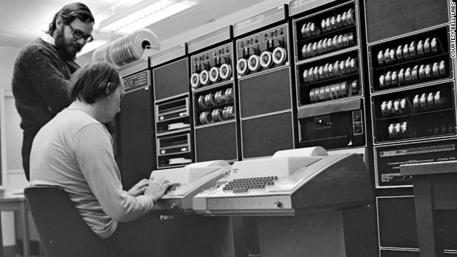
History of UNIX
Thompson, Dennis Ritchie implemented the new system called UNIX.
The Unix operating system is a multiuser, multitasking operating system.
Developed in 1969 at AT&T’s Bell laboratories.

Slide 5
History of UNIX
General Overview of the System
Providing better processing system UNIX was moved to PDP-11 in 1971 with the characteristics of small size: 16 KB for the system, 8KB for the user programs, 512KB of disk and limit of 64 KB per file.
1973 Unix is re-written mostly in C, a new language developed by Dennis Ritchie.
Being written in this high-level language greatly decreased the effort needed to port it to new machines.

Slide 6
History of UNIX
General Overview of the System
1977 There were about 500 Unix sites world-wide.
1980 BSD 4.1 (Berkeley Software Development).
1983 SunOS, BSD 4.2, System V.
1988 AT&T and Sun Microsystems jointly develop System V Release 4 (SVR4). This later developed into UnixWare and Solaris 2.
1991 Linux was originated.

Slide 7
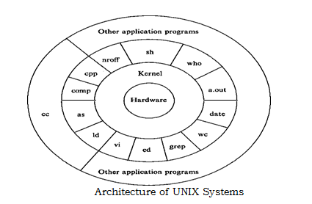
SYSTEM STRUCTURE
General Overview of the System

Slide 8
What is File?
General Overview of the System
Everything in UNIX/Linux operating system is a FILE.
File is a collection of the data and File system is a collection of files.
Grouping these files for easier access referred as “ File System”.

Slide 9
USER PERSPECTIVE
General Overview of the System
The File System
The UNIX file system is characterized by,
A hierarchical structure,
Consistent treatment of file data,
The ability to create and delete files,
Dynamic growth of files,
The protection of file data,
The treatment of peripheral devices (such as terminals and tape units) as files.

Slide 10
Simple Unix file System Tree
General Overview of the System
/ (Root)
bin dev etc usr home lib
passwd src bin tty()
cmd
date.c who.c

Slide 11
Simple Unix file System Tree
General Overview of the System
Root : starting of any file system.
Bin : contains all executable files.
Boot : contains bootable information's.
Dev : contains all device files.
Etc : contains system configuration files.
Home : contains list of all user files.
Lib : contains library files.

Slide 12
Pathnames
General Overview of the System
It is a sequence of component names separated by slash characters.
Two types
Absolute Pathname
Relative Pathname

Slide 13
General Overview of the System
Absolute Pathname:
The full pathname.
Example :
/etc/paswd
/usr/src/cmd/who.c

Slide 14
General Overview of the System
Relative Pathname :
It is the location relative to the current working directory.
Examples :
/dev
Cureent working directory is /tty()
By above pathname designated the file whose name is
/dev/tty()
A relative path name specifies the path relative to another, usually the current working directory that you are at.
Two special directories :
  . the current directory
  .. the parent of the current directory

