Slide 1
IV Semester
BSCPHC 281: Electricity & X-ray Crystallography
Unit-I: Transients & DC Networks Transient Currents:
Theory of CR circuit (charging and discharging) –LR circuit (growth and decay), LCR circuit (discharging). Network theorems: Superposition theorem, Thevenin’s & Norton’s theorems. Maximum power transfer theorem (derivation), some applications. Problems.
Unit-II: Alternating Currents & Filters Alternating currents:
Expression for the RMS value of voltage and currents, j operator principles of superposition and phasor analysis. Response of LR, CR and LCR circuit to sinusoidal voltages using j operators. Series and parallel resonance circuits – expression for the ‘Q’ factor, bandwidth – expression for the power.
Filters: High and low pass filters using CR and LR circuits, frequency response curves, cutoff frequency, qualitative study of band pass filters. Problems.

Slide 2
Unit-III: Electrical & Magnetic Measurements
Force acting on a moving charge in electric and magnetic fields - Lorentz force. Force on a current carrying conductor in a magnetic field. Torque on a current loop in a magnetic field. Magnetic dipole moment – Torque on a magnetic dipole. Equivalence of a current loop and a magnetic dipole.
Ballistic galvanometer – charge sensitivity – effect of damping. Applications of B.G. Determination of capacitance by absolute - determination of high resistance by leakage. Theory of Andersons bridge & De-Sauty’s bridge. Problems.
Unit-IV: X-ray Crystallography & Superconductivity X- ray crystallography:
production of X-rays. Coolidge tube. Continuous and characteristic X-ray spectra. Moseley’s law. Definition of a lattice, unit cell, seven crystal systems. Miller indices, Bragg’s law. Bragg’s spectrometer, structure of NaCl and KCl.
Superconductivity: Elementary ideas – experimental facts, transition temperature, critical field, critical current, Meissner effect. High temperature superconductivity. Applications of superconductivity – production of high magnetic field. Problems.

Slide 3
Books for reference:
Electricity and magnetism – E M Purcell, Cambridge University Press, 2013
Elements of Electromagnetism – Mathew and N O Sadiku, Oxford University Press, 2018
Introductory to Circuit Analysis – Robert Boylested, Pearson Education India, 2007
Electricity and magnetism – D C Tayal, Himalaya Publishing House, 1989
Elements and magnetism – Tareja, Springer New York, 2014
Elements of X- ray diffraction – Cullity & Stock, Addison-Wesley Publishing Co. 1978
Solid state Physics – H C Guptha, Vikas Publishing House Pvt Limited, 2001
Elementary Solid state Physics – Ali Omer, Pearson Education India, 1975
Modern Physics by R. Murugeshan and Kiruthiga Sivaprasath, S Chand, 2010

Slide 4
Question paper pattern for III & IV semester
Internal Assessment: 20 marks
Semester Examination 80 marks
Questions carrying 1 mark 8 out of 10 1 x 8 = 8 marks
Questions carrying 2 mark 6 out of 8 2 x 6 = 12 marks
UNIT I,II, III &IVInternal choice for each unit
Questions carrying 1 x 4 = 4
1 x 6 = 6
Problem 1 x 5 mark
Total 15 x 4 = 60

Slide 5
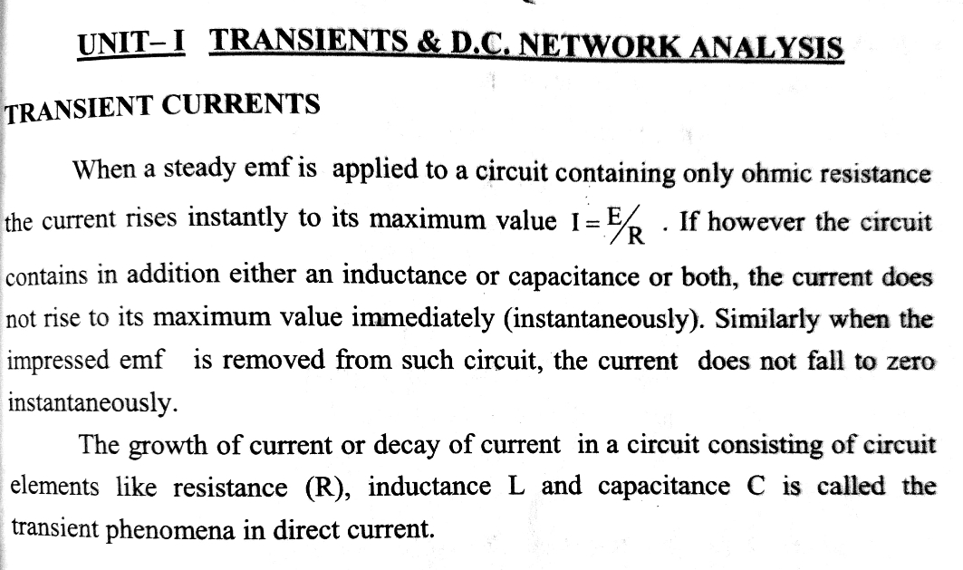

Slide 6
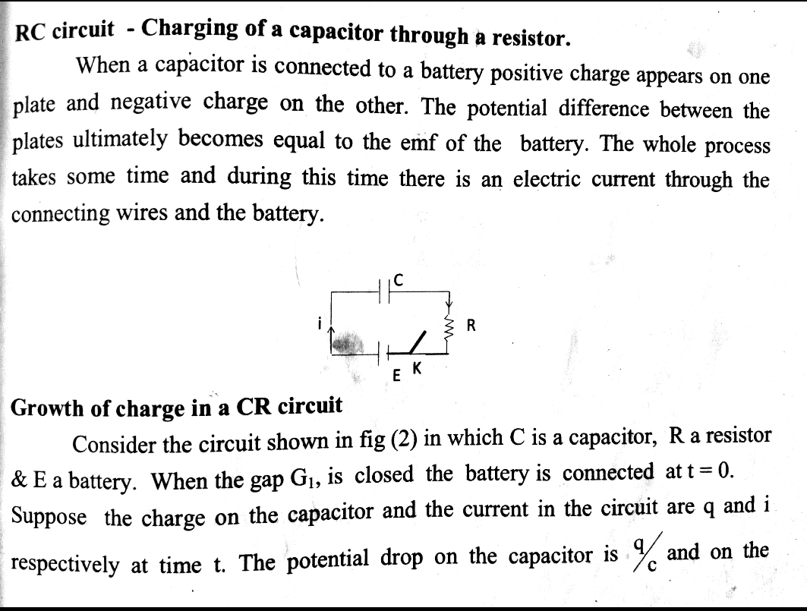

Slide 7
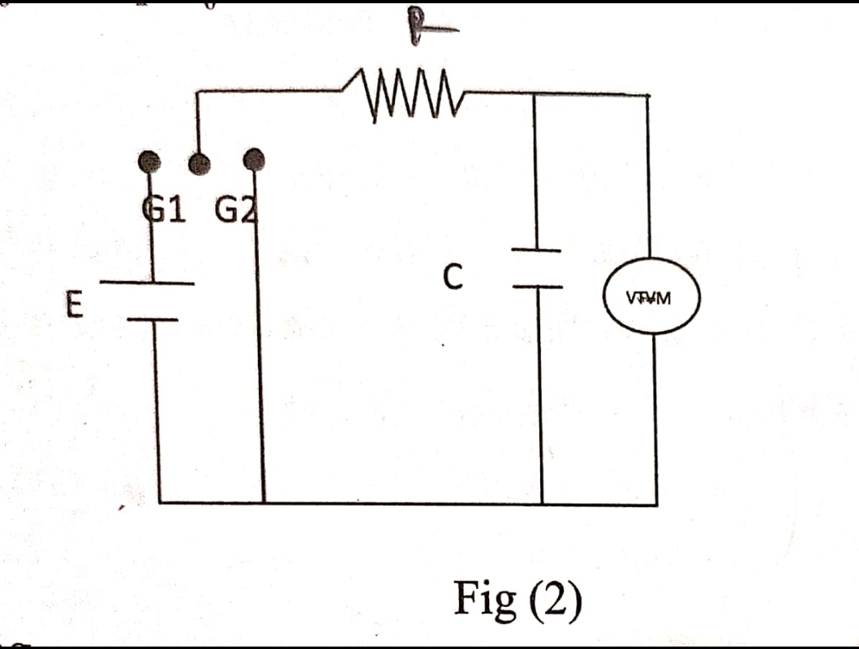

Slide 8
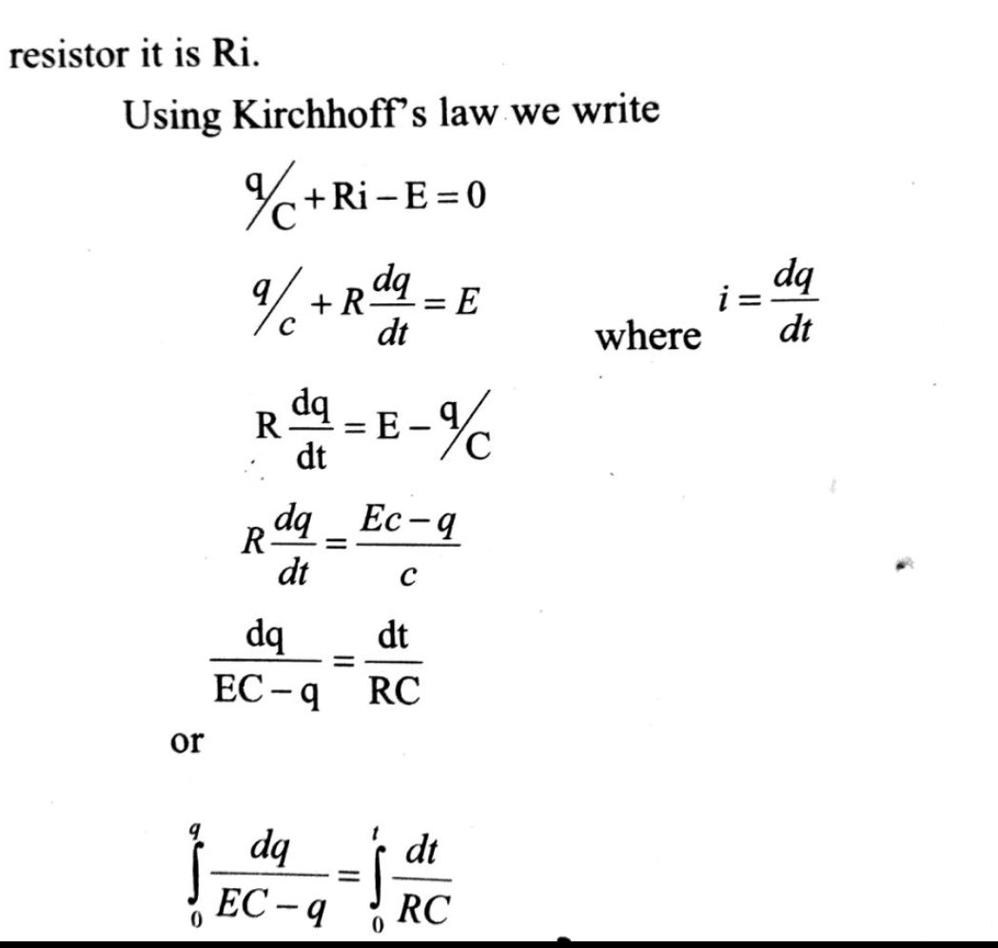

Slide 9
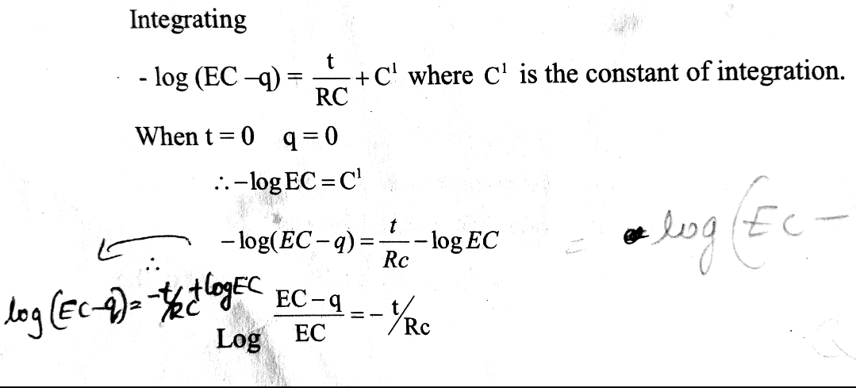

Slide 10
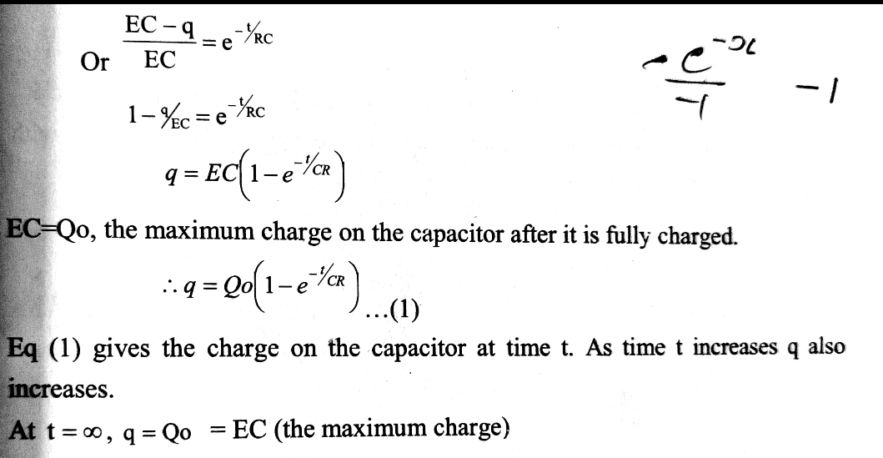

Slide 11
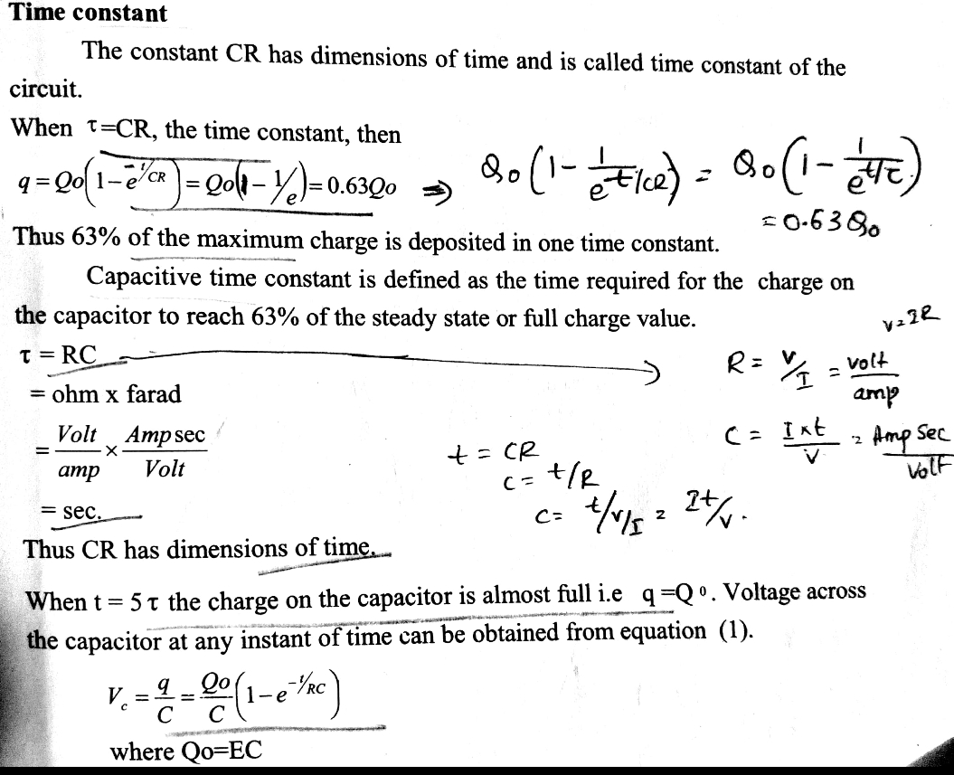

Slide 12
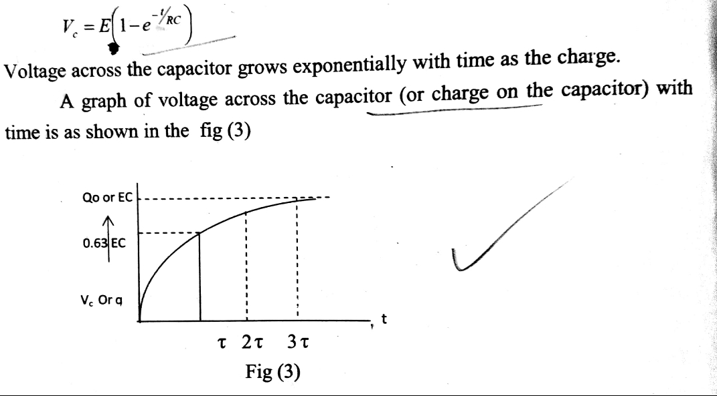

Slide 13
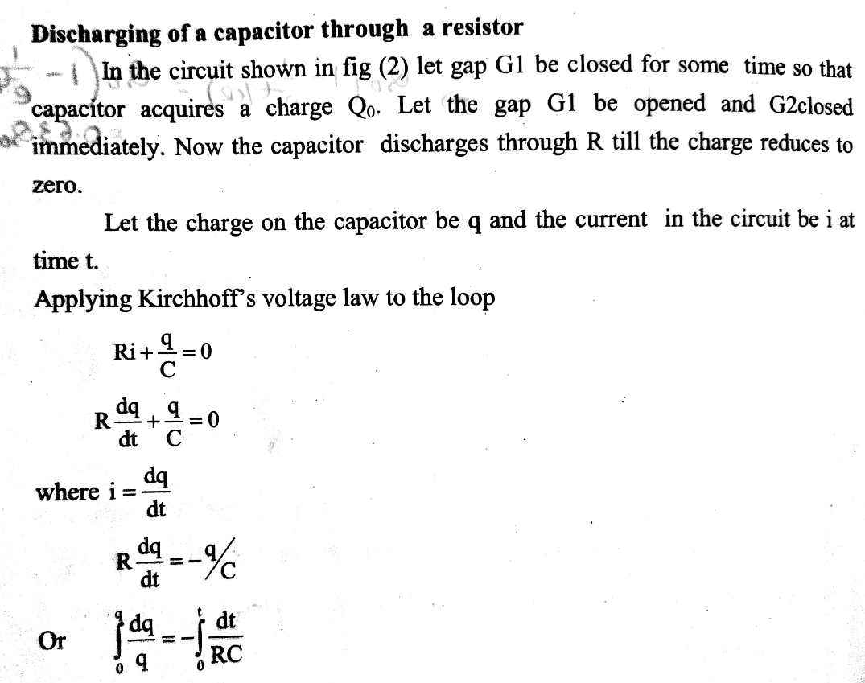

Slide 14
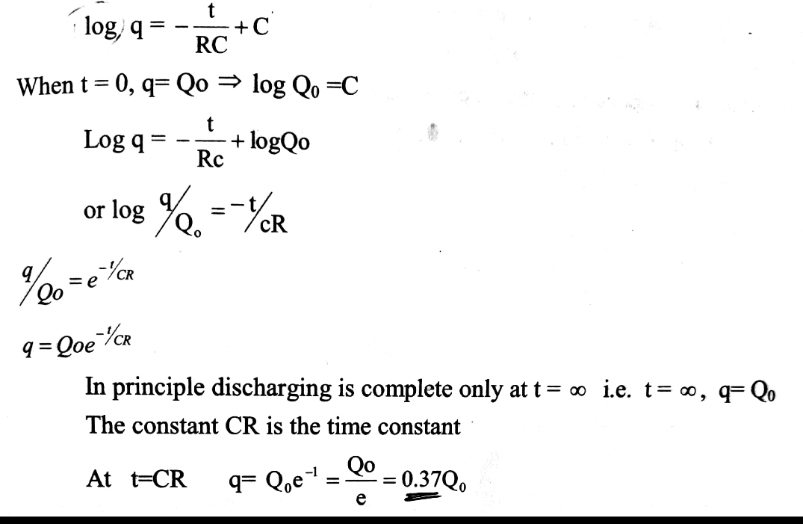

Slide 15
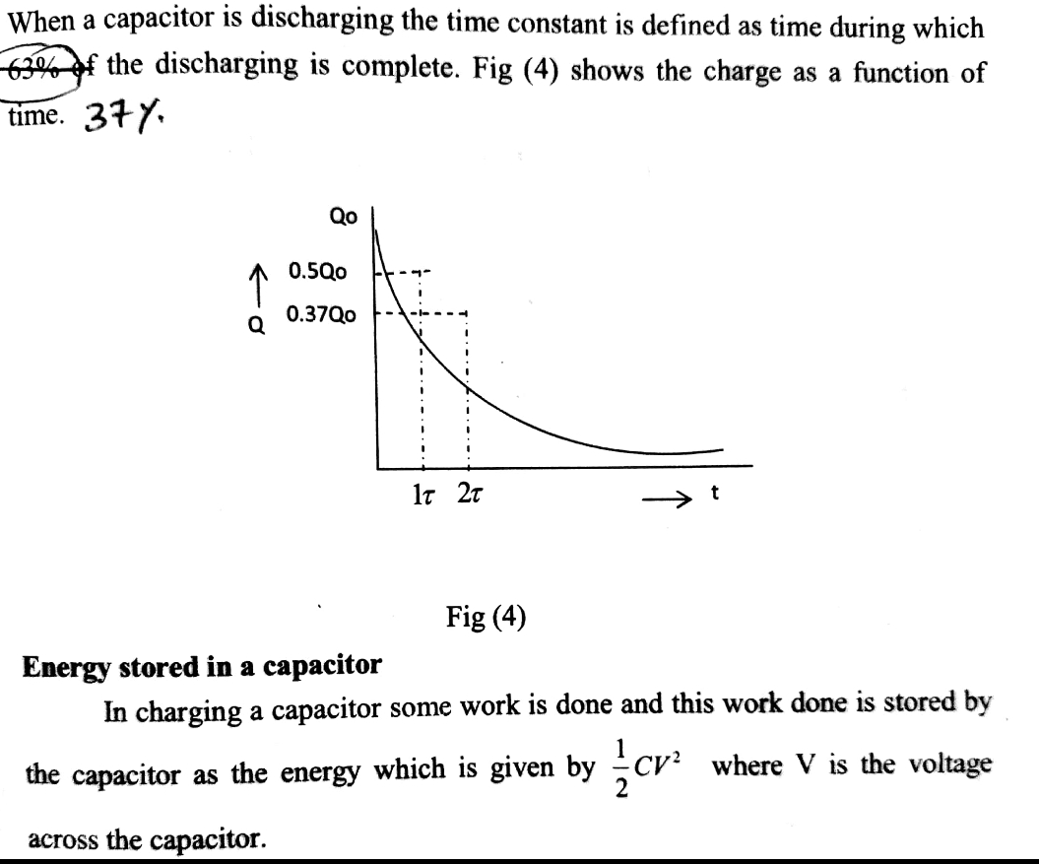

Slide 16
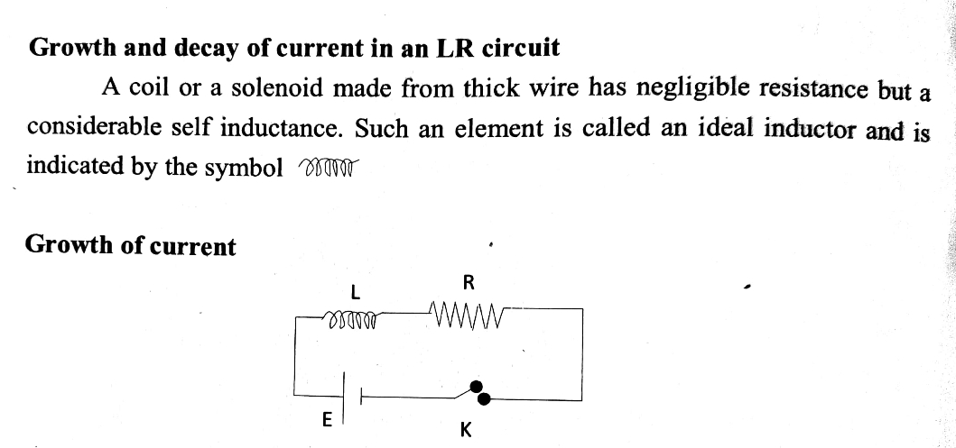

Slide 17
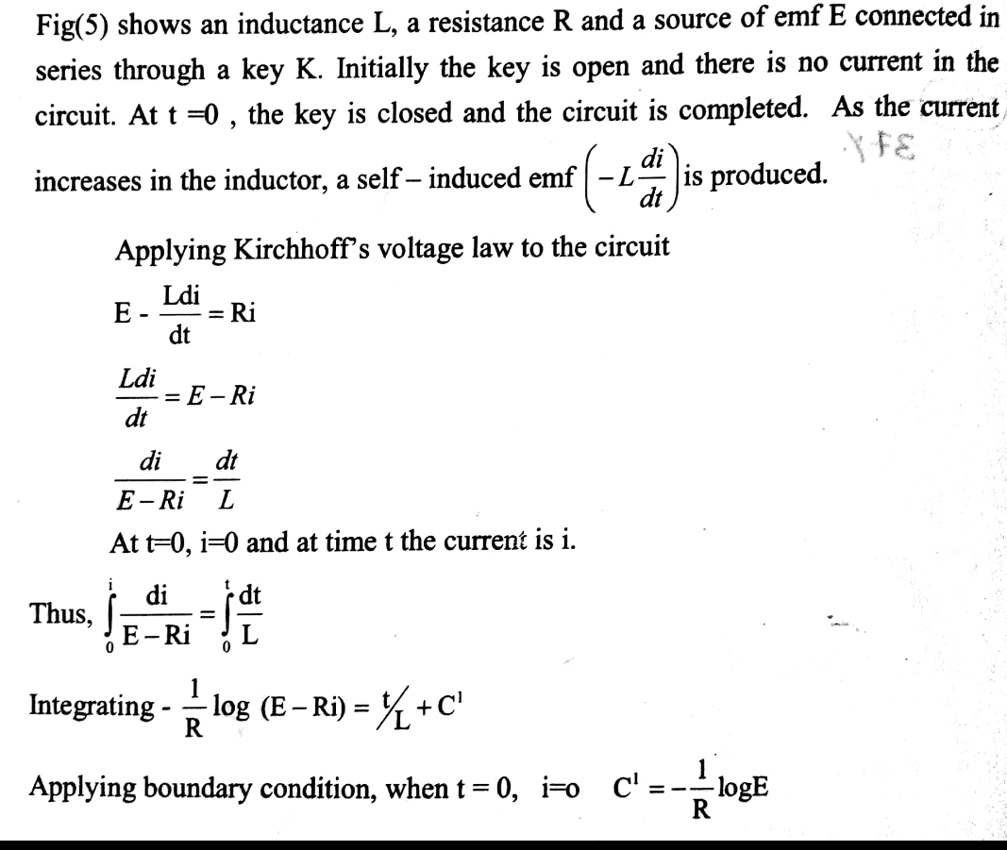

Slide 18
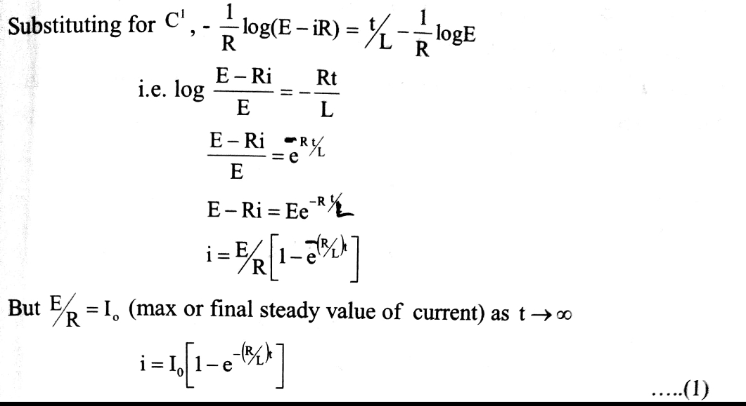

Slide 19
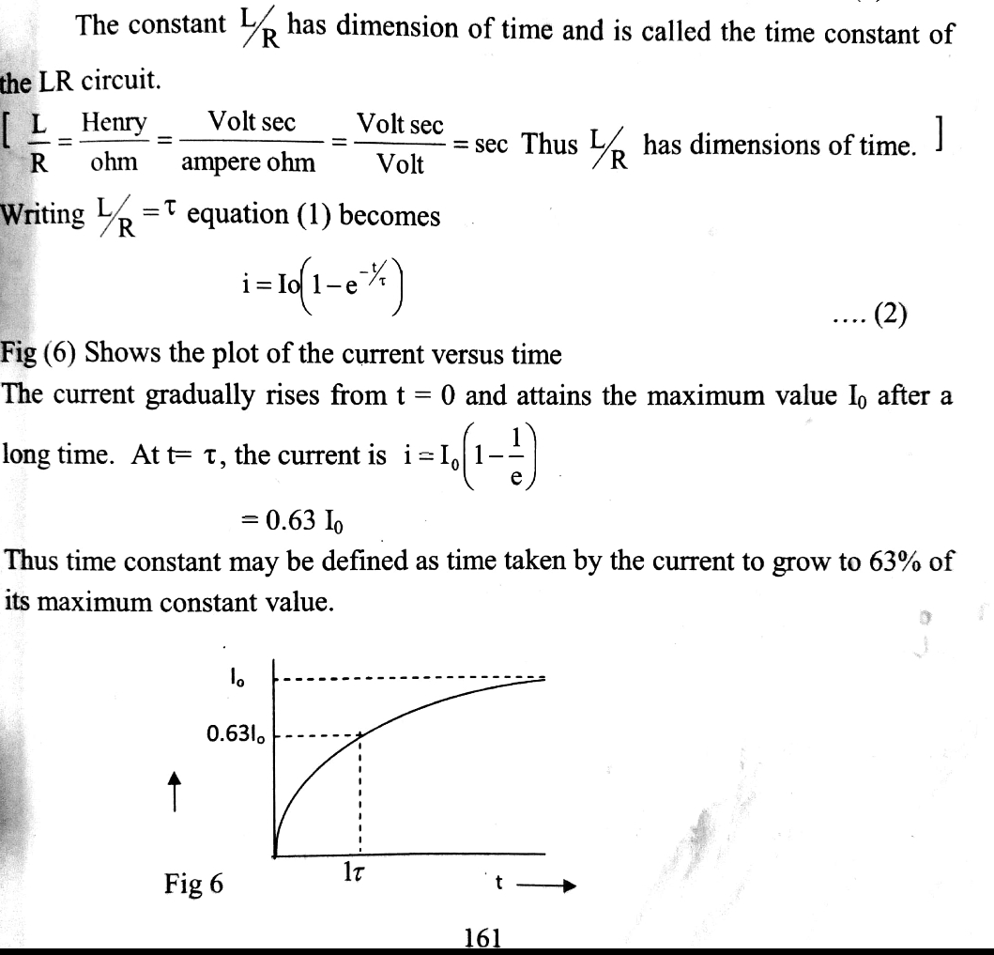
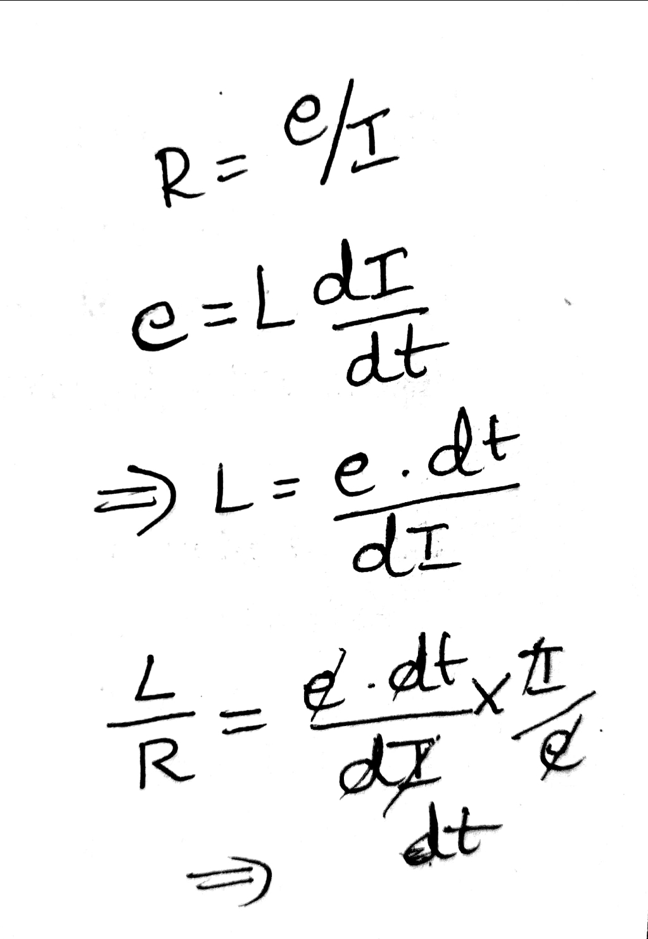

Slide 20
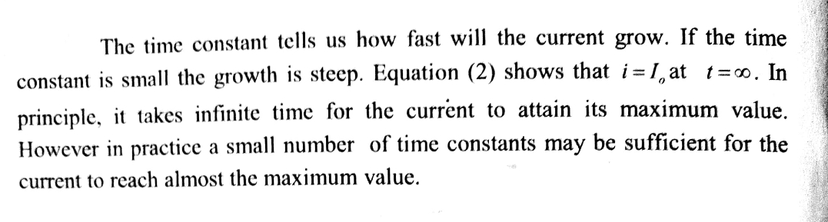

Slide 21
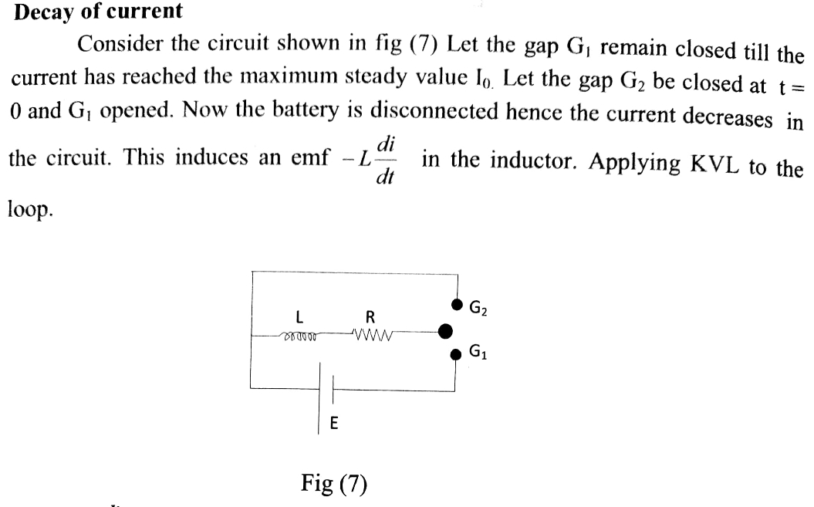

Slide 22
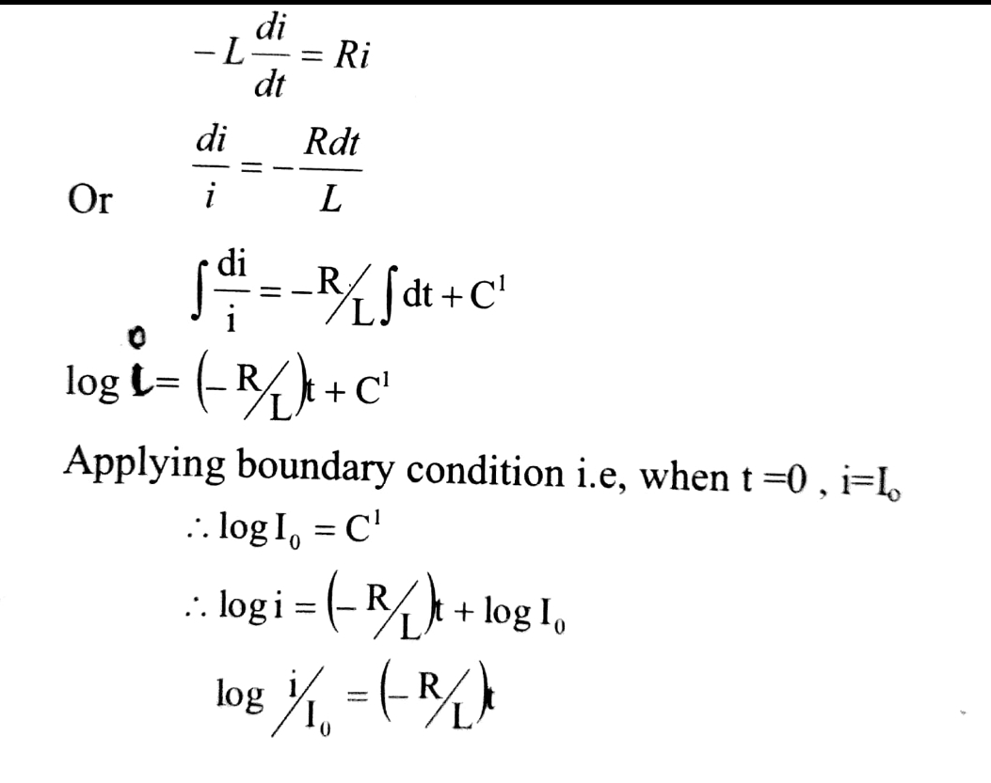

Slide 23
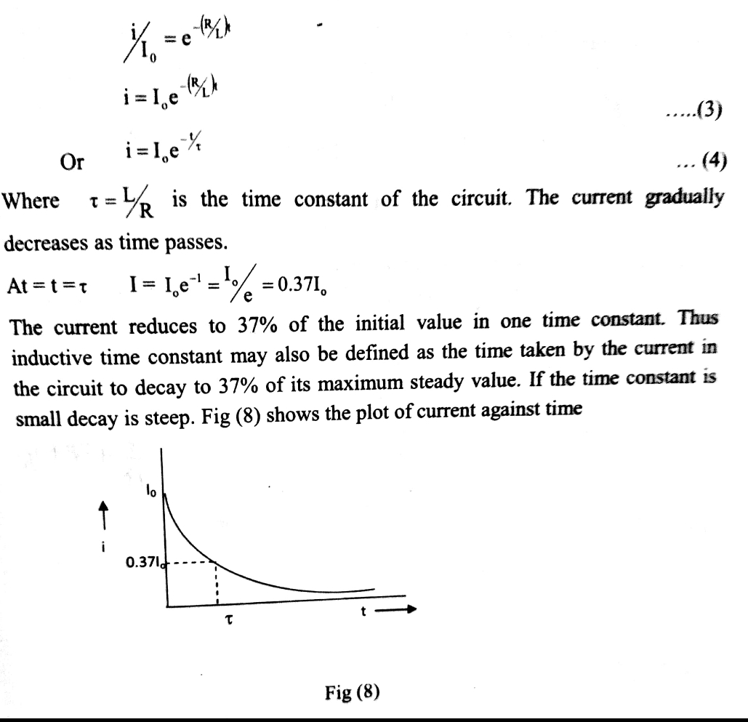

Slide 24
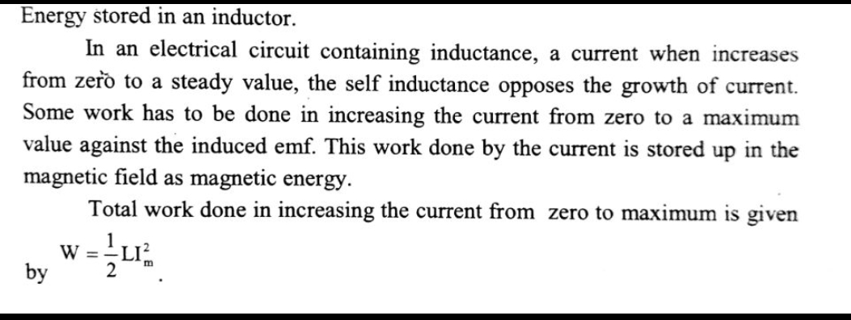

Slide 25
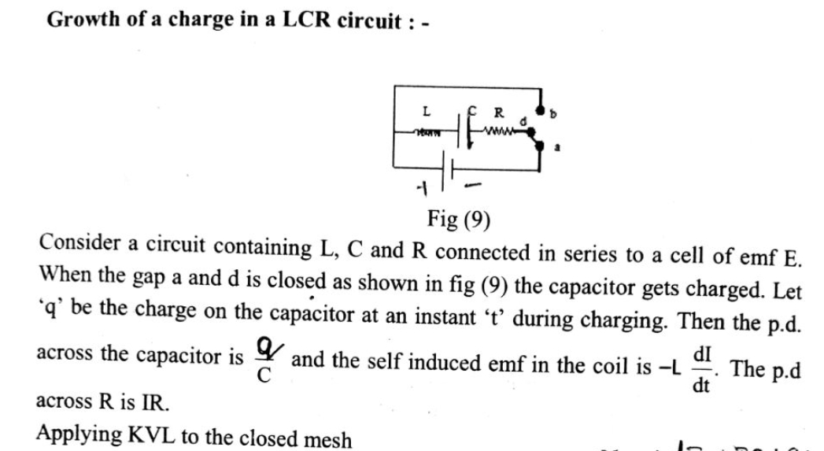

Slide 26
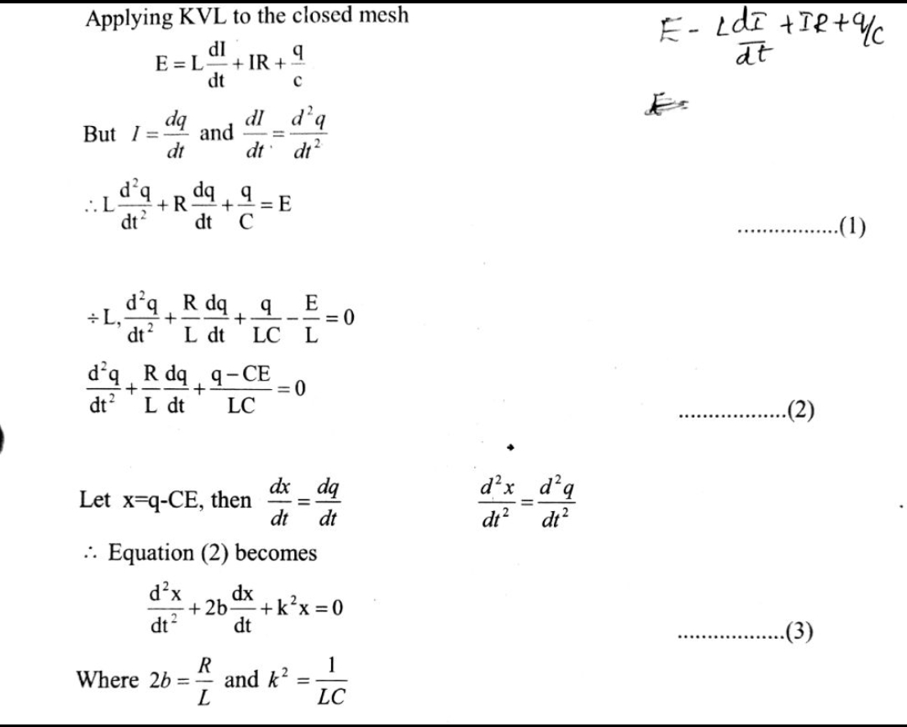

Slide 27
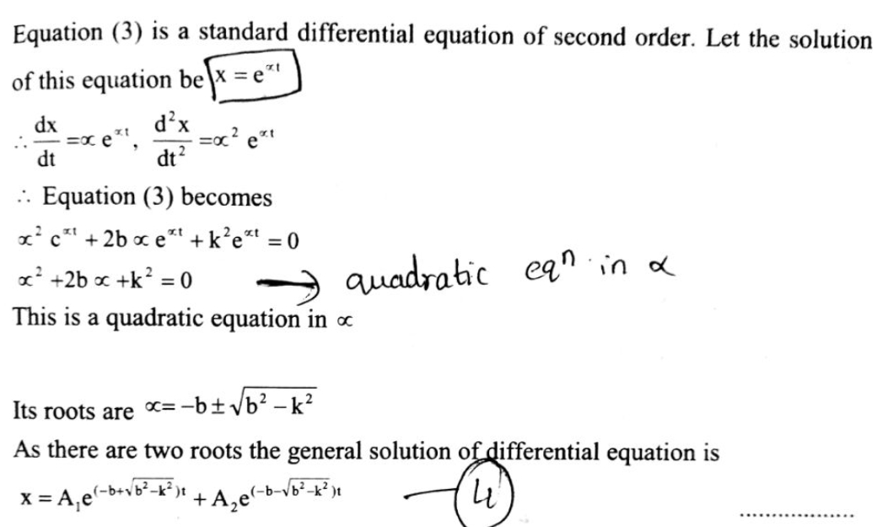

Slide 28
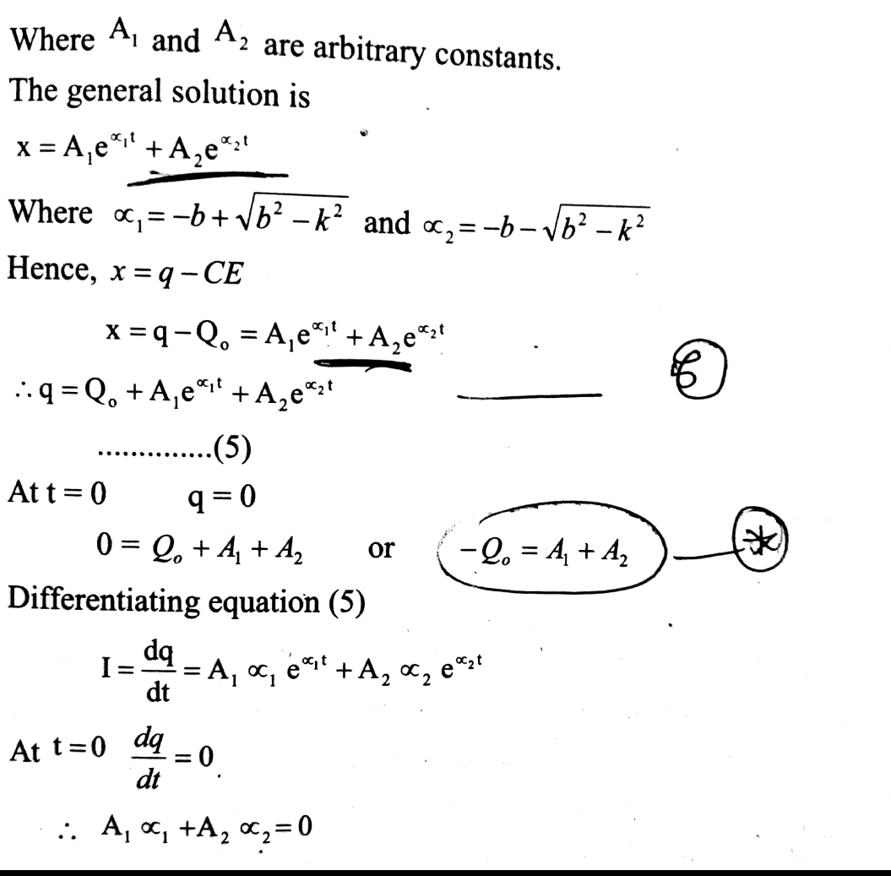

Slide 29
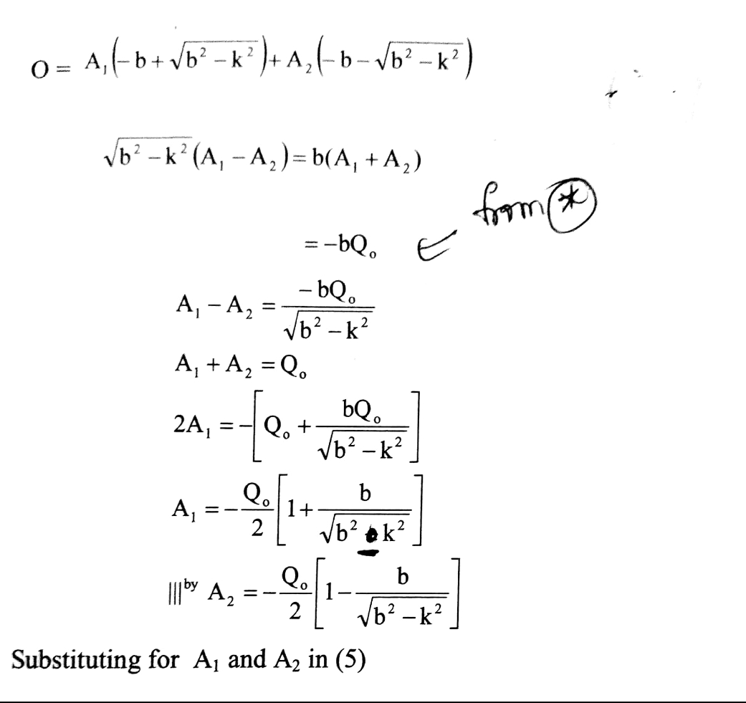

Slide 30
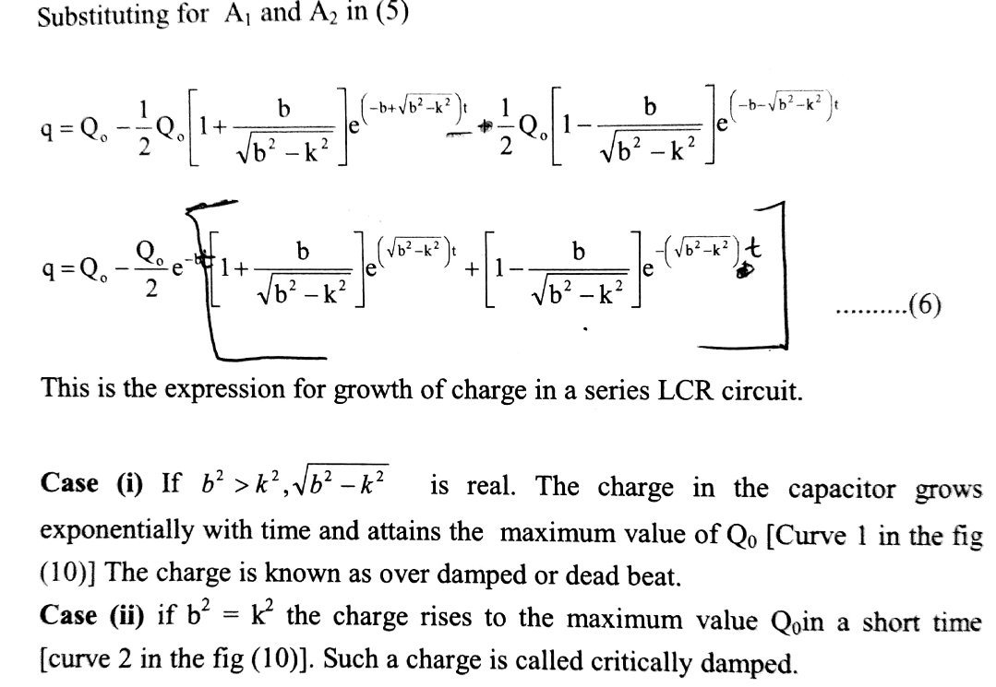

Slide 31
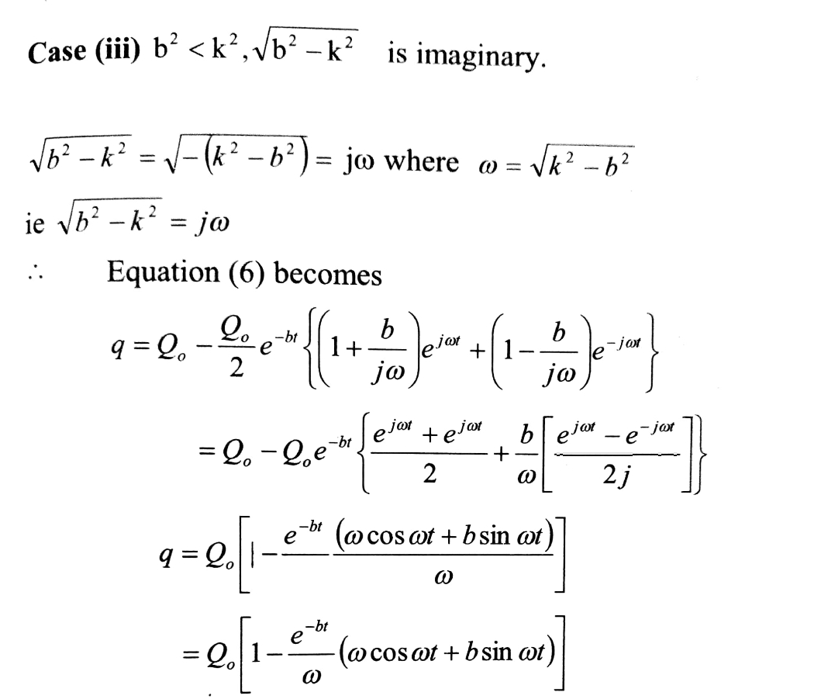
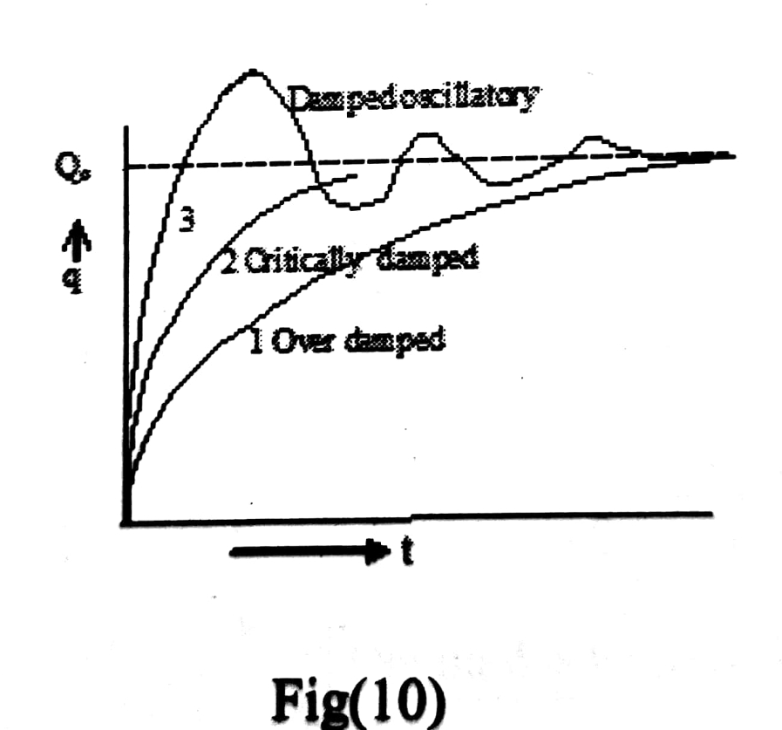

Slide 32
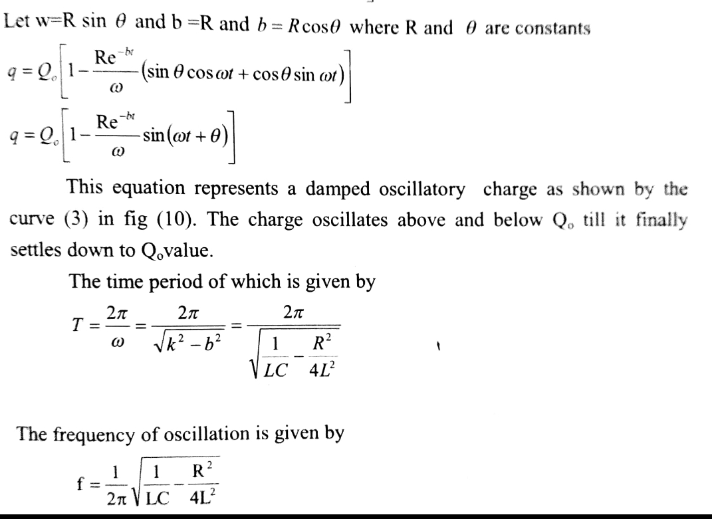

Slide 33
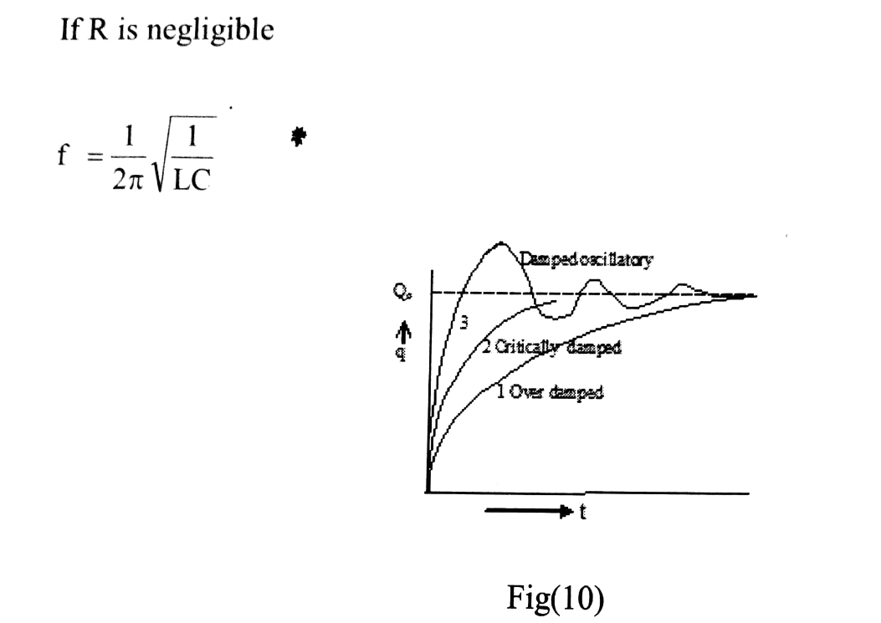

Slide 34
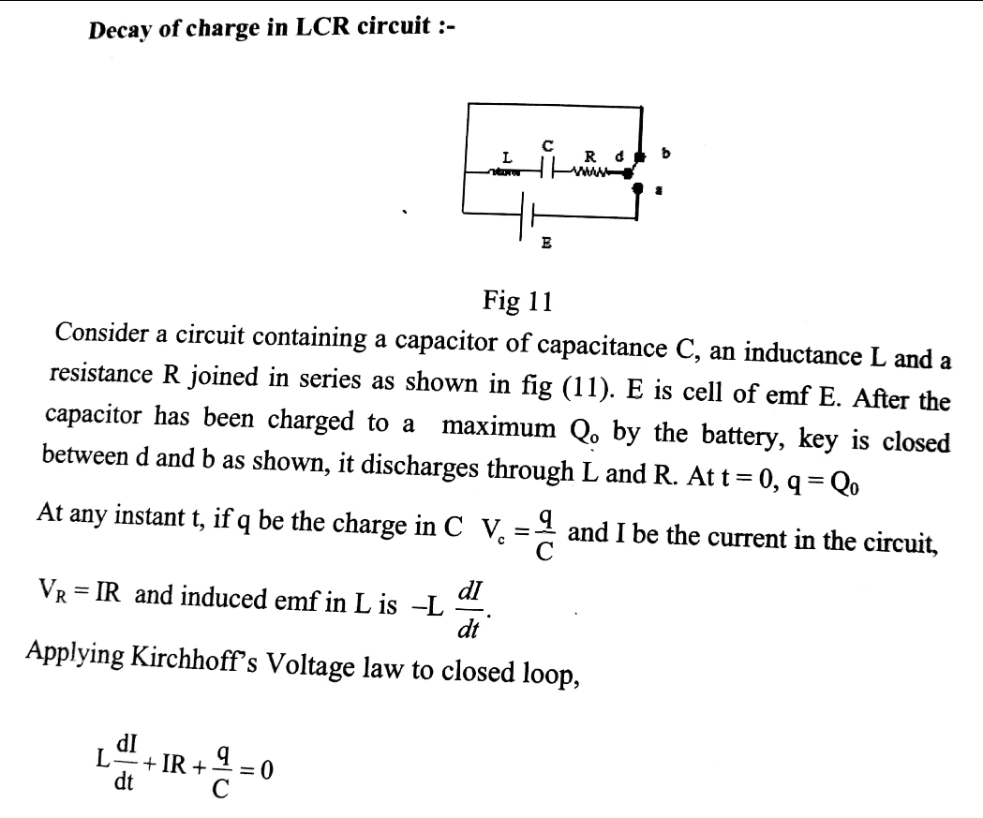

Slide 35
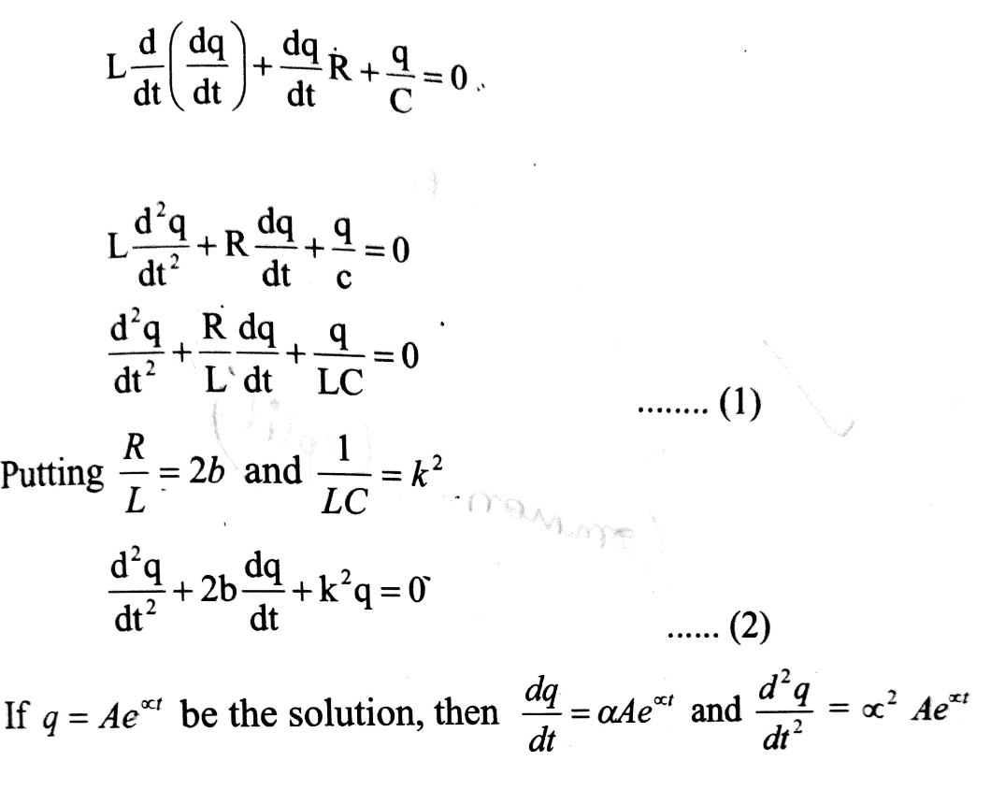

Slide 36
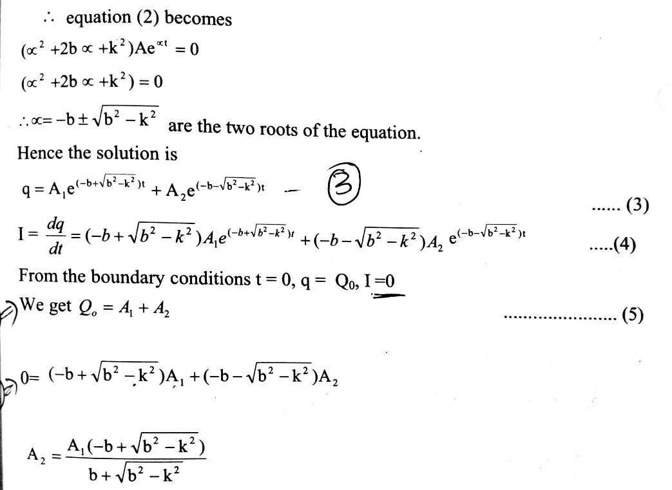

Slide 37
